Slide 1
Ratios and Line Segments: Fill in the gaps
Silent
Teacher
Intelligent Practice
Narration
Your Turn
$$\text{The} \text{point} \text{S} \text{is} \text{on} \text{the} \text{line} \text{AB}\text{, }\text{so} \text{that} \text{the} \text{lengths} \text{AS}\text{:}\text{SB} \text{are} \text{in} \text{the} \text{ratio}\text{ 2:1.}$$
If A = (2,7) and B = (8,22) then find the coordinates of S.
Practice

Slide 2
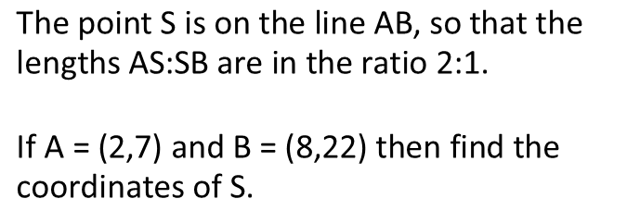
Worked Example
Your Turn
$$\text{The} \text{point} \text{S} \text{is} \text{on} \text{the} \text{line} \text{AB}\text{, }\text{so} \text{that} \text{the} \text{lengths} \text{AS}\text{:}\text{SB} \text{are} \text{in} \text{the} \text{ratio}\text{ 2:1.}$$
$$\text{If} \text{A}\text{ = (2,7) }\text{and} \text{B}\text{ = (8,22) }\text{then} \text{find} \text{the} \text{coordinates} \text{of} \text{S}\text{.}$$
$$\text{The} \text{point} \text{S} \text{is} \text{on} \text{the} \text{line} \text{AB}\text{, }\text{so} \text{that} \text{the} \text{lengths} \text{AS}\text{:}\text{SB} \text{are} \text{in} \text{the} \text{ratio}\text{ 2:1.}$$
$$\text{If} \text{A}\text{ = (1,3) }\text{and} \text{B}\text{ = (13,12) }\text{then} \text{find} \text{the} \text{coordinates} \text{of} \text{S}\text{.}$$
@mrbonemaths

Slide 3
Worked Example
Your Turn
$$\text{The} \text{point} \text{S} \text{is} \text{on} \text{the} \text{line} \text{AB}\text{, }\text{so} \text{that} \text{the} \text{lengths} \text{AS}\text{:}\text{SB} \text{are} \text{in} \text{the} \text{ratio}\text{ 3:2.}$$
$$\text{If} \text{A}\text{ = (4,26) }\text{and} \text{B}\text{ = (24,11) }\text{then} \text{find} \text{the} \text{coordinates} \text{of} \text{S}$$
$$\text{The} \text{point} \text{S} \text{is} \text{on} \text{the} \text{line} \text{AB}\text{, }\text{so} \text{that} \text{the} \text{lengths} \text{AS}\text{:}\text{SB} \text{are} \text{in} \text{the} \text{ratio}\text{ 3:2.}$$
$$\text{If} \text{A}\text{ = (21,3) }\text{and} \text{B}\text{ = (6,33) }\text{then} \text{find} \text{the} \text{coordinates} \text{of} \text{S}\text{.}$$
@mrbonemaths

Slide 4
Ratios and Line Segments: Problem Solving and Reasoning
Point X is a point on the line AB such that AX:XB is in the ratio shown.
Fill in the missing gaps
Ratio AX:XB | Point A | Point X | Point B
2:1 | (2,4) |  | (8,16)
4:2 | (2,4) |  | (8,16)
1:2 | (2,4) |  | (8,16)
1:2 | (2,4) | (8,16)
1:2 |  | (2,4) | (8,16)
 | (2,4) | (8,16) | (26,52)
 | (26,52) | (8,16) | (2,4)
 | (13,26) | (4,8) | (1,2)
3:1 |  | (4,7) | (0,1)
4:1 |  | (4,7) | (0,1)
5:1 |  | (4,7) | (0,1)
1:1 |  | (4,7) | (0,1)
@mrbonemaths

Slide 5
Ratios and Line Segments: Problem Solving and Reasoning
Point X is a point on the line AB such that AX:XB is in the ratio shown.
Fill in the missing gaps
Ratio AX:XB | Point A | Point X | Point B
2:1 | (2,4) | (6,12) | (8,16)
4:2 | (2,4) | (6,12) | (8,16)
1:2 | (2,4) | (4,8) | (8,16)
1:2 | (2,4) | (8,16) | (20,40)
1:2 | (-1,-2) | (2,4) | (8,16)
1:3 | (2,4) | (8,16) | (26,52)
3:1 | (26,52) | (8,16) | (2,4)
3:1 | (13,26) | (4,8) | (1,2)
3:1 | (12,19) | (4,7) | (0,1)
4:1 | (16,25) | (4,7) | (0,1)
5:1 | (20,31) | (4,7) | (0,1)
1:1 | (8,13) | (4,7) | (0,1)
@mrbonemaths

