Slide 1
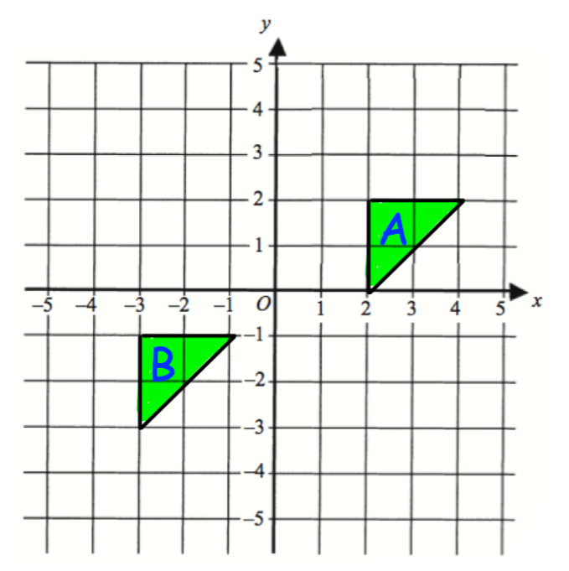
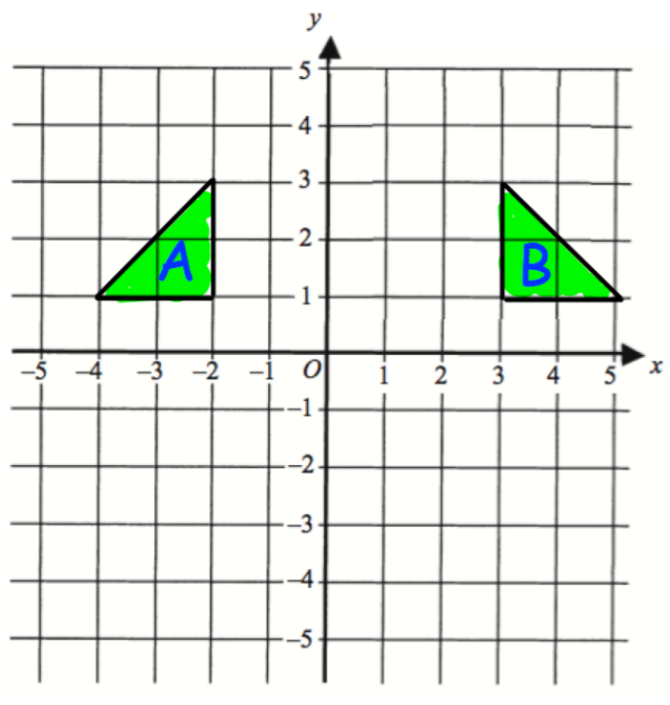
LESSON OBJECTIVE
To enlarge a shape
ENLARGEMENT
Describe fully the single transformation that maps A on to B
2. Describe fully the single transformation that maps A on to B

Slide 2
ENLARGEMENT
LESSON OBJECTIVES
To enlarge a shape by a positive integer scale factor, with a centre of enlargement (Grade 3)
To enlarge a shape by a positive fractional scale factor, with a centre of enlargement (Grade 4)
To enlarge a shape by a negative scale factor (Grade 7)

Slide 3
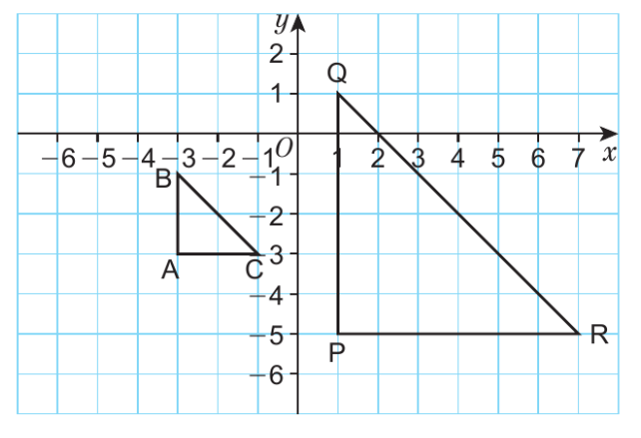
ENLARGEMENT
An enlargement is where an object is enlarged by a given scale factor.
At GCSE, any enlargement will be given by reference to a centre of enlargement.
An object shape can be enlarged by a positive or negative scale factor. In this lesson, we will focus on performing enlargements, both positive and negative.

Slide 4
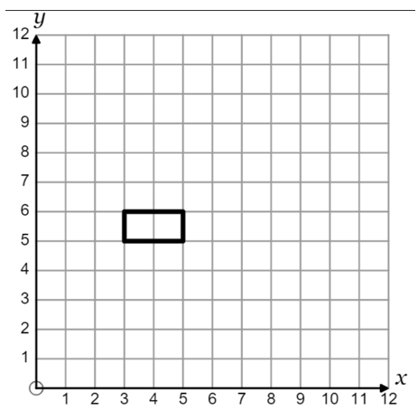
Worked Example
Your Turn
Enlarge shape by scale factor 2 with centre (1,3)
Enlarge shape by scale factor 2 with centre (4,3)

Slide 5
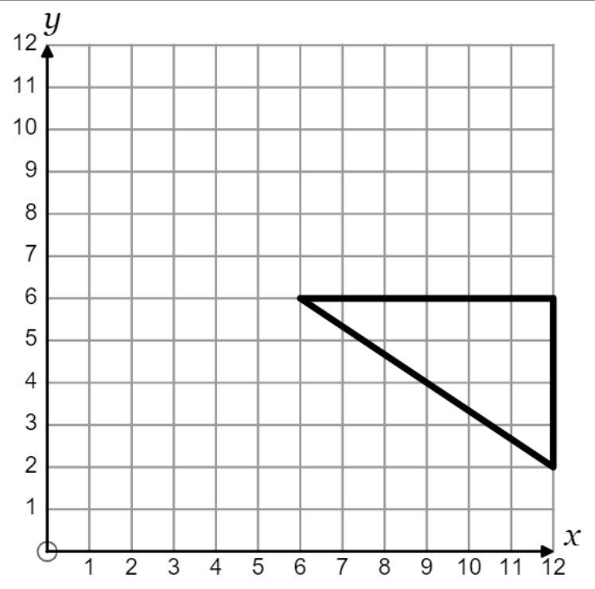
REFLECT, EXPECT, CHECK, EXPLAIN #1
Enlarge by scale factor $\frac{1}{2}$ with centre (2, 10)
Enlarge by scale factor $\frac{1}{4}$ with centre (2, 10)

Slide 6
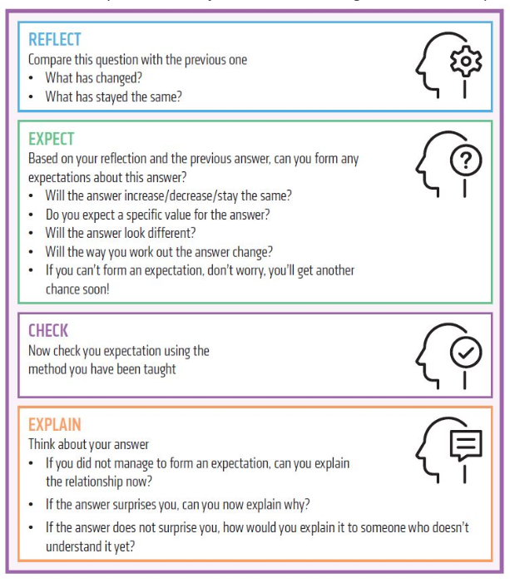
TASK #1
Complete Enlargement worksheet
EXTENSION
Think of two conjectures and test them with your own examples.

Slide 7
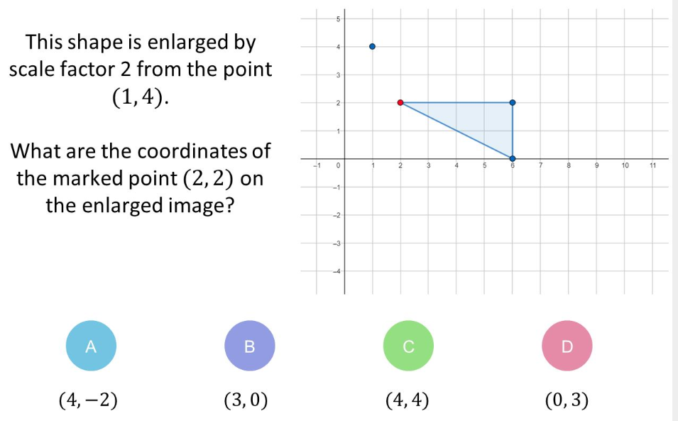
MCQ#1

Slide 8
MCQ#2

Slide 9
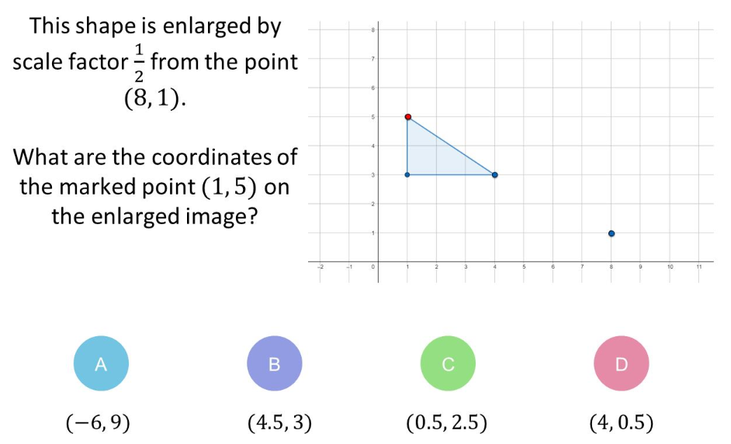
MCQ#3

Slide 10
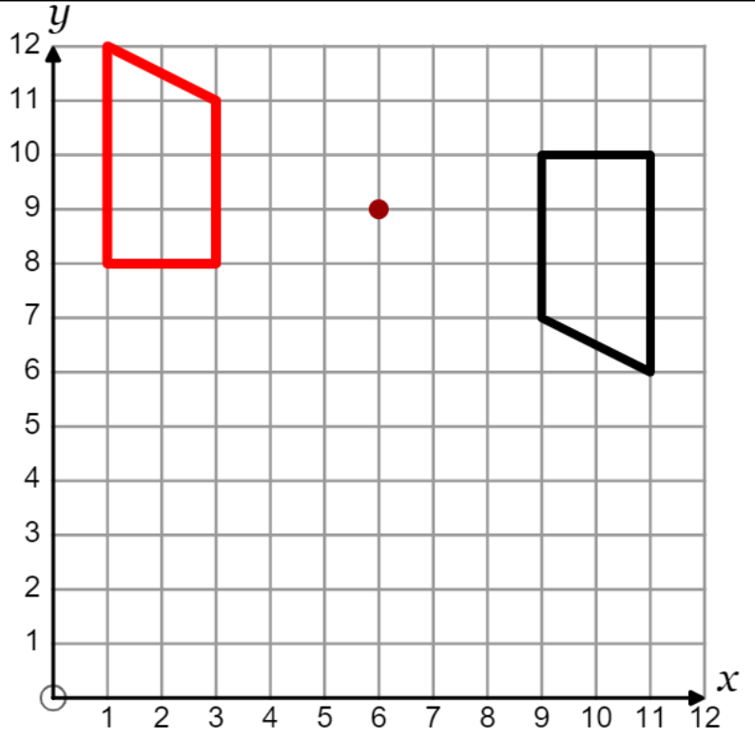
NEGATIVE ENLARGEMENTS
A common misconception is that negative enlargements transform an object shape into a smaller image. This only happens where the scale factor is between -1 and 1.
Instead, a negative enlargement works in a similar fashion to any negative insofar as it causes the object to transform to the other side of the centre of enlargement

Slide 11
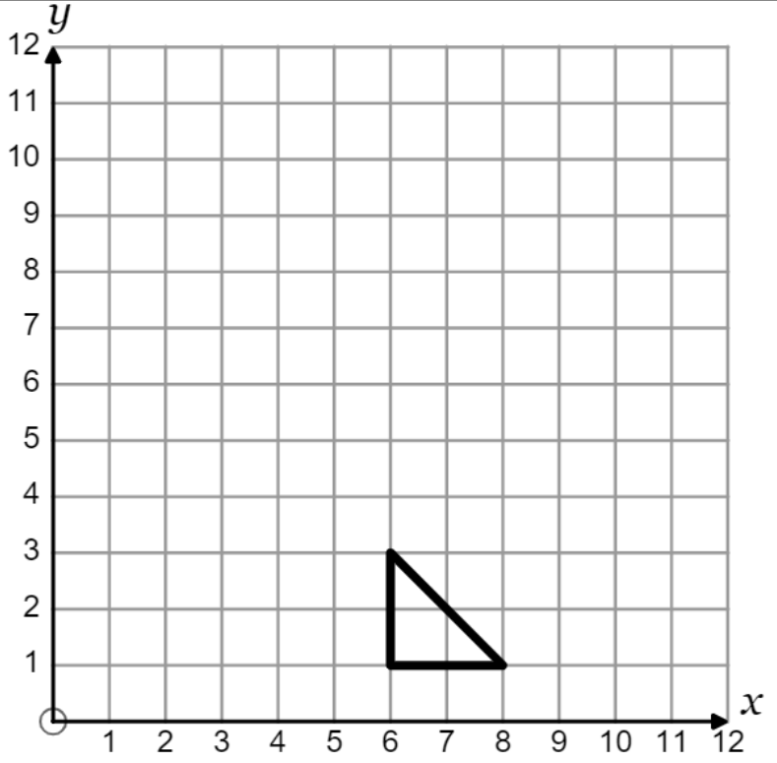
REFLECT, EXPECT, CHECK, EXPLAIN #2
Enlarge by scale factor -2 with centre (7, 4)
Enlarge by scale factor -2 with centre (5, 4)

Slide 12
TASK #2
Complete Enlargement worksheet
EXTENSION
Continue this sequence with two of your own questions, e.g. is it possible to fit an image with scale factor of -4 in the given space?

Slide 13
MCQ#4

Slide 14
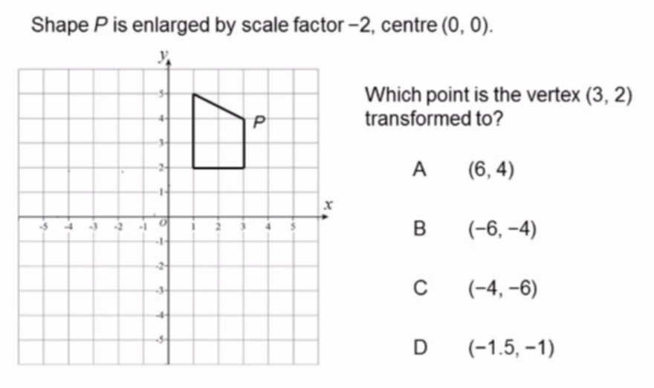
MCQ#5

