Slide 1
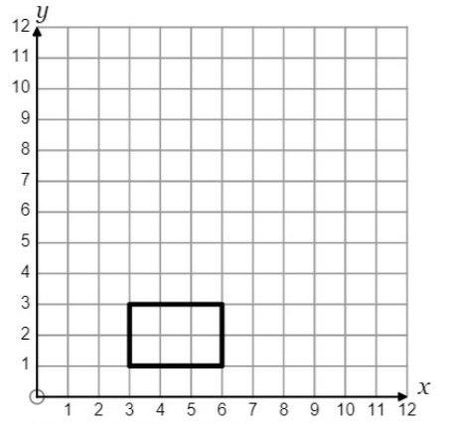
1.
2.
Enlarge by scale factor of 2 from origin
Enlarge by scale factor of 2 from (0, 1)
3.
4.
Enlarge by scale factor of 2 from (1,0)
Enlarge by scale factor of 2 from (3,1)

Slide 2
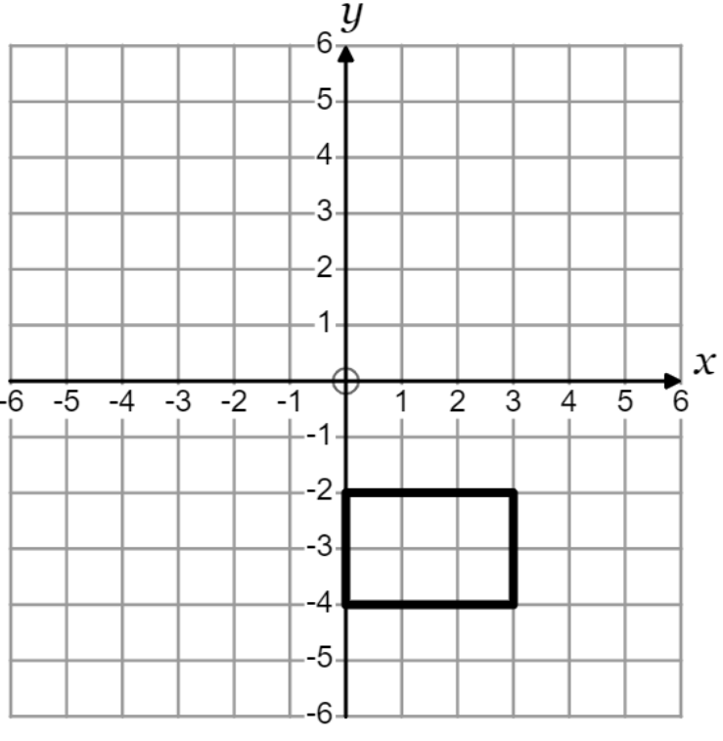
5.
6.
Enlarge by scale factor of 2 from (6,1)
Enlarge by scale factor of 3 from (3,1)
7.
8.
Enlarge by scale factor of 2 from (4, 2)
Enlarge by scale factor of 3 from (2, -5)

Slide 3
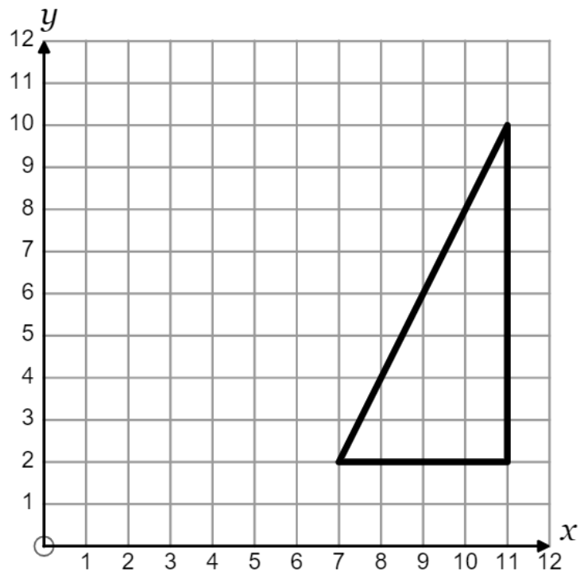
9.
10.
Enlarge by scale factor of $\frac{1}{2}$ from (1, 2)
Enlarge by scale factor of $\frac{1}{4}$ from (1, 2)
11.
12.
Enlarge by scale factor of $\frac{1}{2}$ from (1, 10)
Enlarge by scale factor of $\frac{1}{2}$ from (10, 1)

