Slide 1
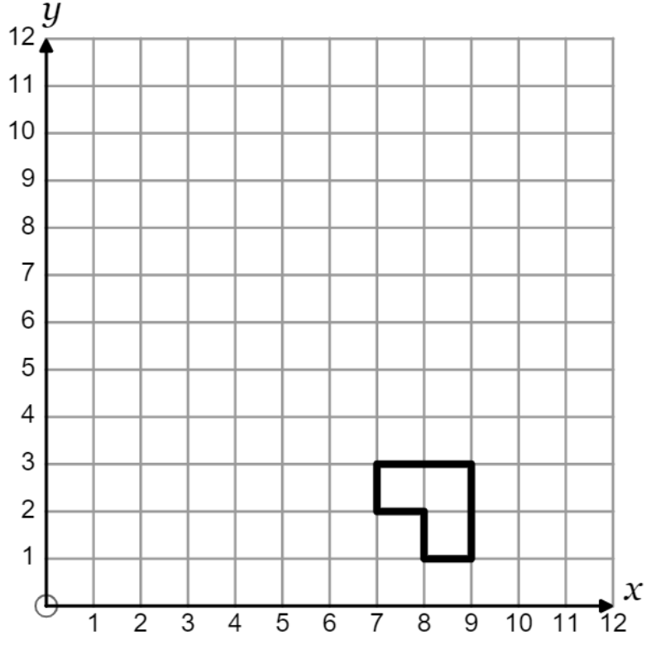
1.
2.
Enlarge by scale factor of -1 from (8, 4)
Enlarge by scale factor of -1 from (9, 4)
3.
4.
Enlarge by scale factor of -1 from (7, 4)
Enlarge by scale factor of -1 from (6, 4)

Slide 2
5.
6.
Enlarge by scale factor of -1 from (6, 2)
Enlarge by scale factor of -2 from (6, 2)
7.
8.
Enlarge by scale factor of -2 from (6, 3)
Enlarge by scale factor of -3 from (7,3)

