Slide 1
Brackets: Expanding double brackets Non Monic Quadratics
Silent
Teacher
Intelligent Practice
Narration
Your Turn
$$\left(3x+5\right)\left(2x+3\right)=$$
$$\left(7x+3\right)\left(5x+5\right)=$$
$$\left(3x−3\right)\left(2x+5\right)=$$
Practice

Slide 2
Worked Example
Your Turn
$$(3x+7)\left(5x+5\right)=$$
$$(4x+7)(6x+5)=$$
@DrChris_Baker

Slide 3


1. $\left(3x+2\right)\left(5x+4\right)=$
2. $\left(5x+4\right)\left(3x+2\right)=$
3. $\left(3x−2\right)\left(5x+4\right)=$
4. $\left(3x+2\right)\left(5x−4\right)=$
5. $\left(3x−2\right)\left(5x−4\right)=$
6. $\left(3x−2\right)\left(4x+4\right)=$
7. $\left(3x−2\right)\left(3x+4\right)=$
8. $\left(3x+2\right)\left(3x+4\right)=$
9. $\left(3x+1\right)\left(3x+4\right)=$
10. $\left(3x+0\right)\left(3x+4\right)=$
11. $\left(3x−1\right)\left(3x+4\right)=$
12. $\left(3x−1\right)\left(cx+4\right)=$
13. $\left(3x−1\right)\left(cx+d\right)=$
14. $\left(3x−b\right)\left(cx+d\right)=$
15. $\left(ax−b\right)\left(cx+d\right)=$
16. $\left(ax−b\right)\left(cx−d\right)=$
17. $\left(ax+b\right)\left(cx+d\right)=$
@DrChris_Baker

Slide 4
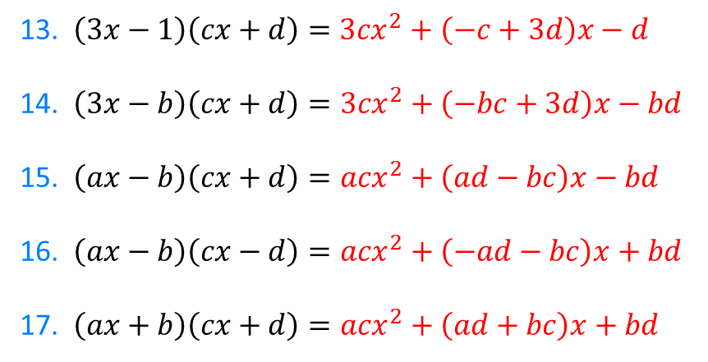
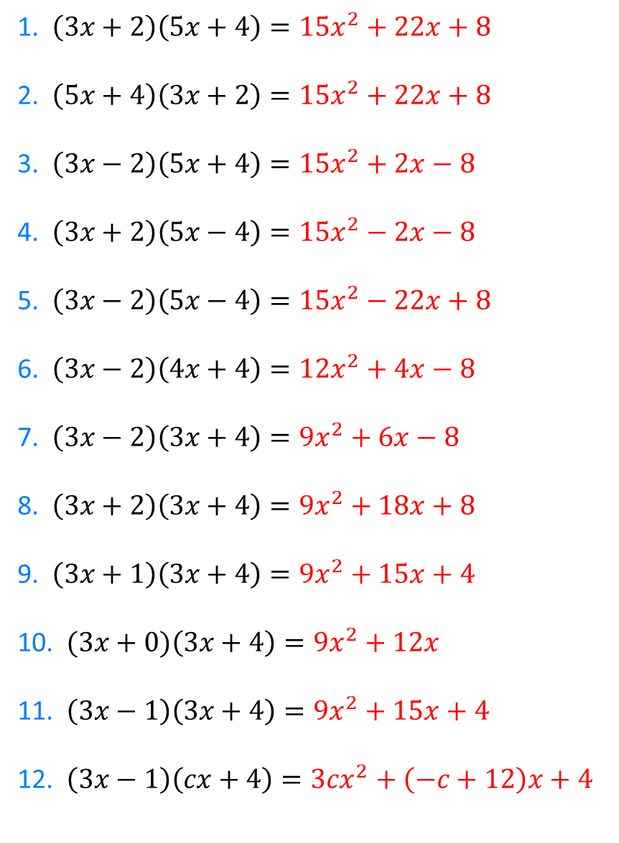
1. $\left(3x+2\right)\left(5x+4\right)={15x}^{2}+22x+8$
2. $\left(5x+4\right)\left(3x+2\right)={15x}^{2}+22x+8$
3. $\left(3x−2\right)\left(5x+4\right)={15x}^{2}+2x−8$
4. $\left(3x+2\right)\left(5x−4\right)={15x}^{2}−2x−8$
5. $\left(3x−2\right)\left(5x−4\right)={15x}^{2}−22x+8$
6. $\left(3x−2\right)\left(4x+4\right)={12x}^{2}+4x−8$
7. $\left(3x−2\right)\left(3x+4\right)={9x}^{2}+6x−8$
8. $\left(3x+2\right)\left(3x+4\right)={9x}^{2}+18x+8$
9. $\left(3x+1\right)\left(3x+4\right)={9x}^{2}+15x+4$
10. $(3x+0)\left(3x+4\right)={9x}^{2}+12x$
11. $\left(3x−1\right)\left(3x+4\right)={9x}^{2}+15x+4$
12. $\left(3x−1\right)\left(cx+4\right)={3cx}^{2}+\left(−c+12\right)x+4$
13. $\left(3x−1\right)\left(cx+d\right)={3cx}^{2}+\left(−c+3d\right)x−d$
14. $\left(3x−b\right)\left(cx+d\right)={3cx}^{2}+\left(−bc+3d\right)x−bd$
15. $\left(ax−b\right)\left(cx+d\right)={acx}^{2}+\left(ad−bc\right)x−bd$
16. $\left(ax−b\right)\left(cx−d\right)={acx}^{2}+\left(−ad−bc\right)x+bd$
17. $\left(ax+b\right)\left(cx+d\right)={acx}^{2}+\left(ad+bc\right)x+bd$
@DrChris_Baker

