Slide 1
Finding the nth term rule of a linear sequence (interweaving)
Silent
Teacher
Intelligent Practice
Narration
Your Turn
$$5, 8, 11, 14, 17…$$
$$4, 7, 10, 13, 16…$$
$$2, 5, 9, 11, 15…$$
Practice

Slide 2
Worked Example
Your Turn
$$Find the nth term rule:$$
$$Find the nth term rule:$$
$$8, 15, 22, 29, 36…$$
$$11, 18, 25, 32, 39…$$

Slide 3
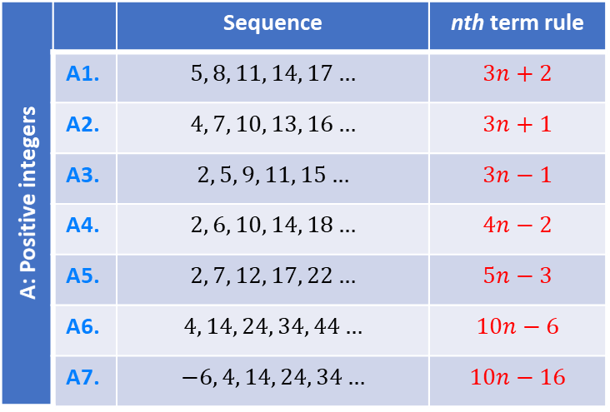
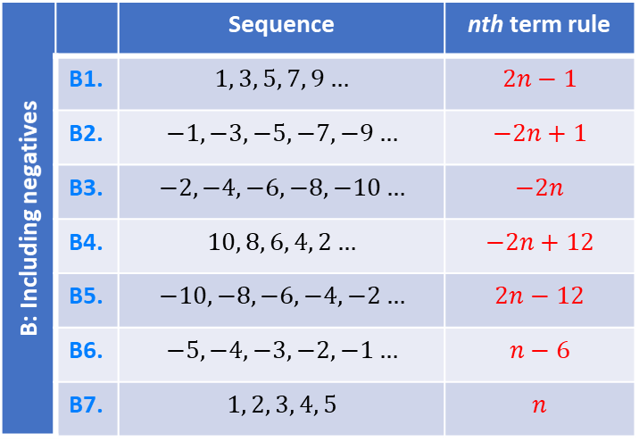
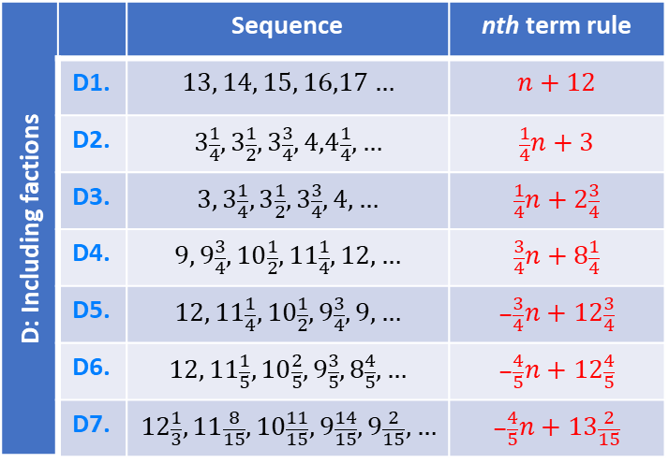
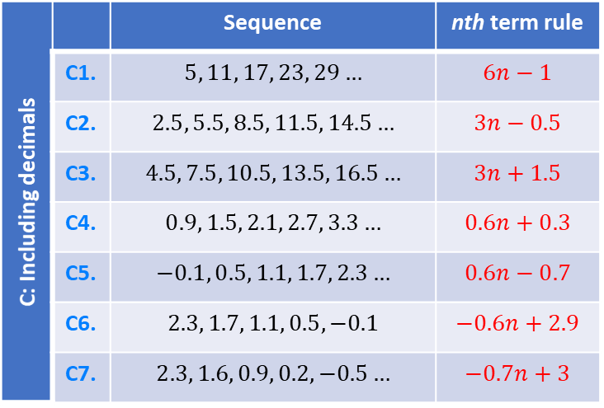
A: Positive integers |  | Sequence | nth term rule
 | A1. | $$5, 8, 11, 14, 17…$$ | $$3n+2$$
 | A2. | $$4, 7, 10, 13, 16…$$ | $$3n+1$$
 | A3. | $$2, 5, 9, 11, 15…$$ | $$3n−1$$
 | A4. | $$2, 6, 10, 14, 18…$$ | $$4n−2$$
 | A5. | $$2, 7, 12, 17, 22…$$ | $$5n−3$$
 | A6. | $$4, 14, 24, 34, 44…$$ | $$10n−6$$
 | A7. | $$−6, 4, 14, 24, 34…$$ | $$10n−16$$
B: Including negatives |  | Sequence | nth term rule
 | B1. | $$1, 3, 5, 7, 9…$$ | $$2n−1$$
 | B2. | $$−1, −3, −5, −7, −9…$$ | $$−2n+1$$
 | B3. | $$−2, −4, −6, −8, −10…$$ | $$−2n$$
 | B4. | $$10, 8, 6, 4, 2…$$ | $$−2n+12$$
 | B5. | $$−10, −8, −6, −4, −2…$$ | $$2n−12$$
 | B6. | $$−5, −4, −3, −2, −1…$$ | $$n−6$$
 | B7. | $$1, 2, 3, 4, 5$$ | $$n$$
C: Including decimals |  | Sequence | nth term rule
 | C1. | $$5, 11, 17, 23, 29…$$ | $$6n−1$$
 | C2. | $$2.5, 5.5, 8.5, 11.5, 14.5…$$ | $$3n−0.5$$
 | C3. | $$4.5, 7.5, 10.5, 13.5, 16.5…$$ | $$3n+1.5$$
 | C4. | $$0.9, 1.5, 2.1, 2.7, 3.3…$$ | $$0.6n+0.3$$
 | C5. | $$−0.1, 0.5, 1.1, 1.7, 2.3…$$ | $$0.6n−0.7$$
 | C6. | $$2.3, 1.7, 1.1, 0.5, −0.1$$ | $$−0.6n+2.9$$
 | C7. | $$2.3, 1.6, 0.9, 0.2, −0.5…$$ | $$−0.7n+3$$
D: Including factions |  | Sequence | nth term rule
 | D1. | $$13, 14, 15, 16,17…$$ | $$n+12$$
 | D2. | $$3\frac{1}{4},3\frac{1}{2},3\frac{3}{4},4,4\frac{1}{4},…$$ | $$\frac{1}{4}n+3$$
 | D3. | $$3, 3\frac{1}{4},3\frac{1}{2},3\frac{3}{4},4,…$$ | $$\frac{1}{4}n+2\frac{3}{4}$$
 | D4. | $$9, 9\frac{3}{4},10\frac{1}{2},11\frac{1}{4},12,…$$ | $$\frac{3}{4}n+8\frac{1}{4}$$
 | D5. | $$12, 11\frac{1}{4},10\frac{1}{2},9\frac{3}{4},9,…$$ | $$−\frac{3}{4}n+12\frac{3}{4}$$
 | D6. | $$12, 11\frac{1}{5},10\frac{2}{5},9\frac{3}{5},8\frac{4}{5},…$$ | $$−\frac{4}{5}n+12\frac{4}{5}$$
 | D7. | $$12\frac{1}{3}, 11\frac{8}{15},10\frac{11}{15},9\frac{14}{15},9\frac{2}{15},…$$ | $$−\frac{4}{5}n+13\frac{2}{15}$$
Notes:
9,

Slide 4
A: Positive integers |  | Sequence | nth term rule
 | A1. | $$5, 8, 11, 14, 17…$$ | $$3n+2$$
 | A2. | $$4, 7, 10, 13, 16…$$ | $$3n+1$$
 | A3. | $$2, 5, 9, 11, 15…$$ | $$3n−1$$
 | A4. | $$2, 6, 10, 14, 18…$$ | $$4n−2$$
 | A5. | $$2, 7, 12, 17, 22…$$ | $$5n−3$$
 | A6. | $$4, 14, 24, 34, 44…$$ | $$10n−6$$
 | A7. | $$−6, 4, 14, 24, 34…$$ | $$10n−16$$
B: Including negatives |  | Sequence | nth term rule
 | B1. | $$1, 3, 5, 7, 9…$$ | $$2n−1$$
 | B2. | $$−1, −3, −5, −7, −9…$$ | $$−2n+1$$
 | B3. | $$−2, −4, −6, −8, −10…$$ | $$−2n$$
 | B4. | $$10, 8, 6, 4, 2…$$ | $$−2n+12$$
 | B5. | $$−10, −8, −6, −4, −2…$$ | $$2n−12$$
 | B6. | $$−5, −4, −3, −2, −1…$$ | $$n−6$$
 | B7. | $$1, 2, 3, 4, 5$$ | $$n$$
C: Including decimals |  | Sequence | nth term rule
 | C1. | $$5, 11, 17, 23, 29…$$ | $$6n−1$$
 | C2. | $$2.5, 5.5, 8.5, 11.5, 14.5…$$ | $$3n−0.5$$
 | C3. | $$4.5, 7.5, 10.5, 13.5, 16.5…$$ | $$3n+1.5$$
 | C4. | $$0.9, 1.5, 2.1, 2.7, 3.3…$$ | $$0.6n+0.3$$
 | C5. | $$−0.1, 0.5, 1.1, 1.7, 2.3…$$ | $$0.6n−0.7$$
 | C6. | $$2.3, 1.7, 1.1, 0.5, −0.1$$ | $$−0.6n+2.9$$
 | C7. | $$2.3, 1.6, 0.9, 0.2, −0.5…$$ | $$−0.7n+3$$
D: Including factions |  | Sequence | nth term rule
 | D1. | $$13, 14, 15, 16,17…$$ | $$n+12$$
 | D2. | $$3\frac{1}{4},3\frac{1}{2},3\frac{3}{4},4,4\frac{1}{4},…$$ | $$\frac{1}{4}n+3$$
 | D3. | $$3, 3\frac{1}{4},3\frac{1}{2},3\frac{3}{4},4,…$$ | $$\frac{1}{4}n+2\frac{3}{4}$$
 | D4. | $$9, 9\frac{3}{4},10\frac{1}{2},11\frac{1}{4},12,…$$ | $$\frac{3}{4}n+8\frac{1}{4}$$
 | D5. | $$12, 11\frac{1}{4},10\frac{1}{2},9\frac{3}{4},9,…$$ | $$−\frac{3}{4}n+12\frac{3}{4}$$
 | D6. | $$12, 11\frac{1}{5},10\frac{2}{5},9\frac{3}{5},8\frac{4}{5},…$$ | $$−\frac{4}{5}n+12\frac{4}{5}$$
 | D7. | $$12\frac{1}{3}, 11\frac{8}{15},10\frac{11}{15},9\frac{14}{15},9\frac{2}{15},…$$ | $$−\frac{4}{5}n+13\frac{2}{15}$$
Notes:
9,

