Slide 1
Function Machines: Input Output Tables
Silent
Teacher
Intelligent Practice
Narration
Your Turn
➔ | +5 | ➔
➔ | x3 | ➔
➔ | x2 | ➔ | -3 | ➔
Practice

Slide 2
Worked Example
Your Turn
Complete the table
Complete the table
➔ | +4 | ➔
➔ | x4 | ➔
Input | Output
2
10
20
 | 12
 | 10
h
Input | Output
2
10
20
 | 12
 | 10
h

Slide 3
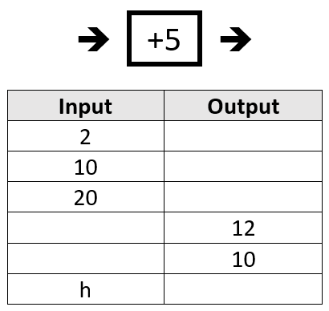
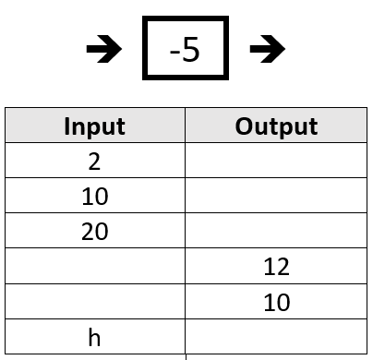
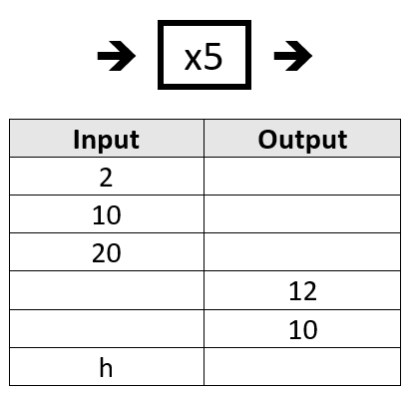
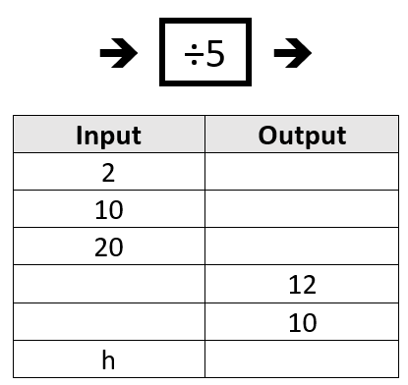
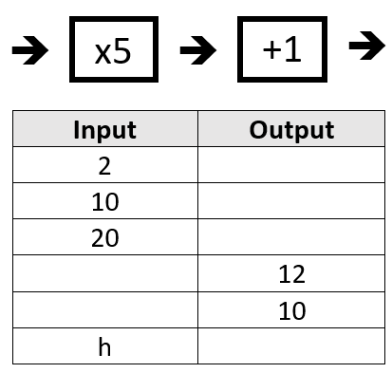
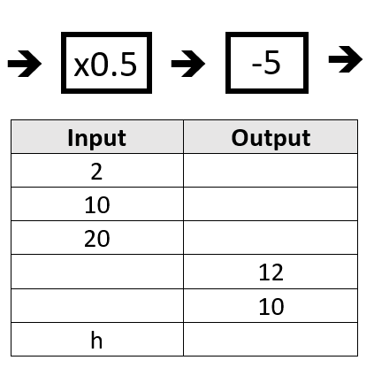

Slide 4
