Slide 1
Integration: Reverse chain rule or substitution
Silent
Teacher
Intelligent Practice
Narration
Your Turn
$$\int{6x{\left(x^{2}−4\right)}^{3}dx}$$
$$\int{\sin{x}\cos{x}dx}$$
Practice

Slide 2
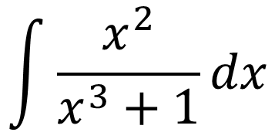
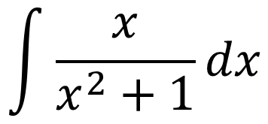
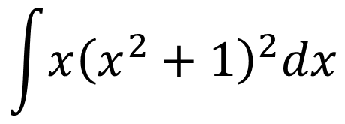
Worked Example
Your Turn
$$\int{x{\left(x^{2}+1\right)}^{2}dx}$$
$$\int{x^{2}{ \left(x^{3}+1\right)}^{2}dx}$$
$$\int{\frac{x}{x^{2}+1}dx}$$
$$\int{\frac{x^{2}}{x^{3}+1}dx}$$
@DrChris_Baker
Notes:
Useful to show reverse chain rule and substitution to show where the reverse chain rule comes from and make the link between integration by substitution and the chain rule for differentiation.

Slide 3
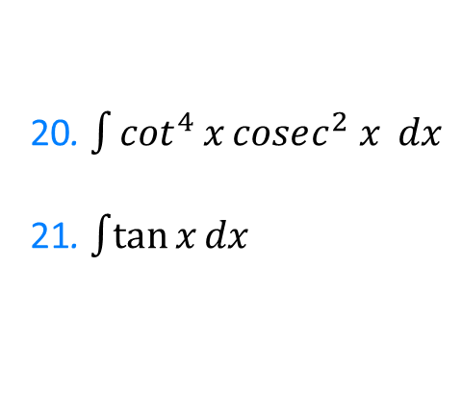
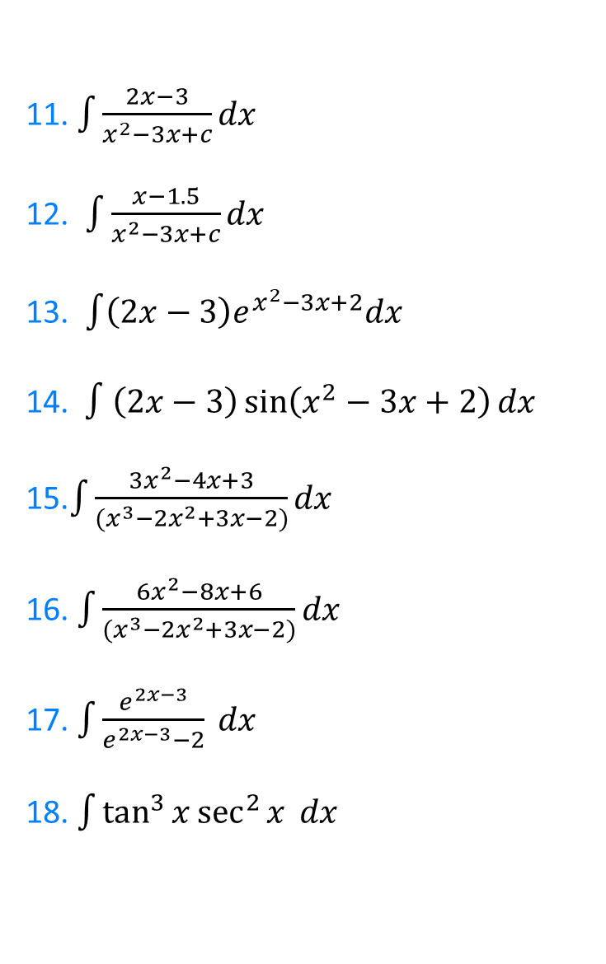

1. $\int{x{\left(x^{2}−6\right)}^{2}dx}$
2. $\int{\sin^{2}{x}\cos{x}dx}$
3. $\int{\sin^{5}{x}\cos{x}dx}$
4. $\int{x\cos\left(x^{2}−3\right)dx}$
5. $\int{x\cos\left(x^{2}−3\right) dx}$
6.$\int{x^{2}\cos\left(x^{3}−3\right)dx }$
7. $∫t^{2}\cos\left(t^{3}−3\right)dt$
8. $\int{\frac{x}{x^{2}−3}dx }$
9. $\int{\frac{x^{2}}{x^{3}−3}dx }$
10. $\int{\frac{2x−3}{x^{2}−3x+2}dx }$
11. $\int{\frac{2x−3}{x^{2}−3x+c}dx }$
12. $\int{\frac{x−1.5}{x^{2}−3x+c}dx }$
13. $\int{\left(2x−3\right)e^{x^{2}−3x+2}dx }$
14. $∫\left(2x−3\right)\sin\left(x^{2}−3x+2\right)dx$
15.$\int{\frac{3x^{2}−4x+3}{(x^{3}−2x^{2}+3x−2)}dx}$
16. $\int{\frac{6x^{2}−8x+6}{(x^{3}−2x^{2}+3x−2)}dx}$
17. $\int{\frac{e^{2x−3}}{e^{2x−3}−2} }dx$
18. $\int{\tan^{3}{x}\sec^{2}{x} }dx$
20. $\int{\cot^{4}{x}cosec^{2} x }dx$
21. $\int{\tan{x}}dx$
@DrChris_Baker

Slide 4
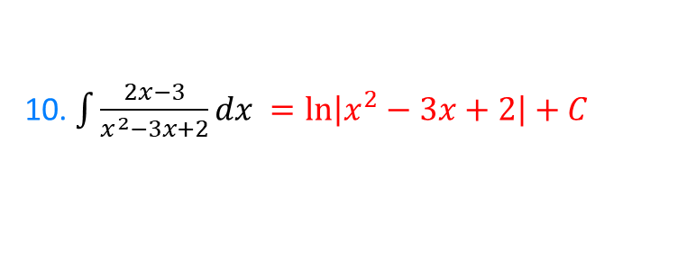
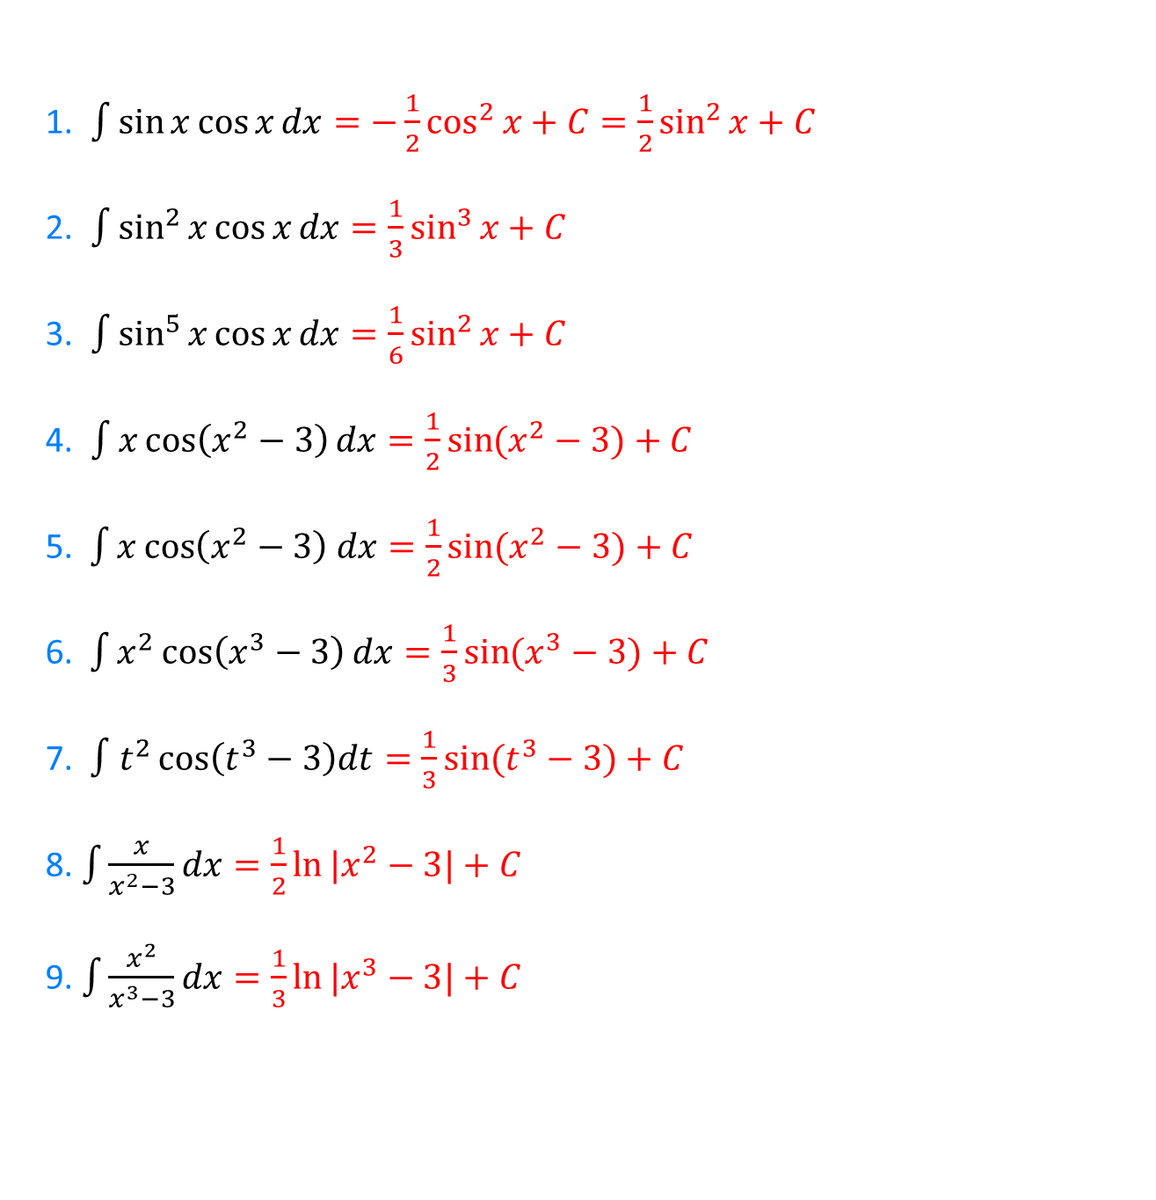
1. $\int{\sin{x}\cos{x}dx}=−\frac{1}{2}\cos^{2}{x}+C=\frac{1}{2}\sin^{2}{x}+C$
2. $\int{\sin^{2}{x}\cos{x}dx=\frac{1}{3}\sin^{3}{x}+C}$
3. $\int{\sin^{5}{x}\cos{x}dx}=\frac{1}{6}\sin^{2}{x}+C$
4. $\int{x\cos\left(x^{2}−3\right)dx}=\frac{1}{2}\sin{(x^{2}−3)}+C$
5. $\int{x\cos\left(x^{2}−3\right) dx=\frac{1}{2}\sin{(x^{2}−3)}+C }$
6.$\int{x^{2}\cos\left(x^{3}−3\right)dx=\frac{1}{3}\sin{(x^{3}−3)}+C }$
7. $∫t^{2}\cos\left(t^{3}−3\right)dt=\frac{1}{3}\sin{(t^{3}−3)}+C$
8. $\int{\frac{x}{x^{2}−3}dx=\frac{1}{2}\ln{|x^{2}−3|}+C}$
9. $\int{\frac{x^{2}}{x^{3}−3}dx=\frac{1}{3}\ln{|x^{3}−3|}+C}$
10. $\int{\frac{2x−3}{x^{2}−3x+2}dx }=\ln\left|x^{2}−3x+2\right|+C$
@DrChris_Baker

Slide 5
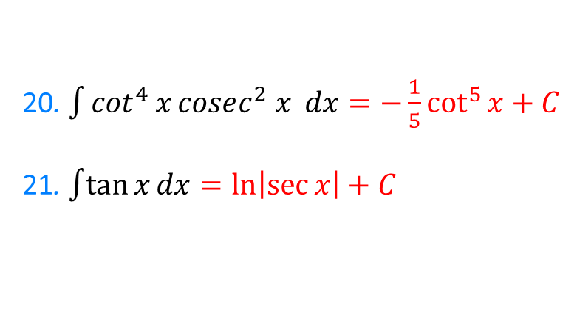
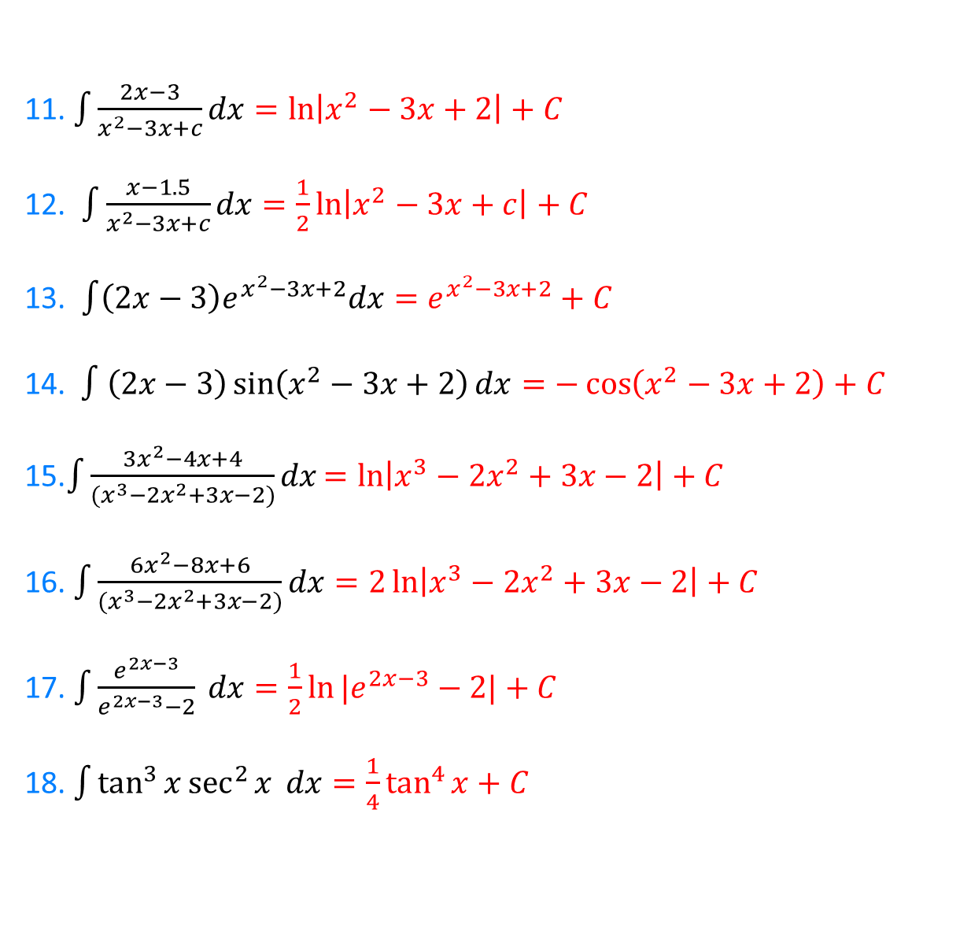
20. $\int{\cot^{4}{x}cosec^{2} x }dx=−\frac{1}{5}\cot^{5}{x}+C$
21. $\int{\tan{x}}dx=\ln\left|\sec{x}\right|+C$
11. $\int{\frac{2x−3}{x^{2}−3x+c}dx=\ln\left|x^{2}−3x+2\right|+C}$
12. $\int{\frac{x−1.5}{x^{2}−3x+c}dx=\frac{1}{2}\ln\left|x^{2}−3x+c\right|+C}$
13. $\int{\left(2x−3\right)e^{x^{2}−3x+2}dx}=e^{x^{2}−3x+2}+C$
14. $∫\left(2x−3\right)\sin\left(x^{2}−3x+2\right)dx=−\cos\left(x^{2}−3x+2\right)+C$
15.$\int{\frac{3x^{2}−4x+4}{(x^{3}−2x^{2}+3x−2)}dx}=ln\left|x^{3}−2x^{2}+3x−2\right|+C$
16. $\int{\frac{6x^{2}−8x+6}{(x^{3}−2x^{2}+3x−2)}dx}=2\ln\left|x^{3}−2x^{2}+3x−2\right|+C$
17. $\int{\frac{e^{2x−3}}{e^{2x−3}−2} }dx=\frac{1}{2}\ln{|e^{2x−3}−2|}+C$
18. $\int{\tan^{3}{x}\sec^{2}{x} }dx=\frac{1}{4}\tan^{4}{x}+C$
@DrChris_Baker

