Slide 1
Inverse Function Machines
Silent
Teacher
Intelligent Practice
Narration
Your Turn
➔ | x2 | ➔ | -3 | ➔ | 7
⬅ |  | ⬅ |  | ⬅ | 7
Practice

Slide 2
Worked Example
Your Turn
 | ➔ | x2 | ➔ | -3 | ➔ | 7
 | ⬅ |  | ⬅ |  | ⬅ | 7
 | ➔ | x4 | ➔ | +3 | ➔ | 7
 | ⬅ |  | ⬅ |  | ⬅ | 7

Slide 3
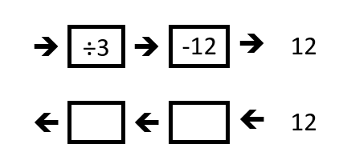

Slide 4
