Slide 1
Isometric Drawing
Silent
Teacher
Intelligent Practice
Narration
Your Turn
Practice

Slide 2
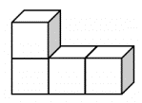
Worked Example
Your Turn

