Slide 1
Plans and Elevations
Silent
Teacher
Intelligent Practice
Narration
Your Turn
Practice

Slide 2
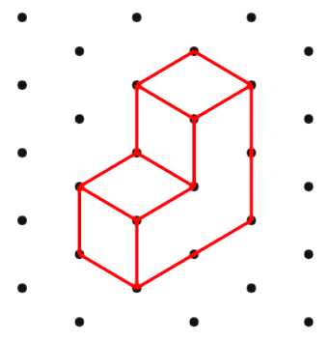
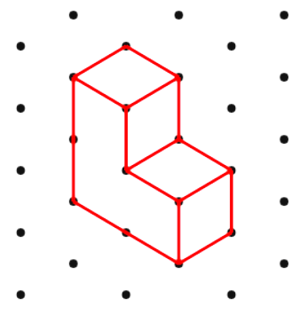
Worked Example
Your Turn
Plan
Plan
Front
Elevation
Front
Elevation

Slide 3
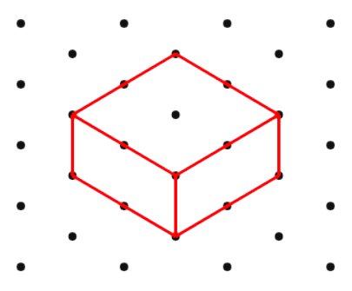
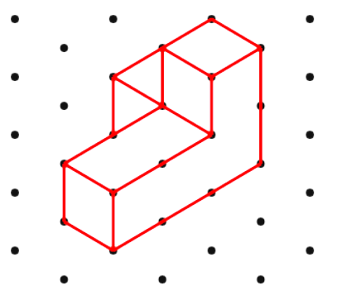
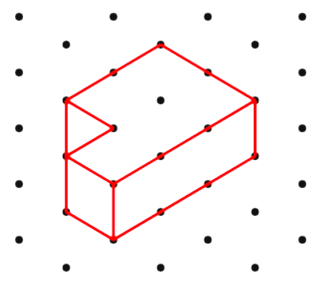
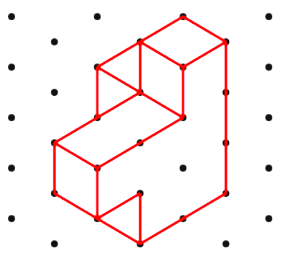
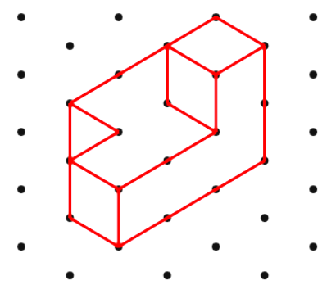
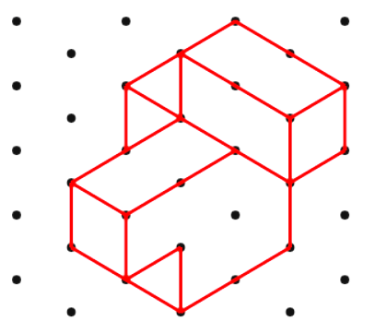
Plan
Plan
Front
Elevation
Front
Elevation
Plan
Plan
Front
Elevation
Front
Elevation
Plan
Plan
Front
Elevation
Front
Elevation

Slide 4
Plan
Plan
Front
Elevation
Front
Elevation
Plan
Plan
Front
Elevation
Front
Elevation
Plan
Plan
Front
Elevation
Front
Elevation

