Slide 1
Ratio including algebraic terms 2
Silent
Teacher
Intelligent Practice
Narration
Your Turn
$$4x −6 :6 is in the ratio 3:1$$
$$3x −6 :6 is in the ratio 3:1$$
Practice

Slide 2
Worked Example
Your Turn
$$2x+3:5 is in the ratio 3:1.$$
$$Find the value of ′x′$$
$$10:6x+2 is in the ratio 1:2.$$
$$Find the value of ′x′$$
@bannisterjodi

Slide 3
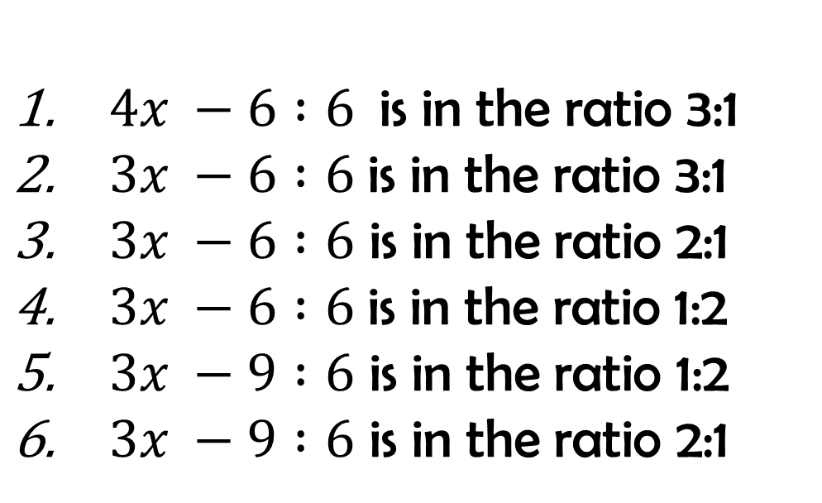
For the following, find the value of ‘x’ in each case
$4x −6 :6$is in the ratio 3:1
$3x −6 :6$is in the ratio 3:1
$3x −6 :6$ is in the ratio 2:1
$3x −6 :6$is in the ratio 1:2
$3x −9 :6$ is in the ratio 1:2
$3x −9 :6$ is in the ratio 2:1
@bannisterjodi

Slide 4
For the following, find the value of ‘x’ in each case
$4x −6 :6$is in the ratio 3:1
$3x −6 :6$is in the ratio 3:1
$3x −6 :6$ is in the ratio 2:1
$3x −6 :6$is in the ratio 1:2
$3x −9 :6$ is in the ratio 1:2
$3x −9 :6$ is in the ratio 2:1
x = 6
x = 8
x = 6
x = 3
x = 4
x = 7
@bannisterjodi

