Slide 1
Ratio including algebraic terms 4
Silent
Teacher
Intelligent Practice
Narration
Your Turn
$$x^{2}+8:12 is in the ratio 2:1$$
$$x^{2}−1 :12 is in the ratio 2:1$$
Practice

Slide 2
Worked Example
Your Turn
$$x^{2}−9:8 is in the ratio 2:1.$$
$$Find the possible values of ′x′$$
$$x^{2}+5:21 is in the ratio 5:1.$$
$$Find the possible values of ′x′$$
@bannisterjodi

Slide 3
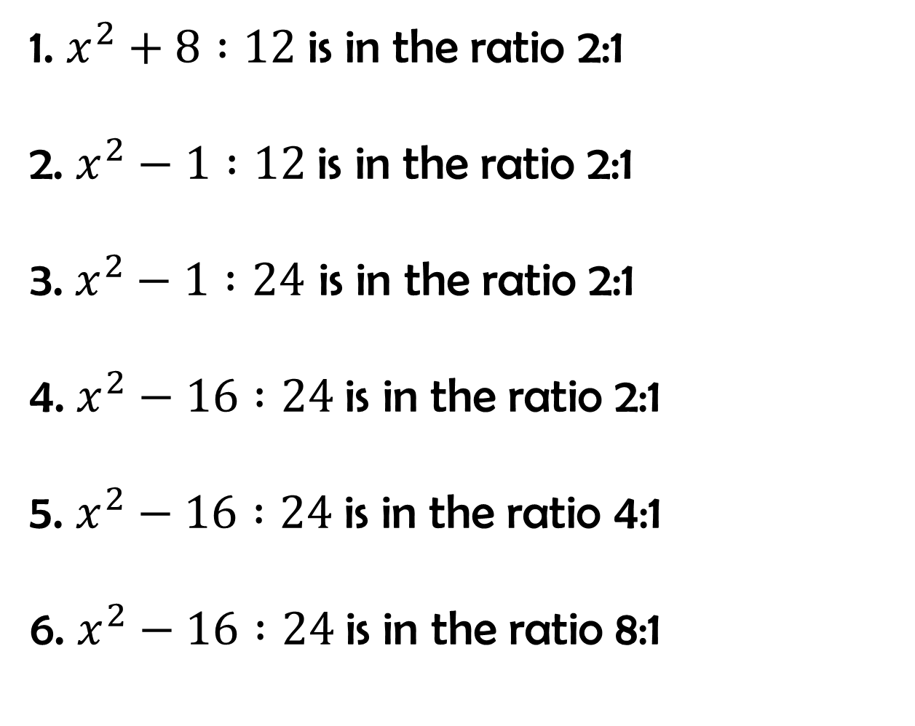
For the following, find the value of ‘x’ in each case
1. $x^{2}+8 :12$is in the ratio 2:1
2. $x^{2}−1 :12$is in the ratio 2:1
3. $x^{2}−1 :24$ is in the ratio 2:1
4. $x^{2}−16 :24$is in the ratio 2:1
5. $x^{2}−16 :24$is in the ratio 4:1
6. $x^{2}−16 :24$is in the ratio 8:1
@bannisterjodi

Slide 4
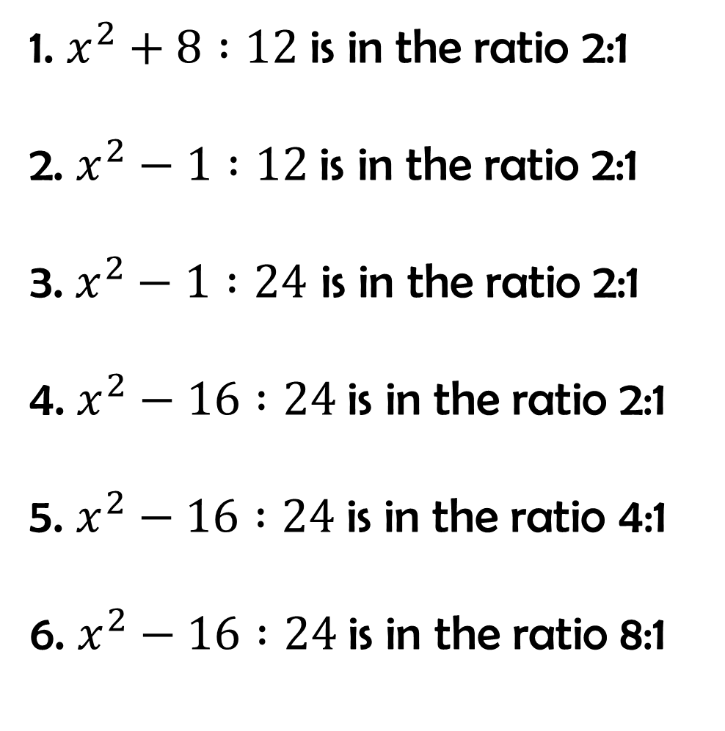
For the following, find the value of ‘x’ in each case
1. $x^{2}+8 :12$is in the ratio 2:1
2. $x^{2}−1 :12$is in the ratio 2:1
3. $x^{2}−1 :24$ is in the ratio 2:1
4. $x^{2}−16 :24$is in the ratio 2:1
5. $x^{2}−16 :24$is in the ratio 4:1
6. $x^{2}−16 :24$is in the ratio 8:1
x = 4 or -4
x = 5 or -5
x = 7 or -7
x = 8 or -8
x = $√112$ or -$√112$
x = $√208$ or -$√208$
@bannisterjodi

