Slide 1
Ratio including algebraic terms
Silent
Teacher
Intelligent Practice
Narration
Your Turn
$$2x :3 is in the ratio 4:1$$
$$2x :3 is in the ratio 5:1$$
$$2x :3 is in the ratio 6:1$$
Practice

Slide 2
Worked Example
Your Turn
$$2x :5 is in the ratio 4:1.$$
$$Find the value of ′x′$$
$$10 :5x is in the ratio 1:3.$$
$$Find the value of ′x′$$
@bannisterjodi

Slide 3
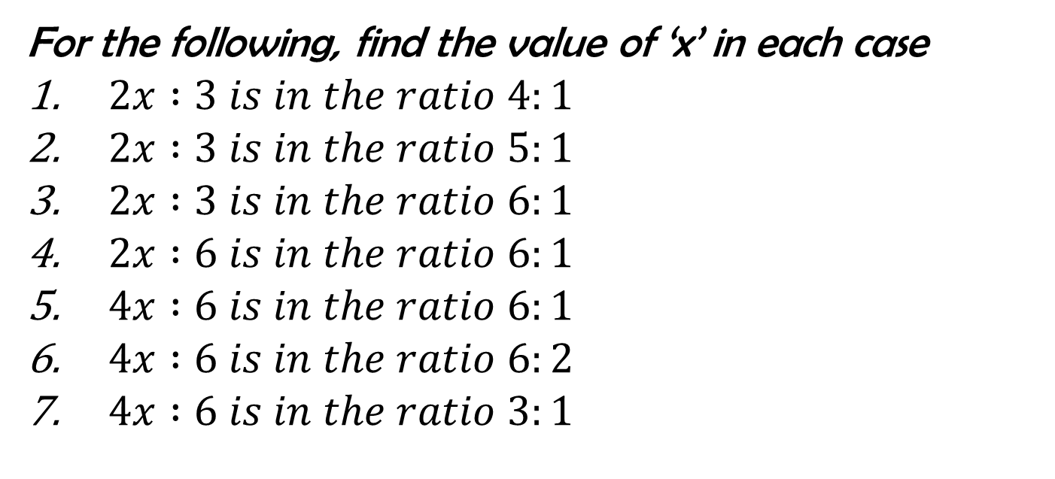
For the following, find the value of ‘x’ in each case
$2x :3 is in the ratio 4:1$
$2x :3 is in the ratio 5:1$
$2x :3 is in the ratio 6:1$
$2x :6 is in the ratio 6:1$
$4x :6 is in the ratio 6:1$
$4x :6 is in the ratio 6:2$
$4x :6 is in the ratio 3:1$
@bannisterjodi

Slide 4
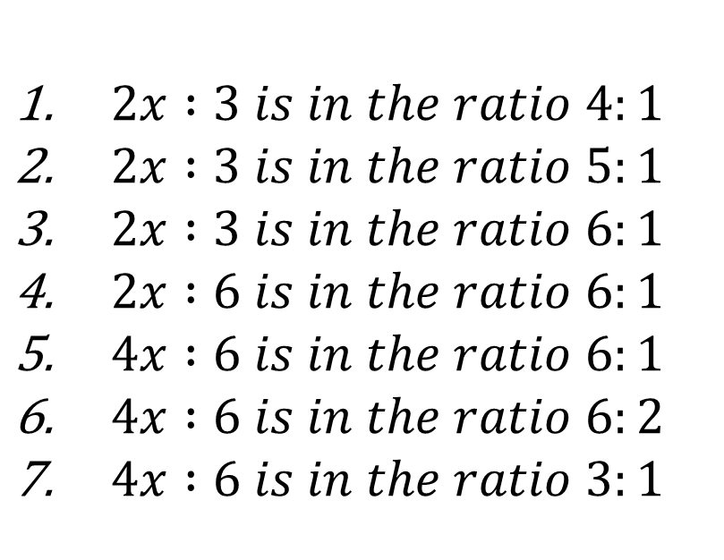
$2x :3 is in the ratio 4:1$
$2x :3 is in the ratio 5:1$
$2x :3 is in the ratio 6:1$
$2x :6 is in the ratio 6:1$
$4x :6 is in the ratio 6:1$
$4x :6 is in the ratio 6:2$
$4x :6 is in the ratio 3:1$
1. X = 6
2. X = 7.5
3. X = 9
4. X = 18
5. X = 9
6. X = 4.5
7. X = 4.5
@bannisterjodi

