Slide 1
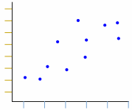
Identifying an appropriate line of best fit
True/false
Reflect
Your Turn
Rule
Notes:
1

Slide 2
Yes / No
Yes / No
Yes / No
Yes / No
@Alhassanmaths

Slide 3
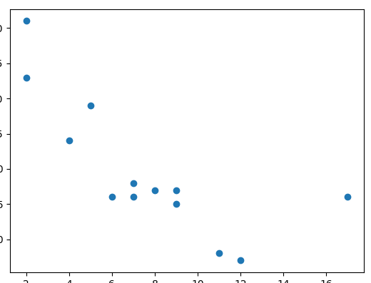
Yes / No
Yes / No
Yes / No
Yes / No
@Alhassanmaths

Slide 4
Yes / No
Yes / No
Yes / No
Yes / No
@Alhassanmaths

Slide 5
Yes / No
Yes / No
Yes / No
Yes / No
@Alhassanmaths

Slide 6
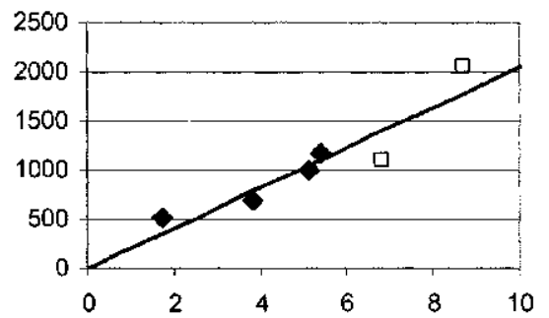
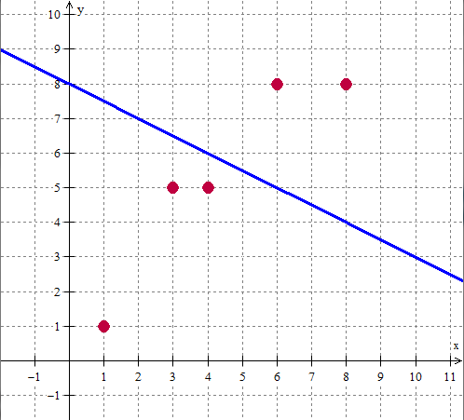
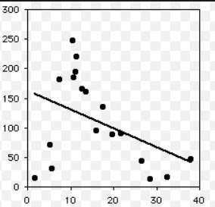
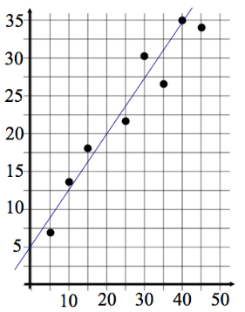
Your Turn
Yes / No
Yes / No
Yes / No
Yes / No
@Alhassanmaths

Slide 7
Your Turn
Yes / No
Yes / No
Yes / No
Yes / No
@Alhassanmaths

