Slide 1
Similar Shapes: Missing Edges
Silent
Teacher
Intelligent Practice
Narration
Your Turn
c
1 cm
12cm
3 cm
Practice

Slide 2
Worked Example
Your Turn
Similar rectangles
p cm
Similar rectangles
q cm
2 cm
3 cm
24 cm
24 cm
8 cm
8 cm

Slide 3
3 cm
Similar rectangles
d
1 cm
2 cm
a
12cm
3 cm
6 cm
e
4 cm
2 cm
1 cm
120cm
b
6 cm
3 cm
c
2 cm
1 cm
12cm
f
3 cm
6 cm
1.2cm

Slide 4
Similar triangles
g
15cm
3 cm
4cm
1 cm
3 cm
2 cm
j
h
15cm
4cm
3 cm
2 cm
3 cm
k
5cm
15cm
150mm
40mm
i
2 cm
3 cm
L
50mm

Slide 5
3 cm
Similar rectangles
d
1 cm
2 cm
a
1cm | 3cm
3cm | 9cm
12cm
6cm | 12cm
2cm | 4cm
3 cm
6 cm
e
4 cm
2 cm
1 cm
1cm | 4cm
3cm | 12cm
120cm
6cm | 120cm
2cm | 40cm
b
6 cm
3 cm
c
2 cm
6cm | 1.2cm
2cm | 0.4cm
1 cm
12cm
3cm | 12cm
1cm | 4cm
f
3 cm
6 cm
1.2cm

Slide 6
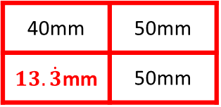
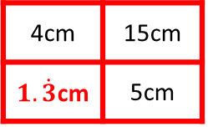
g
1cm | 3cm
3cm | 9cm
15cm
4cm | 15cm
2cm | 7.5cm
3 cm
4cm
1 cm
3 cm
2 cm
j
2cm | 3cm
3cm | 4.5cm
15cm
4cm | 15cm
$1.\dot{3}$cm | 5cm
h
4cm
3 cm
2 cm
3 cm
k
5cm
15cm
2cm | 3cm
10cm | 15cm
150mm
40mm | 50mm
$13.\dot{3}$mm | 50mm
40mm
i
2 cm
3 cm
L
50mm

