Slide 1
Coefficients and Constants: Fill in the gaps
Silent
Teacher
Intelligent Practice
Narration
Your Turn
$$x^{2}−3xy+3=0$$
$$x^{2}y−3x^{3}+2y+3=0$$
Practice

Slide 2
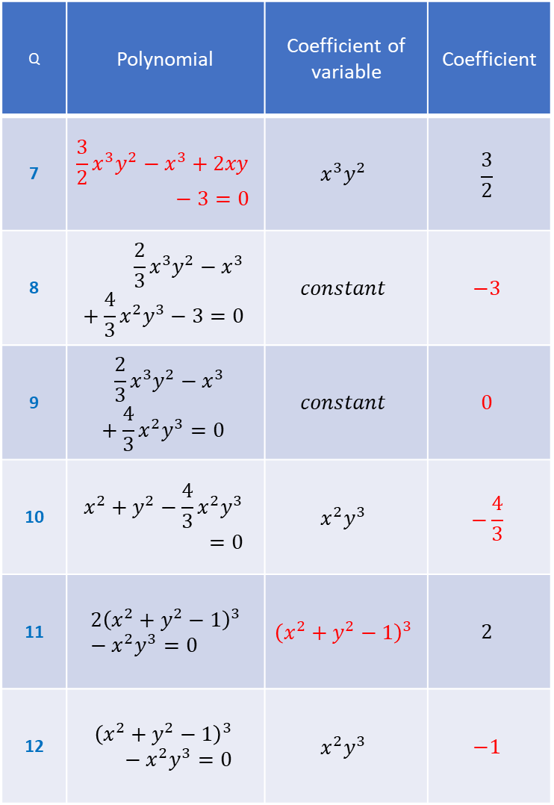
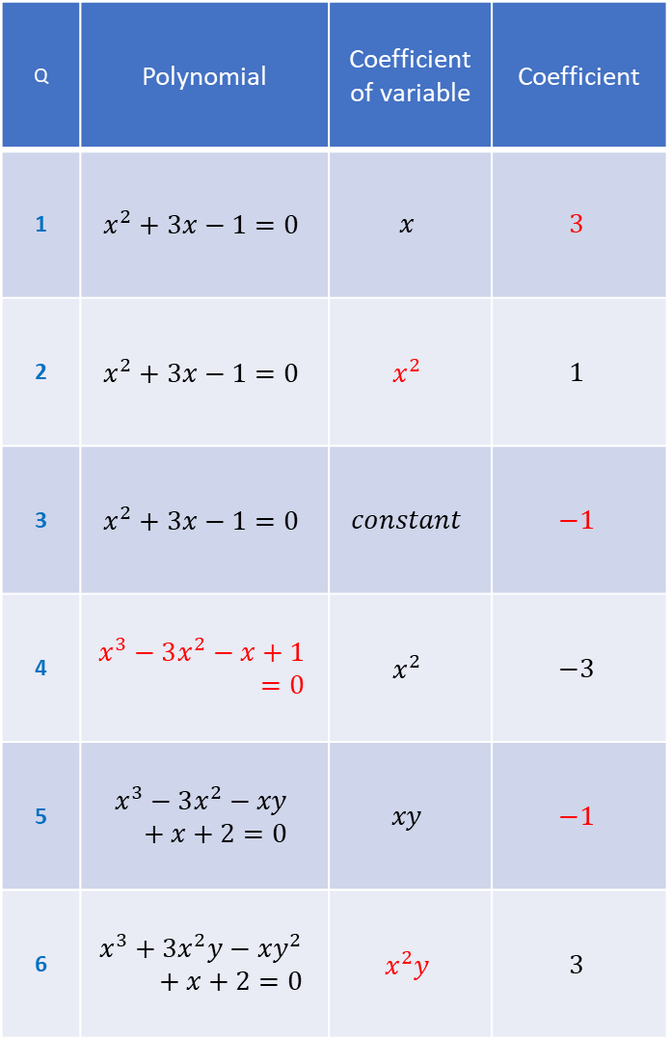
Q | Polynomial | Coefficient of variable | Coefficient
1 | $$x^{2}+3x−1=0$$ | $$x$$ | $$3$$
2 | $$x^{2}+3x−1=0$$ | $$x^{2}$$ | $$1$$
3 | $$x^{2}+3x−1=0$$ | $$constant$$ | $$−1$$
4 | $$x^{3}−3x^{2}−x+1=0$$ | $$x^{2}$$ | $$−3$$
5 | $$x^{3}−3x^{2}−xy+x+2=0$$ | $$xy$$ | $$−1$$
6 | $$x^{3}+3x^{2}y−xy^{2}+x+2=0$$ | $$x^{2}y$$ | $$3$$
Q | Polynomial | Coefficient of variable | Coefficient
7 | $${\frac{3}{2}x}^{3}y^{2}−x^{3}+2xy−3=0$$ | $$x^{3}y^{2}$$ | $$\frac{3}{2}$$
8 | $$\frac{2}{3}x^{3}y^{2}−x^{3}+\frac{4}{3}x^{2}y^{3}−3=0$$ | $$constant$$ | $$−3$$
9 | $$\frac{2}{3}x^{3}y^{2}−x^{3}+\frac{4}{3}x^{2}y^{3}=0$$ | $$constant$$ | $$0$$
10 | $$x^{2}+y^{2}−\frac{4}{3}x^{2}y^{3}=0$$ | $$x^{2}y^{3}$$ | $$−\frac{4}{3}$$
11 | $$2{\left(x^{2}+y^{2}−1\right)}^{3}−x^{2}y^{3}=0$$ | $${\left(x^{2}+y^{2}−1\right)}^{3}$$ | $$2$$
12 | $${\left(x^{2}+y^{2}−1\right)}^{3}−x^{2}y^{3}=0$$ | $$x^{2}y^{3}$$ | $$−1$$

Slide 3
Q | Polynomial | Coefficient of variable | Coefficient
1 | $$x^{2}+3x−1=0$$ | $$x$$ | $$3$$
2 | $$x^{2}+3x−1=0$$ | $$x^{2}$$ | $$1$$
3 | $$x^{2}+3x−1=0$$ | $$constant$$ | $$−1$$
4 | $$x^{3}−3x^{2}−x+1=0$$ | $$x^{2}$$ | $$−3$$
5 | $$x^{3}−3x^{2}−xy+x+2=0$$ | $$xy$$ | $$−1$$
6 | $$x^{3}+3x^{2}y−xy^{2}+x+2=0$$ | $$x^{2}y$$ | $$3$$
Q | Polynomial | Coefficient of variable | Coefficient
7 | $${\frac{3}{2}x}^{3}y^{2}−x^{3}+2xy−3=0$$ | $$x^{3}y^{2}$$ | $$\frac{3}{2}$$
8 | $$\frac{2}{3}x^{3}y^{2}−x^{3}+\frac{4}{3}x^{2}y^{3}−3=0$$ | $$constant$$ | $$−3$$
9 | $$\frac{2}{3}x^{3}y^{2}−x^{3}+\frac{4}{3}x^{2}y^{3}=0$$ | $$constant$$ | $$0$$
10 | $$x^{2}+y^{2}−\frac{4}{3}x^{2}y^{3}=0$$ | $$x^{2}y^{3}$$ | $$−\frac{4}{3}$$
11 | $$2{\left(x^{2}+y^{2}−1\right)}^{3}−x^{2}y^{3}=0$$ | $${\left(x^{2}+y^{2}−1\right)}^{3}$$ | $$2$$
12 | $${\left(x^{2}+y^{2}−1\right)}^{3}−x^{2}y^{3}=0$$ | $$x^{2}y^{3}$$ | $$−1$$

