Slide 1
Surds: Multiplying 2
Silent
Teacher
Intelligent Practice
Narration
Your Turn
2$\sqrt{5}×\sqrt{3}$
$$\sqrt{6}×2\sqrt{3}$$
$$5\sqrt{24}×3\sqrt{3}$$
Practice

Slide 2
Worked Example
Your Turn
2$\sqrt{5}×\sqrt{6}$
2$\sqrt{5}×\sqrt{7}$
3$\sqrt{3}×2\sqrt{6}$
3$\sqrt{3}×2\sqrt{8}$

Slide 3
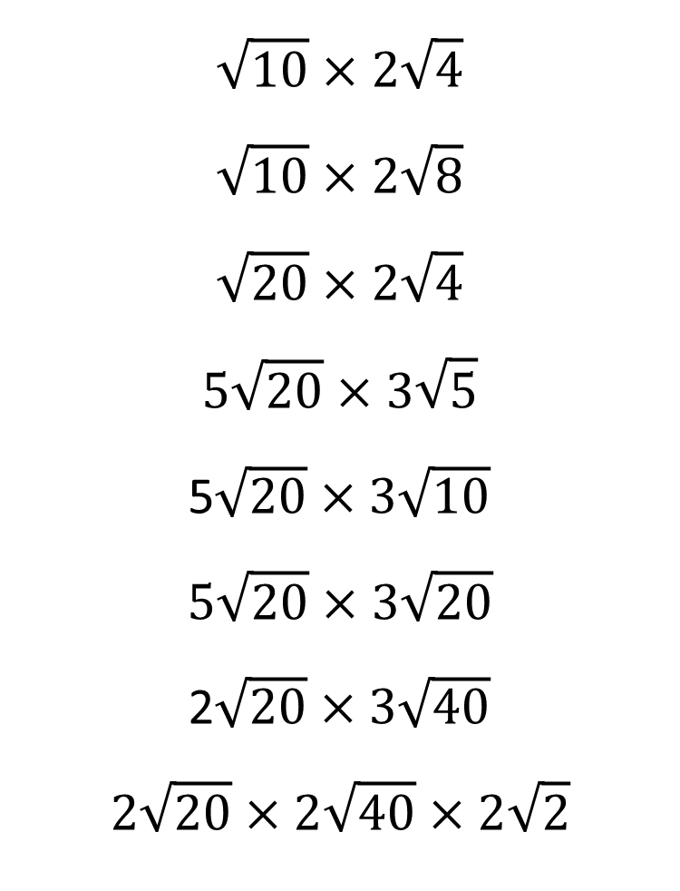
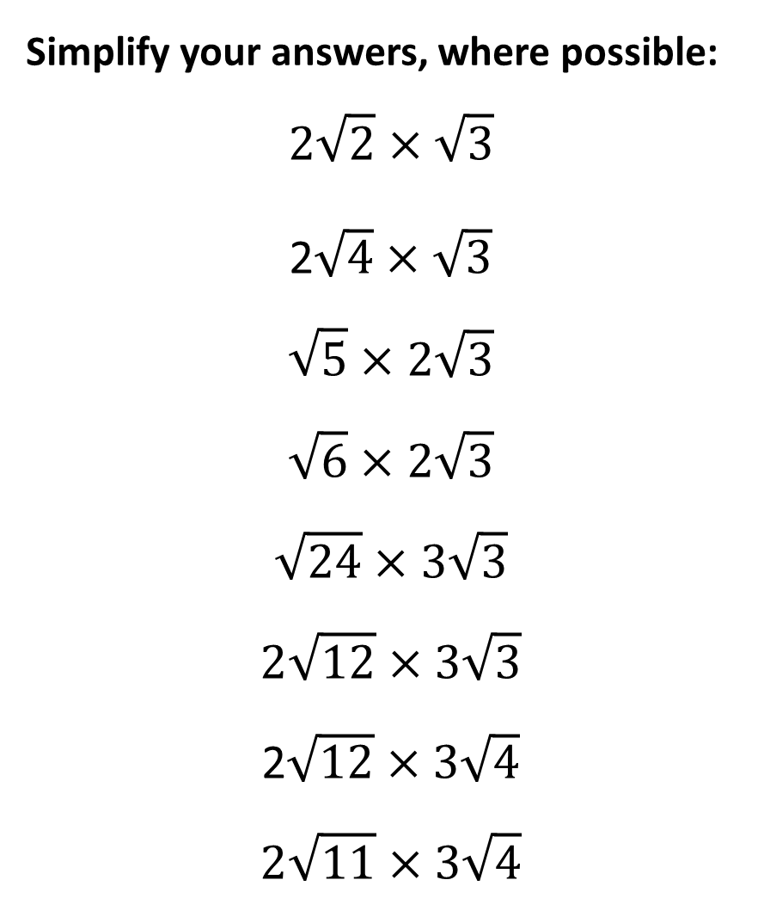
Simplify your answers, where possible: $$2\sqrt{2}×\sqrt{3}$$
2$\sqrt{4}×\sqrt{3}$
$$\sqrt{5}×2\sqrt{3}$$
$$\sqrt{6}×2\sqrt{3}$$
$$\sqrt{24}×3\sqrt{3}$$
$$2\sqrt{12}×3\sqrt{3}$$
2$\sqrt{12}×3\sqrt{4}$
$$2\sqrt{11}×3\sqrt{4}$$
$$\sqrt{10}×2\sqrt{4}$$
$$\sqrt{10}×2\sqrt{8}$$
$$\sqrt{20}×2\sqrt{4}$$
$$5\sqrt{20}×3\sqrt{5}$$
5$\sqrt{20}×3\sqrt{10}$
$$5\sqrt{20}×3\sqrt{20}$$
2$\sqrt{20}×3\sqrt{40}$
$$2\sqrt{20}×2\sqrt{40}×2\sqrt{2}$$

Slide 4
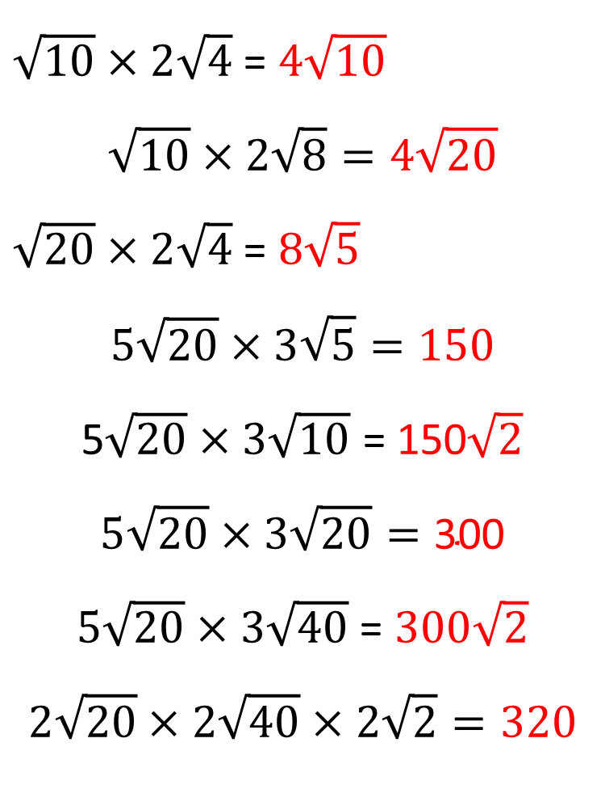
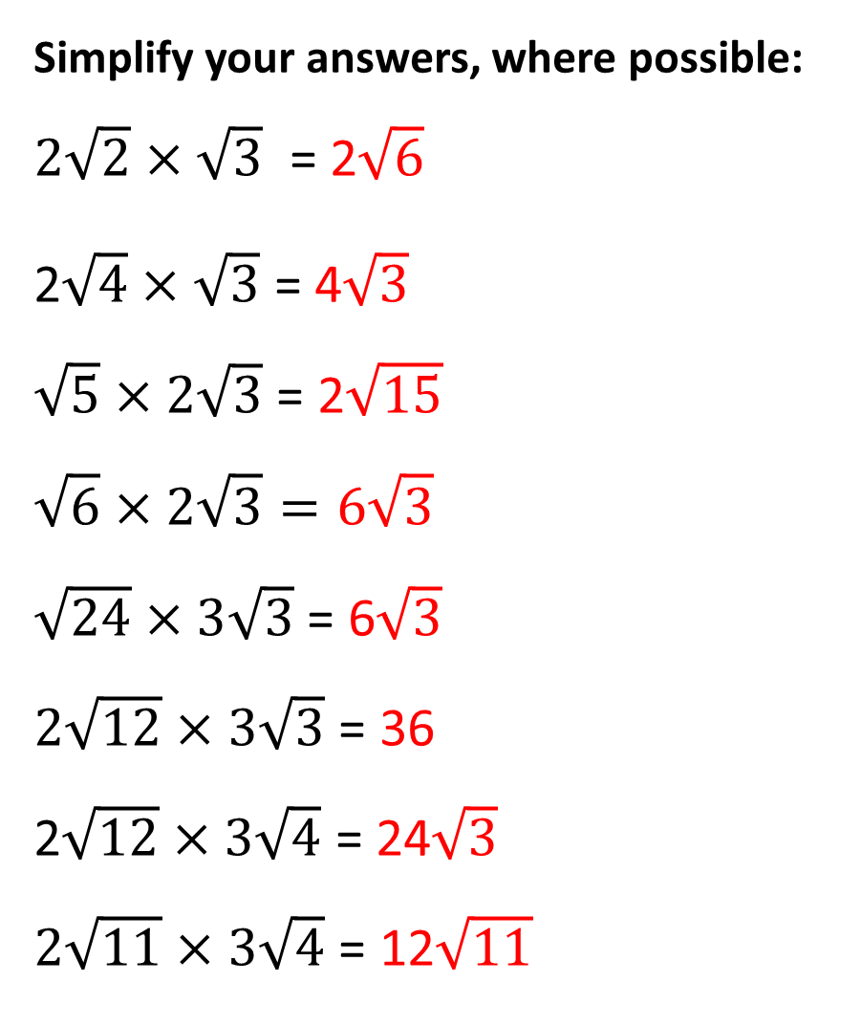
Simplify your answers, where possible: $2\sqrt{2}×\sqrt{3}$ = 2$\sqrt{6}$
2$\sqrt{4}×\sqrt{3}$ = 4$\sqrt{3}$
$\sqrt{5}×2\sqrt{3}$ = 2$\sqrt{15}$
$$\sqrt{6}×2\sqrt{3}=6\sqrt{3}$$
$\sqrt{24}×3\sqrt{3}$ = 6$\sqrt{3}$
$2\sqrt{12}×3\sqrt{3}$ = 36
2$\sqrt{12}×3\sqrt{4}$ = 24$\sqrt{3}$
$2\sqrt{11}×3\sqrt{4}$ = 12$\sqrt{11}$
$\sqrt{10}×2\sqrt{4}$ = $4\sqrt{10}$
$$\sqrt{10}×2\sqrt{8}=4\sqrt{20}$$
$\sqrt{20}×2\sqrt{4}$ = $8\sqrt{5}$
$$5\sqrt{20}×3\sqrt{5}=150$$
5$\sqrt{20}×3\sqrt{10}$ = 150$\sqrt{2}$
$$5\sqrt{20}×3\sqrt{20}=\text{300}$$
$5\sqrt{20}×3\sqrt{40}$ = $300\sqrt{2}$
$$2\sqrt{20}×2\sqrt{40}×2\sqrt{2}=320$$

