Slide 1
Area of a triangle - trigonometry
Silent
Teacher
Intelligent Practice
Narration
Your Turn
60º
2 $cm$
1 $cm$
1 $cm$
$\sqrt{3}$ $cm$
Practice

Slide 2
Worked Example
Your Turn
Calculate the area of the triangle.
Calculate the area of the triangle.
6 cm
8 cm
60 º
5 cm
60 º
7 cm
@em_3190

Slide 3
Where possible, find the area of the triangle.
1.
2.
3.
4.
60º
2 $cm$
2 $cm$
30º
2 $cm$
1 $cm$
1 $cm$
30º
1 $cm$
$\sqrt{3}$ $cm$
$\sqrt{3}$ $cm$
5.
6.
7.
30º
4 $m$
30º
8 $m$
$\sqrt{2}$ $m$
1 $m$
2 $m$
45º
4 $m$
8.
9.
$5\sqrt{2}$ $cm$
$$3 cm$$
$$\sqrt{2 } m$$
45º
45º
4 $m$
11.
$4\sqrt{3}$ $cm$
10.
$$5 cm$$
$$3 m$$
$$4 m$$
$$5 m$$
@em_3190

Slide 4
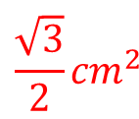
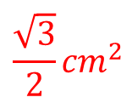
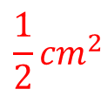
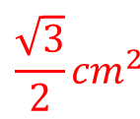
Where possible, find the area of the triangle.
1.
2.
3.
4.
60º
2 $cm$
2 $cm$
30º
2 $cm$
1 $cm$
1 $cm$
1 $cm$
30º
$$\frac{\sqrt{3}}{2}{cm}^{2}$$
$\sqrt{3}$ $cm$
$$\frac{\sqrt{3}}{2}{cm}^{2}$$
$\sqrt{3}$ $cm$
$$\frac{\sqrt{3}}{2}{cm}^{2}$$
$$\frac{1}{2}{cm}^{2}$$
5.
6.
7.
30º
4 $m$
30º
8 $m$
$\sqrt{2}$ $m$
1 $m$
2 $m$
45º
$$2 m^{2}$$
$$2 m^{2}$$
4 $m$
$$2 m^{2}$$
8.
9.
$5\sqrt{2}$ $cm$
$$3 cm$$
$$\sqrt{2 } m$$
45º
45º
4 $m$
11.
$4\sqrt{3}$ $cm$
$$not enough info$$
10.
$$10\sqrt{3} {cm}^{2}$$
$$5 cm$$
$$3 m$$
$$4 m$$
$$not enough info$$
$$5 m$$
$$6 m^{2}$$
@em_3190

