Slide 1
Standard Deviation From a List
Silent
Teacher
Intelligent Practice
Narration
Your Turn
1, 1, 2, 3, 3
2, 2, 3, 4, 4
4, 4, 6, 8, 8
Practice

Slide 2
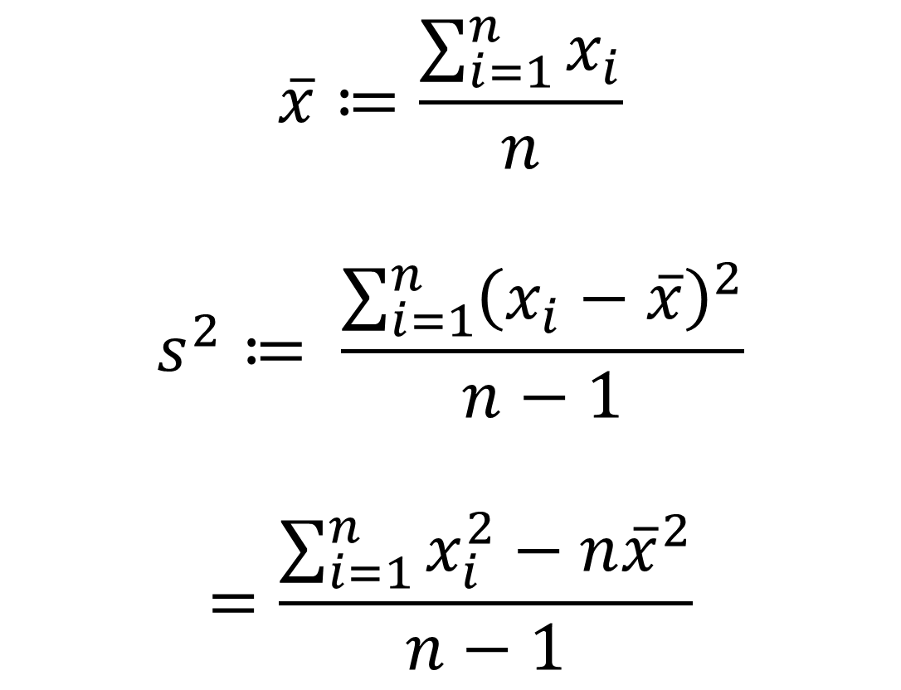
$$\overline{x}≔\frac{\sum_{i=1}^{n}{x_{i}}}{n}$$
$$s^{2}≔ \frac{\sum_{i=1}^{n}{{\left(x_{i}−\overline{x}\right)}^{2}}}{n−1}$$
$$=\frac{\sum_{i=1}^{n}{x_{i}^{2}}−n{\overline{x}}^{2}}{n−1}$$
@Mr Mansbridge

Slide 3
Worked Example
Your Turn
Work out the variance and standard deviation of:
Work out the variance and standard deviation of:
1, 3, 5, 7, 9
1, 4, 7, 10, 13
$s^{2}=$
$s=$
$s^{2}=$
$s=$
@Mr Mansbridge

Slide 4
1, 1, 1, 1, 1
1, 1, 2, 3, 3
2, 2, 3, 4, 4
4, 4, 6, 8, 8
3, 4, 6, 8, 9
2, 4, 6, 8, 10
1, 2, 3, 4, 5
0, 1, 2, 3, 4, 5, 6
0, 0.5, 1, 1.5, 2, 2.5, 3
-3, -2.5, -2, -1.5, -1, -0.5, 0
-1.5, -1, -0.5, 0, 0.5, 1, 1.5
-1.5, -1, -0.5, 0.5, 1, 1.5
-1, -0.5, 0.5, 1
@Mr Mansbridge

Slide 5

1, 1, 1, 1, 1
1, 1, 2, 3, 3
2, 2, 3, 4, 4
4, 4, 6, 8, 8
3, 4, 6, 8, 9
2, 4, 6, 8, 10
1, 2, 3, 4, 5
0, 1, 2, 3, 4, 5, 6
0, 0.5, 1, 1.5, 2, 2.5, 3
-3, -2.5, -2, -1.5, -1, -0.5, 0
-1.5, -1, -0.5, 0, 0.5, 1, 1.5
-1.5, -1, -0.5, 0.5, 1, 1.5
-1, -0.5, 0.5, 1
$s^{2}=0$
$s^{2}=1$
$s^{2}=1$
$s^{2}=4$
$s^{2}=6.5$
$s^{2}=10$
$s^{2}=2.5$
$s^{2}=4.\dot{6}$
$s^{2}=1.1\dot{6}$
$s^{2}=1.1\dot{6}$
$s^{2}=1.1\dot{6}$
$s^{2}=1.4$
$s^{2}=0.8\dot{3}$
$s=0$
$s=1$
$s=1$
$s=2$
$s≈2.55$
$s≈3.16$
$s≈1.58$
$s≈2.16$
$s≈1.08$
$s≈1.08$
$s≈1.08$
$s≈1.18$
$s≈0.91$

