Slide 1
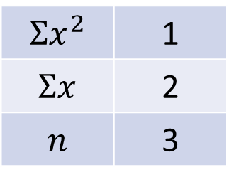
Standard Deviation From Summary Tables
Silent
Teacher
Intelligent Practice
Narration
Your Turn
$$Σx^{2}$$ | 1
$$Σx$$ | 2
$$n$$ | 3
$s^{2}=$
$s=$
Practice

Slide 2

$$\overline{x}≔\frac{\sum{x}}{n}$$
$$s^{2}≔\frac{\sum{x^{2}}−n{\overline{x}}^{2}}{n−1}$$
@Mr Mansbridge

Slide 3
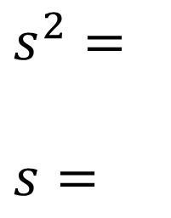
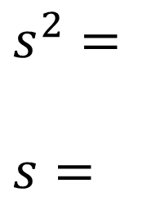
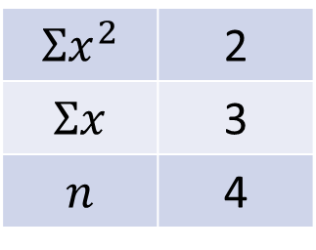
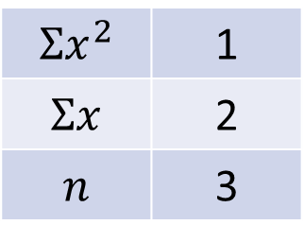
Worked Example
Your Turn
Work out the sample variance and standard deviation of:
Work out the sample variance and standard deviation of:
$$Σx^{2}$$ | 1
$$Σx$$ | 2
$$n$$ | 3
$$Σx^{2}$$ | 2
$$Σx$$ | 3
$$n$$ | 4
$s^{2}=$
$s=$
$s^{2}=$
$s=$
@Mr Mansbridge

Slide 4
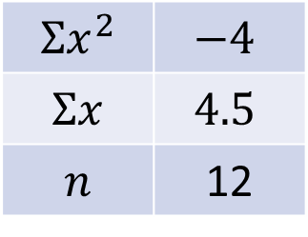
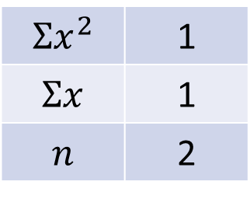
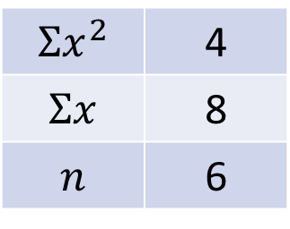
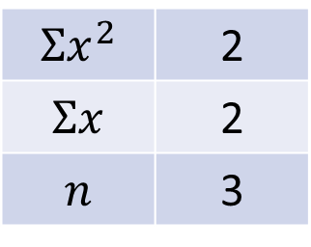
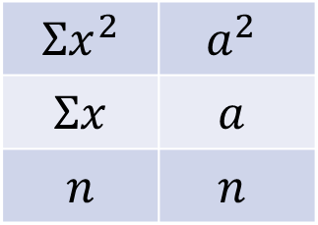
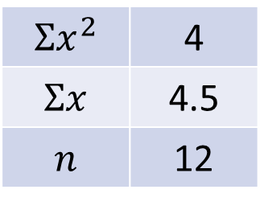
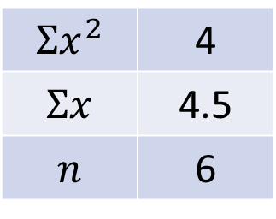
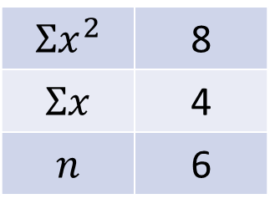
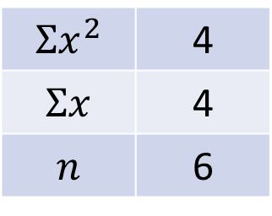
1.
$$Σx^{2}$$ | 1
$$Σx$$ | 1
$$n$$ | 2
4.
$$Σx^{2}$$ | 8
$$Σx$$ | 4
$$n$$ | 6
7.
$$Σx^{2}$$ | 4
$$Σx$$ | 4.5
$$n$$ | 12
2.
$$Σx^{2}$$ | 2
$$Σx$$ | 2
$$n$$ | 3
5.
$$Σx^{2}$$ | 4
$$Σx$$ | 8
$$n$$ | 6
8.
$$Σx^{2}$$ | $$−4$$
$$Σx$$ | $$4.5$$
$$n$$ | 12
3.
$$Σx^{2}$$ | 4
$$Σx$$ | 4
$$n$$ | 6
6.
$$Σx^{2}$$ | 4
$$Σx$$ | 4.5
$$n$$ | 6
9.
$$Σx^{2}$$ | $$a^{2}$$
$$Σx$$ | $$a$$
$$n$$ | $$n$$
@Mr Mansbridge

Slide 5
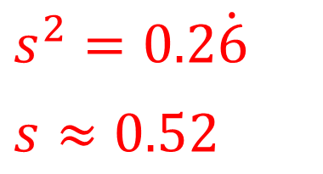
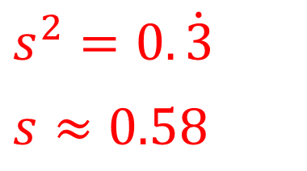
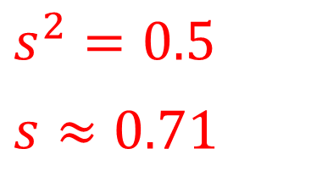
1.
$$Σx^{2}$$ | 1
$$Σx$$ | 1
$$n$$ | 2
$s^{2}=0.5$
$s≈0.71$
2.
$$Σx^{2}$$ | 2
$$Σx$$ | 2
$$n$$ | 3
$s^{2}=0.\dot{3}$
$s≈0.58$
3.
$$Σx^{2}$$ | 4
$$Σx$$ | 4
$$n$$ | 6
$s^{2}=0.2\dot{6}$
$s≈0.52$
@Mr Mansbridge

Slide 6
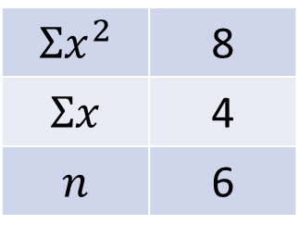
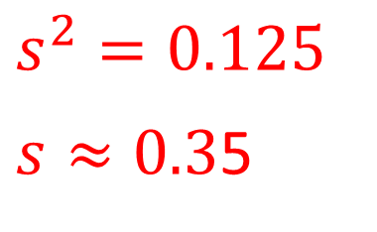
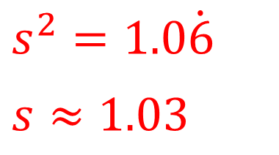
4.
$$Σx^{2}$$ | 8
$$Σx$$ | 4
$$n$$ | 6
$s^{2}=1.0\dot{6}$
$s≈1.03$
5.
$$Σx^{2}$$ | 4
$$Σx$$ | 8
$$n$$ | 6
This example makes no sense. Why?
6.
$$Σx^{2}$$ | 4
$$Σx$$ | 4.5
$$n$$ | 6
$s^{2}=0.125$
$s≈0.3$5
@Mr Mansbridge

Slide 7
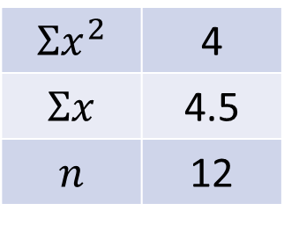
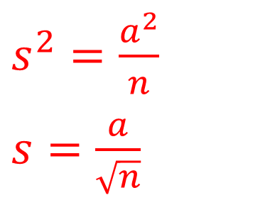
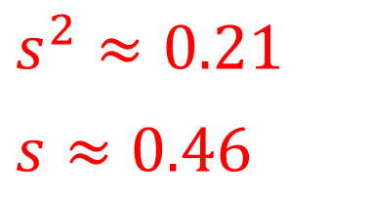
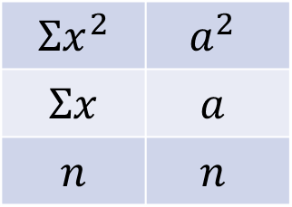
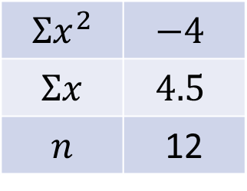
7.
$$Σx^{2}$$ | 4
$$Σx$$ | 4.5
$$n$$ | 12
$s^{2}≈0.21$
$s≈0.46$
8.
$$Σx^{2}$$ | $$−4$$
$$Σx$$ | $$4.5$$
$$n$$ | 12
This example makes no sense. Why?
9.
$$Σx^{2}$$ | $$a^{2}$$
$$Σx$$ | $$a$$
$$n$$ | $$n$$
$s^{2}=\frac{a^{2}}{n}$
$s=\frac{a}{\sqrt{n}}$
@Mr Mansbridge

