Slide 1
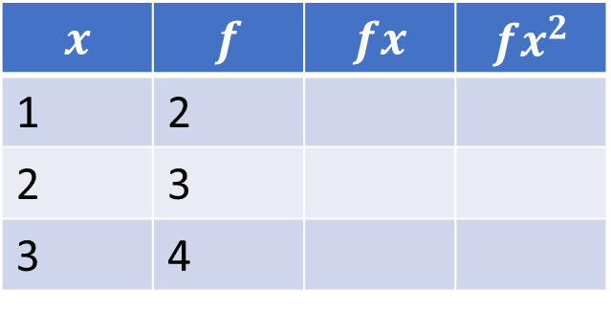
Standard Deviation From Non-Grouped Frequency Tables
Silent
Teacher
Intelligent Practice
Narration
Your Turn
$$x$$ | $$f$$ | $$fx$$ | $$fx^{2}$$
1 | 2
2 | 3
3 | 4
Practice

Slide 2

$$n≔\sum{f}$$
$$\overline{x}≔\frac{1}{n}\sum{fx}$$
$$s^{2}≔\frac{\sum{fx^{2}}−n{\overline{x}}^{2}}{n−1}$$
@Mr Mansbridge

Slide 3
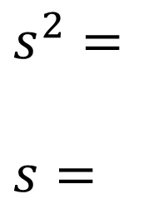
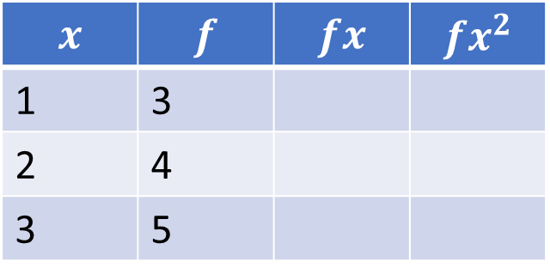
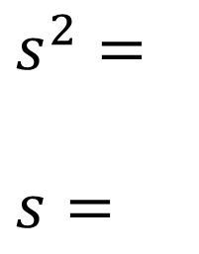
Worked Example
Your Turn
Work out the sample variance and standard deviation of:
Work out the sample variance and standard deviation of:
$$x$$ | $$f$$ | $$fx$$ | $$fx^{2}$$
1 | 2
2 | 3
3 | 4
$$x$$ | $$f$$ | $$fx$$ | $$fx^{2}$$
1 | 3
2 | 4
3 | 5
$s^{2}=$
$s=$
$s^{2}=$
$s=$
@Mr Mansbridge

Slide 4
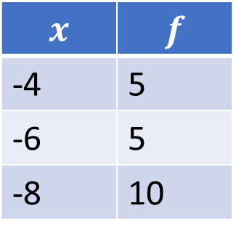
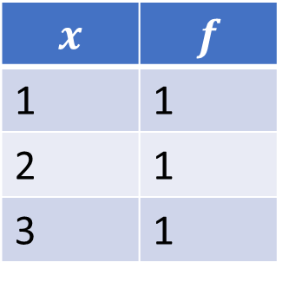
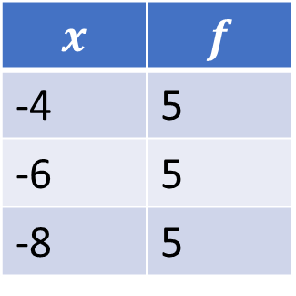
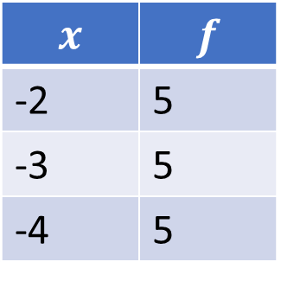
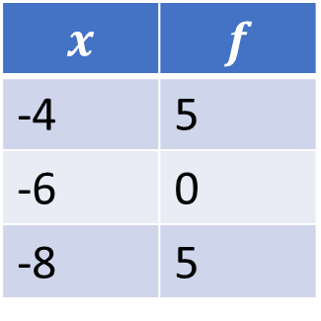
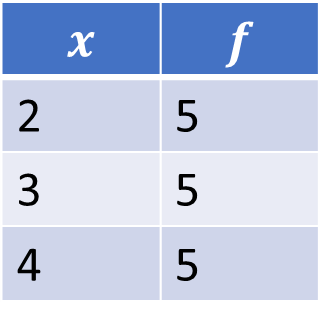
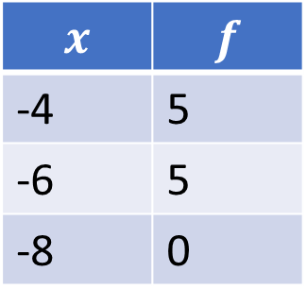
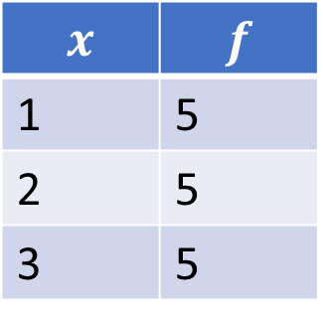
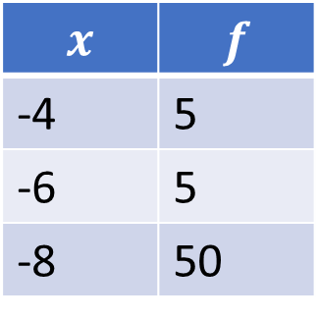
1.
$$x$$ | $$f$$
1 | 1
2 | 1
3 | 1
4.
$$x$$ | $$f$$
-2 | 5
-3 | 5
-4 | 5
7.
$$x$$ | $$f$$
-4 | 5
-6 | 5
-8 | 50
2.
$$x$$ | $$f$$
1 | 5
2 | 5
3 | 5
5.
$$x$$ | $$f$$
-4 | 5
-6 | 5
-8 | 5
8.
$$x$$ | $$f$$
-4 | 5
-6 | 5
-8 | 0
3.
$$x$$ | $$f$$
2 | 5
3 | 5
4 | 5
6.
$$x$$ | $$f$$
-4 | 5
-6 | 5
-8 | 10
9.
$$x$$ | $$f$$
-4 | 5
-6 | 0
-8 | 5
@Mr Mansbridge

Slide 5
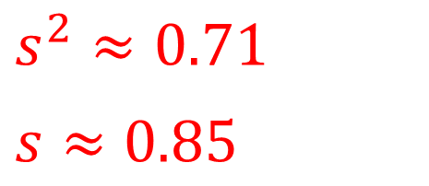
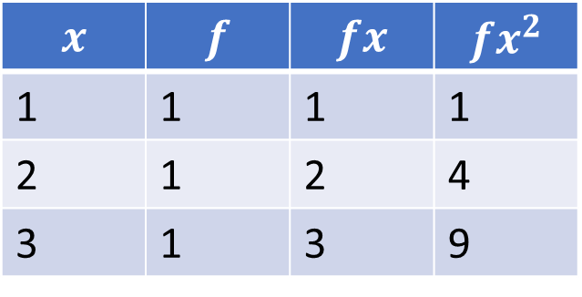
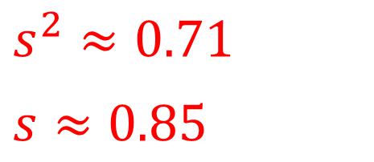

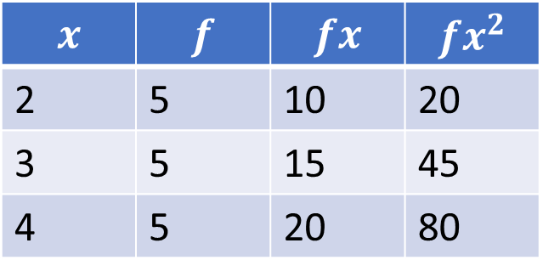
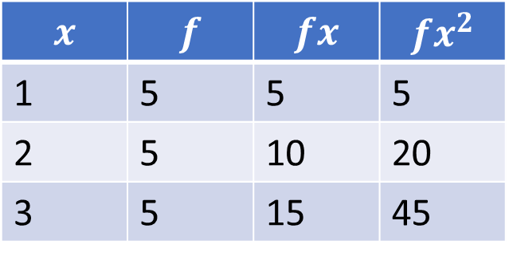
1.
$$x$$ | $$f$$ | $$fx$$ | $$fx^{2}$$
1 | 1 | 1 | 1
2 | 1 | 2 | 4
3 | 1 | 3 | 9
$s^{2}=1$
$s=1$
2.
$$x$$ | $$f$$ | $$fx$$ | $$fx^{2}$$
1 | 5 | 5 | 5
2 | 5 | 10 | 20
3 | 5 | 15 | 45
$s^{2}≈0.71$
$s≈0.85$
3.
$$x$$ | $$f$$ | $$fx$$ | $$fx^{2}$$
2 | 5 | 10 | 20
3 | 5 | 15 | 45
4 | 5 | 20 | 80
$s^{2}≈0.71$
$s≈0.85$
@Mr Mansbridge

Slide 6
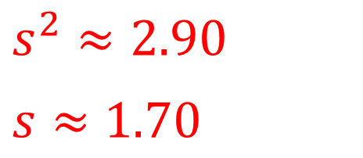
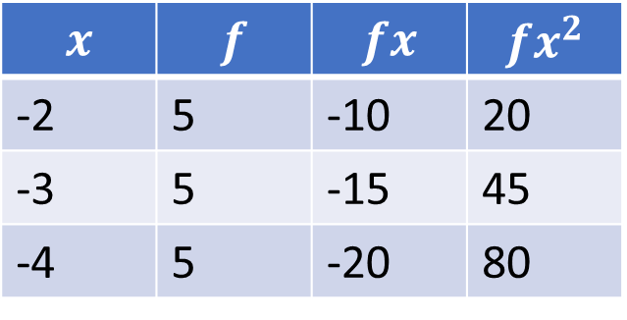
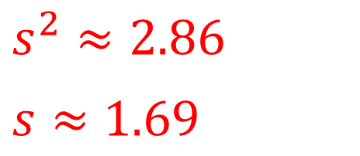
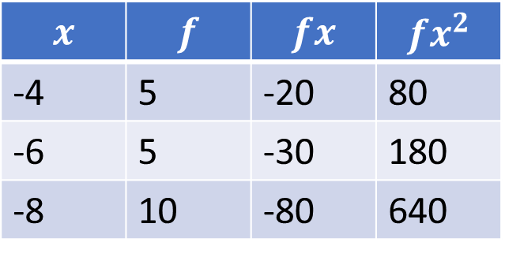
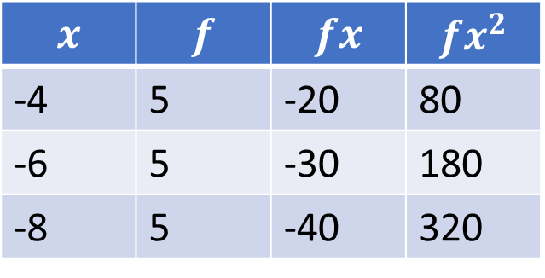
4.
$$x$$ | $$f$$ | $$fx$$ | $$fx^{2}$$
-2 | 5 | -10 | 20
-3 | 5 | -15 | 45
-4 | 5 | -20 | 80
$s^{2}≈0.71$
$s≈0.85$
5.
$$x$$ | $$f$$ | $$fx$$ | $$fx^{2}$$
-4 | 5 | -20 | 80
-6 | 5 | -30 | 180
-8 | 5 | -40 | 320
$s^{2}≈2.86$
$s≈1.69$
6.
$$x$$ | $$f$$ | $$fx$$ | $$fx^{2}$$
-4 | 5 | -20 | 80
-6 | 5 | -30 | 180
-8 | 10 | -80 | 640
$s^{2}≈2.90$
$s≈1.70$
@Mr Mansbridge

Slide 7
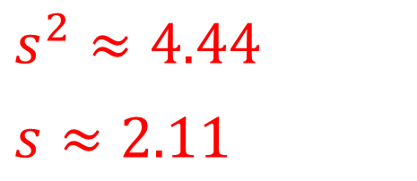
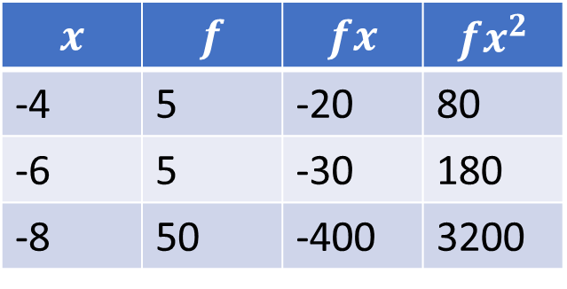
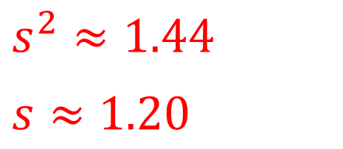
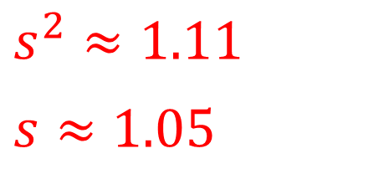
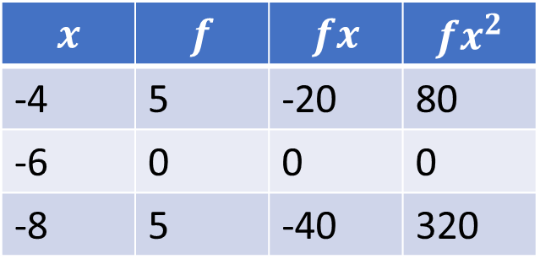
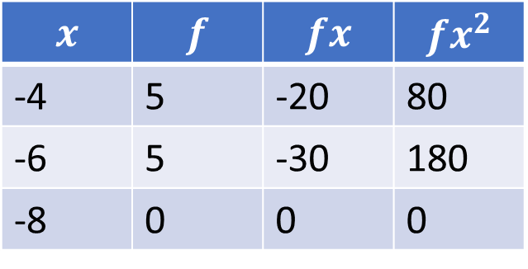
7.
$$x$$ | $$f$$ | $$fx$$ | $$fx^{2}$$
-4 | 5 | -20 | 80
-6 | 5 | -30 | 180
-8 | 50 | -400 | 3200
$s^{2}≈1.44$
$s≈1.20$
8.
$$x$$ | $$f$$ | $$fx$$ | $$fx^{2}$$
-4 | 5 | -20 | 80
-6 | 5 | -30 | 180
-8 | 0 | 0 | 0
$s^{2}≈1.11$
$s≈1.05$
9.
$$x$$ | $$f$$ | $$fx$$ | $$fx^{2}$$
-4 | 5 | -20 | 80
-6 | 0 | 0 | 0
-8 | 5 | -40 | 320
$s^{2}≈4.44$
$s≈2.11$
@Mr Mansbridge

