Slide 1
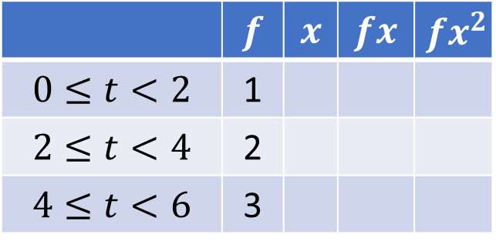
Standard Deviation From Grouped Frequency Tables
Silent
Teacher
Intelligent Practice
Narration
Your Turn
 | $$f$$ | $$x$$ | $$fx$$ | $$fx^{2}$$
$$0≤t<2$$ | 1
$$2≤t<4$$ | 2
$$4≤t<6$$ | 3
Practice

Slide 2

$$n≔\sum{f}$$
$$\overline{x}≔\frac{1}{n}\sum{fx}$$
$$s^{2}≔\frac{\sum{fx^{2}}−n{\overline{x}}^{2}}{n−1}$$
@Mr Mansbridge

Slide 3
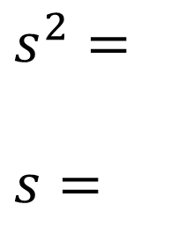
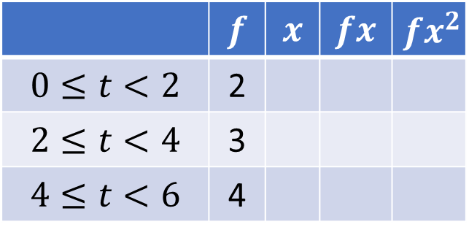
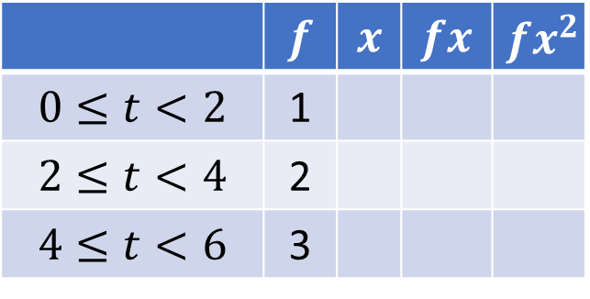
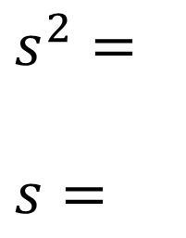
Worked Example
Your Turn
Estimate the sample variance and standard deviation of:
Estimate the sample variance and standard deviation of:
 | $$f$$ | $$x$$ | $$fx$$ | $$fx^{2}$$
$$0≤t<2$$ | 1
$$2≤t<4$$ | 2
$$4≤t<6$$ | 3
 | $$f$$ | $$x$$ | $$fx$$ | $$fx^{2}$$
$$0≤t<2$$ | 2
$$2≤t<4$$ | 3
$$4≤t<6$$ | 4
$s^{2}=$
$s=$
$s^{2}=$
$s=$
@Mr Mansbridge

Slide 4
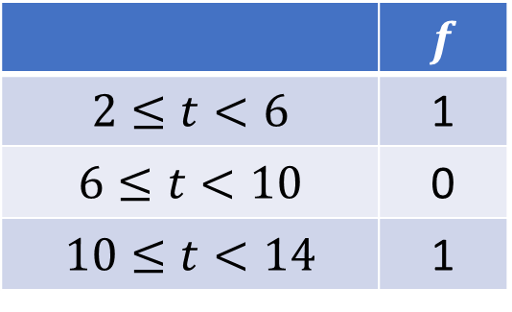
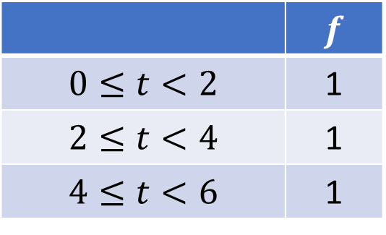
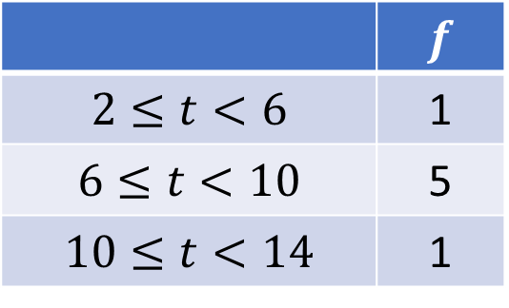
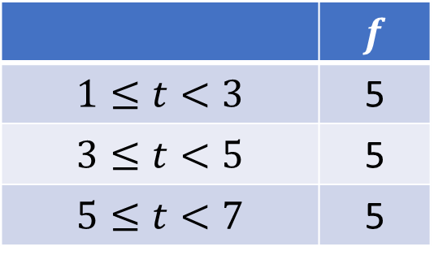
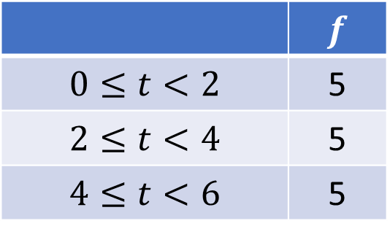
1.
 | $$f$$
$$0≤t<2$$ | 1
$$2≤t<4$$ | 1
$$4≤t<6$$ | 1
4.
 | $$f$$
$$2≤t<6$$ | 5
$$6≤t<10$$ | 5
$$10≤t<14$$ | 5
2.
 | $$f$$
$$0≤t<2$$ | 5
$$2≤t<4$$ | 5
$$4≤t<6$$ | 5
5.
 | $$f$$
$$2≤t<6$$ | 1
$$6≤t<10$$ | 5
$$10≤t<14$$ | 1
3.
 | $$f$$
$$1≤t<3$$ | 5
$$3≤t<5$$ | 5
$$5≤t<7$$ | 5
6.
 | $$f$$
$$2≤t<6$$ | 1
$$6≤t<10$$ | 0
$$10≤t<14$$ | 1
@Mr Mansbridge

Slide 5
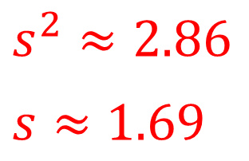
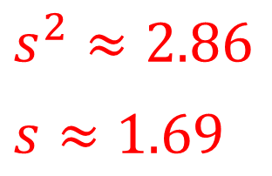
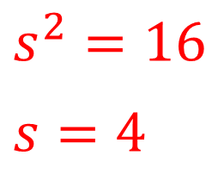
1.
 | $$f$$ | $$x$$ | $$fx$$ | $$fx^{2}$$
$$0≤t<2$$ | 1 | 1 | 1 | 1
$$2≤t<4$$ | 1 | 3 | 3 | 9
$$4≤t<6$$ | 1 | 5 | 5 | 25
$s^{2}=16$
$s=4$
2.
 | $$f$$ | $$x$$ | $$fx$$ | $$fx^{2}$$
$$0≤t<2$$ | 5 | 1 | 5 | 5
$$2≤t<4$$ | 5 | 3 | 15 | 45
$$4≤t<6$$ | 5 | 5 | 25 | 125
$s^{2}≈2.86$
$s≈1.69$
3.
 | $$f$$ | $$x$$ | $$fx$$ | $$fx^{2}$$
$$1≤t<3$$ | 5 | 2 | 10 | 20
$$3≤t<5$$ | 5 | 4 | 20 | 80
$$5≤t<7$$ | 5 | 6 | 30 | 180
$s^{2}≈2.86$
$s≈1.69$
@Mr Mansbridge

Slide 6
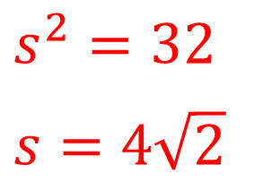
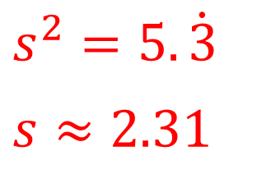
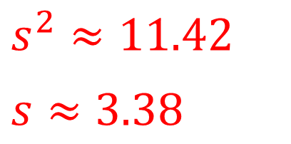
4.
 | $$f$$ | $$x$$ | $$fx$$ | $$fx^{2}$$
$$2≤t<6$$ | 5 | 4 | 20 | 80
$$6≤t<10$$ | 5 | 8 | 40 | 320
$$10≤t<14$$ | 5 | 12 | 60 | 720
$s^{2}≈11.42$
$s≈3.38$
5.
 | $$f$$ | $$x$$ | $$fx$$ | $$fx^{2}$$
$$2≤t<6$$ | 1 | 4 | 4 | 16
$$6≤t<10$$ | 5 | 8 | 40 | 320
$$10≤t<14$$ | 1 | 12 | 12 | 144
$s^{2}=5.\dot{3}$
$s≈2.31$
6.
 | $$f$$ | $$x$$ | $$fx$$ | $$fx^{2}$$
$$2≤t<6$$ | 1 | 4 | 4 | 16
$$6≤t<10$$ | 0 | 8 | 0 | 0
$$10≤t<14$$ | 1 | 12 | 12 | 144
$s^{2}=32$
$s=4\sqrt{2}$
@Mr Mansbridge

