Slide 1

Direct / Inverse Proportion (x and y)
Silent
Teacher
Intelligent Practice
Narration
Your Turn
$y \text{∝}$ x → y = kx
$y \text{∝}$ x² → y = kx²
$y \text{∝}$ 1/x → y = k/x
Practice
@engmohamedosama

Slide 2
Worked Example
Your Turn
$\text{Write} \text{a} \text{Formula} \text{for}$:
$\text{Write} \text{a} \text{Formula} \text{for}$:
$y \text{is} \text{porportional} \text{to}$ x
y$\text{is} \text{porportional} \text{to}$ x
y$\text{is} \text{inversly} \text{porportional} \text{to}$ x
$y \text{is} \text{inversly} \text{porportional} \text{to}$ x
$$x=2 y=4$$
$x=4 y=$8
@engmohamedosama

Slide 3
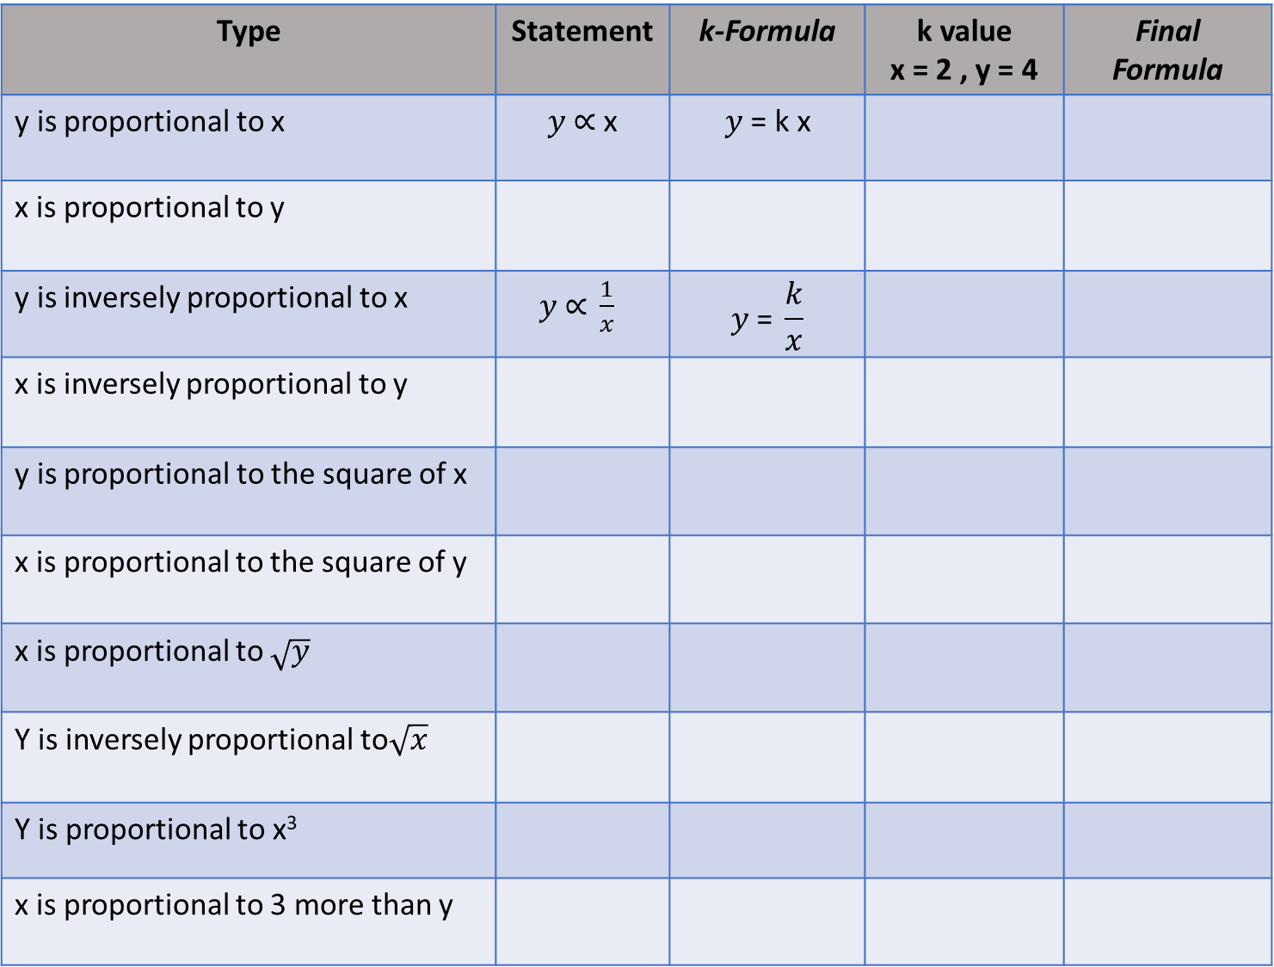
Type | Statement | k-Formula | k value x = 2 , y = 4 | Final Formula
y is proportional to x | $y \text{∝}$ x | $$y \text{=} \text{k} \text{x}$$
x is proportional to y
y is inversely proportional to x | $y \text{∝} \frac{1}{x}$ | $$y \text{=} \frac{k}{x}$$
x is inversely proportional to y
y is proportional to the square of x
x is proportional to the square of y
x is proportional to $\sqrt{y}$
Y is inversely proportional to$\sqrt{x}$
Y is proportional to x³
x is proportional to 3 more than y
Notes:
Extension:
1- Using the formula, Find y, when x = …..
2- Sketch the final Formula

Slide 4
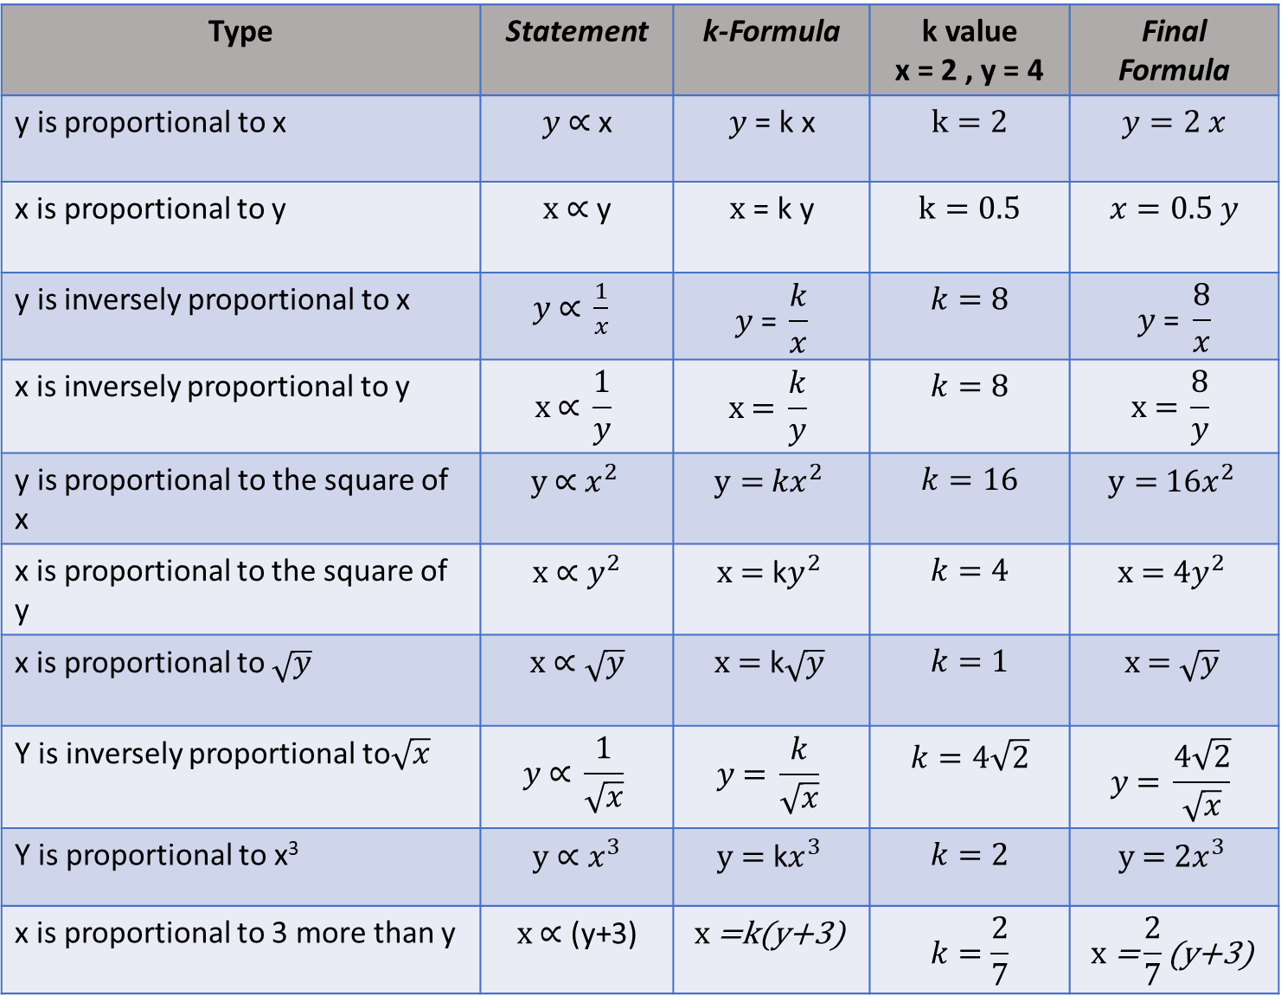
Type | Statement | k-Formula | k value x = 2 , y = 4 | Final Formula
y is proportional to x | $y \text{∝}$ x | $$y \text{=} \text{k} \text{x}$$ | $$k=2$$ | $$y=2 x$$
x is proportional to y | $x \text{∝}$ y | $$x \text{=} \text{k} \text{y}$$ | $$k=0.5$$ | $$x=0.5 y$$
y is inversely proportional to x | $y \text{∝} \frac{1}{x}$ | $$y \text{=} \frac{k}{x}$$ | $$k=8$$ | $$y \text{=} \frac{8}{x}$$
x is inversely proportional to y | $$x \text{∝} \frac{1}{y}$$ | $$x \text{=} \frac{k}{y}$$ | $$k=8$$ | $$x \text{=} \frac{8}{y}$$
y is proportional to the square of x | $$y \text{∝}{ x}^{2}$$ | $$y={ kx}^{2}$$ | $$k=16$$ | $$y={ 16x}^{2}$$
x is proportional to the square of y | $$x \text{∝} y^{2}$$ | $$x \text{=} \text{k}y^{2}$$ | $$k=4$$ | $$x \text{=} {4y}^{2}$$
x is proportional to $\sqrt{y}$ | $$x \text{∝} \sqrt{y}$$ | $$x \text{=} \text{k}\sqrt{y}$$ | $$k=1$$ | $$x \text{=} \sqrt{y}$$
Y is inversely proportional to$\sqrt{x}$ | $$y \text{∝} \frac{1}{\sqrt{x}}$$ | $$y \text{=} \frac{k}{\sqrt{x}}$$ | $$k=4\sqrt{2}$$ | $$y \text{=} \frac{4\sqrt{2}}{\sqrt{x}}$$
Y is proportional to x³ | $$y \text{∝} x^{3}$$ | $$y \text{=} \text{k}x^{3}$$ | $$k=2$$ | $$y \text{=} 2x^{3}$$
x is proportional to 3 more than y | $$x \text{∝}\text{ (}\text{y}\text{+3)}$$ | $$x \text{=}\text{k}\text{(}\text{y}\text{+3)}$$ | $$k=\frac{2}{7}$$ | $$x \text{=}\frac{2}{7}\text{(}\text{y}\text{+3)}$$
Notes:
Extension:
1- Using the formula, Find y, when x = …..
2- Sketch the final Formula

