Slide 1
Enlargement (inc. fractional & negative)
Silent
Teacher
Intelligent Practice
Narration
Your Turn
Scale factor $3$, centre $(3, 6)$
Scale factor $\frac{1}{2}$, centre $(−2, 1)$
Scale factor $−2$, centre $(4, 0)$
Practice

Slide 2
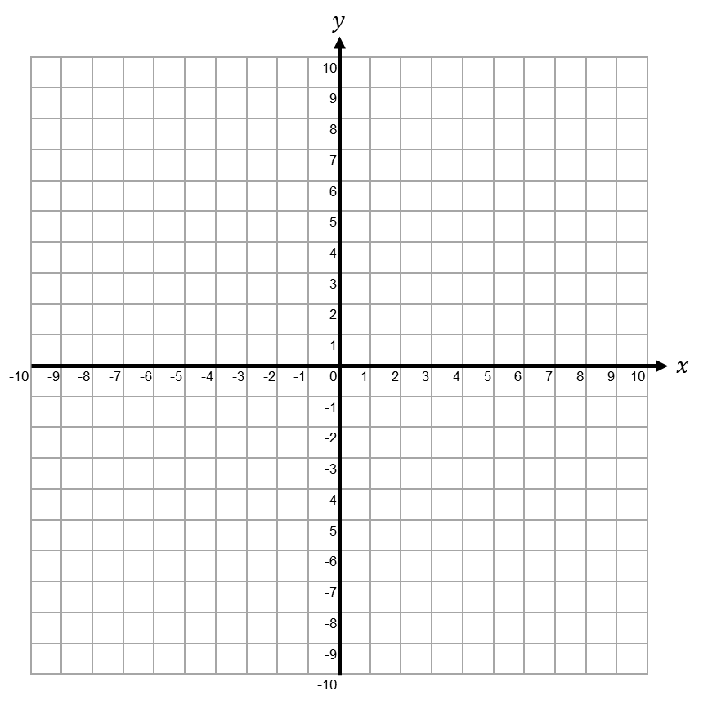
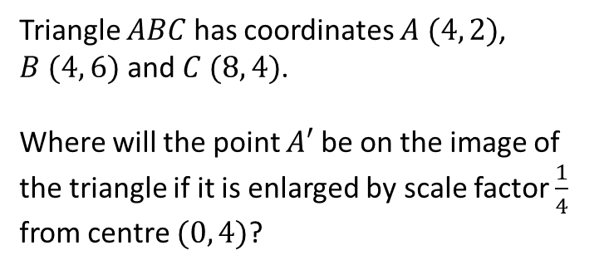
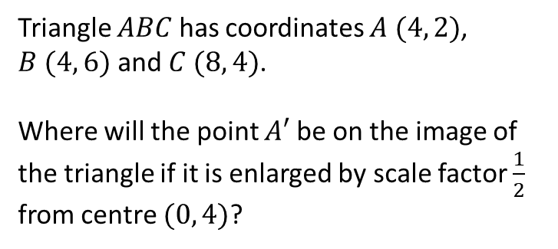
Worked Example
Your Turn
Triangle $ABC$ has coordinates $A (4, 2)$, $B (4, 6)$ and $C (8, 4)$.
Where will the point $A′$ be on the image of the triangle if it is enlarged by scale factor $\frac{1}{2}$ from centre $(0, 4)$?
Triangle $ABC$ has coordinates $A (4, 2)$, $B (4, 6)$ and $C (8, 4)$.
Where will the point $A′$ be on the image of the triangle if it is enlarged by scale factor $\frac{1}{4}$ from centre $(0, 4)$?
@PixiMaths

Slide 3
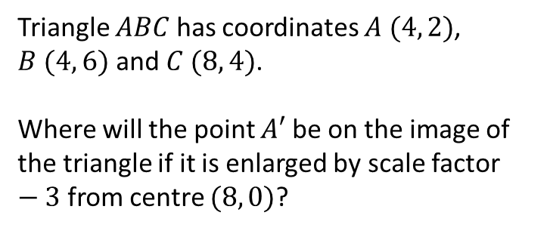
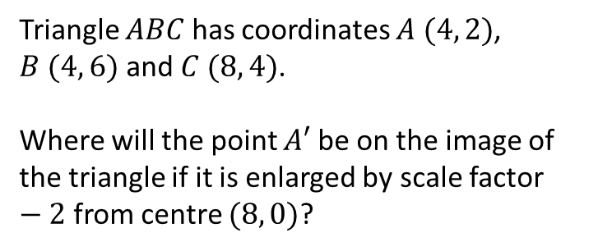
Worked Example
Your Turn
Triangle $ABC$ has coordinates $A (4, 2)$, $B (4, 6)$ and $C (8, 4)$.
Where will the point $A′$ be on the image of the triangle if it is enlarged by scale factor $−2$ from centre $(8, 0)$?
Triangle $ABC$ has coordinates $A (4, 2)$, $B (4, 6)$ and $C (8, 4)$.
Where will the point $A′$ be on the image of the triangle if it is enlarged by scale factor $−3$ from centre $(8, 0)$?
@PixiMaths

Slide 4
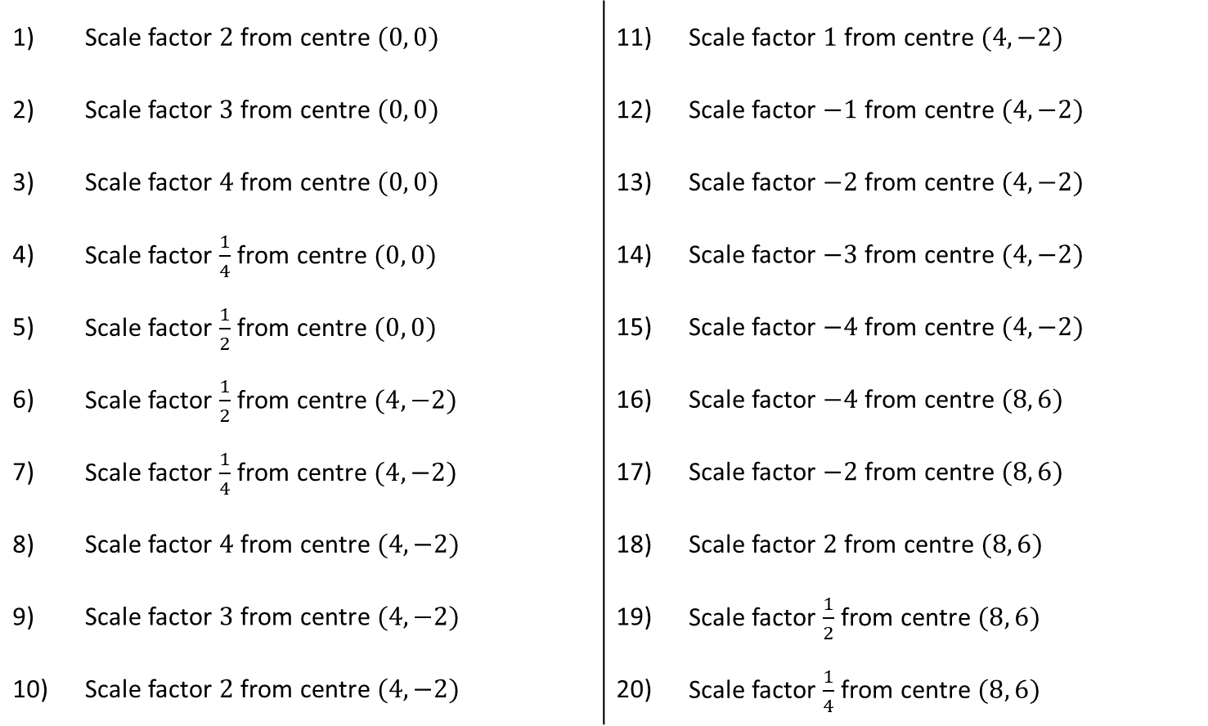
Triangle $ABC$ has coordinates $A (4, 2)$, $B (4, 6)$ and $C (8, 4)$.
Where will the point $A′$ be on the image of the triangle if it is enlarged by:
1) | Scale factor $2$ from centre $(0, 0)$ |  | 11) | Scale factor $1$ from centre $(4, −2)$
2) | Scale factor $3$ from centre $(0, 0)$ |  | 12) | Scale factor $−1$ from centre $(4, −2)$
3) | Scale factor $4$ from centre $(0, 0)$ |  | 13) | Scale factor $−2$ from centre $(4, −2)$
4) | Scale factor $\frac{1}{4}$ from centre $(0, 0)$ |  | 14) | Scale factor $−3$ from centre $(4, −2)$
5) | Scale factor $\frac{1}{2}$ from centre $(0, 0)$ |  | 15) | Scale factor $−4$ from centre $(4, −2)$
6) | Scale factor $\frac{1}{2}$ from centre $(4, −2)$ |  | 16) | Scale factor $−4$ from centre $(8, 6)$
7) | Scale factor $\frac{1}{4}$ from centre $(4, −2)$ |  | 17) | Scale factor $−2$ from centre $(8, 6)$
8) | Scale factor $4$ from centre $(4, −2)$ |  | 18) | Scale factor $2$ from centre $(8, 6)$
9) | Scale factor $3$ from centre $(4, −2)$ |  | 19) | Scale factor $\frac{1}{2}$ from centre $(8, 6)$
10) | Scale factor $2$ from centre $(4, −2)$ |  | 20) | Scale factor $\frac{1}{4}$ from centre $(8, 6)$
@PixiMaths

Slide 5
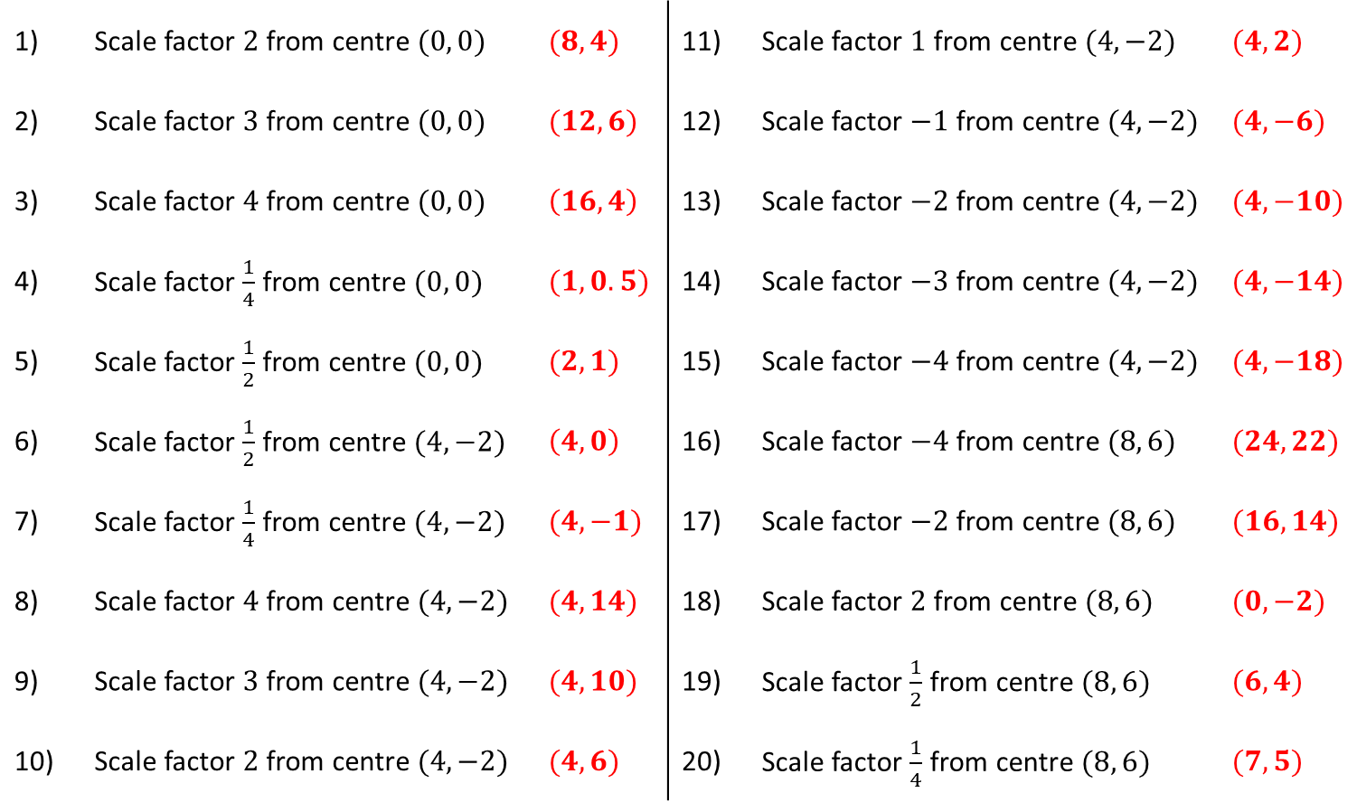
Triangle $ABC$ has coordinates $A (4, 2)$, $B (4, 6)$ and $C (8, 4)$.
Where will the point $A′$ be on the image of the triangle if it is enlarged by:
1) | Scale factor $2$ from centre $(0, 0)$ | $(8, 4)$ | 11) | Scale factor $1$ from centre $(4, −2)$ | $(4,2)$
2) | Scale factor $3$ from centre $(0, 0)$ | $(12, 6)$ | 12) | Scale factor $−1$ from centre $(4, −2)$ | $(4, −6)$
3) | Scale factor $4$ from centre $(0, 0)$ | $\left(16, 4\right)$ | 13) | Scale factor $−2$ from centre $(4, −2)$ | $(4, −10)$
4) | Scale factor $\frac{1}{4}$ from centre $(0, 0)$ | $(1, 0.5)$ | 14) | Scale factor $−3$ from centre $(4, −2)$ | $(4, −14)$
5) | Scale factor $\frac{1}{2}$ from centre $(0, 0)$ | $(2, 1)$ | 15) | Scale factor $−4$ from centre $(4, −2)$ | $(4, −18)$
6) | Scale factor $\frac{1}{2}$ from centre $(4, −2)$ | $\left(4, 0\right)$ | 16) | Scale factor $−4$ from centre $(8, 6)$ | $(24, 22)$
7) | Scale factor $\frac{1}{4}$ from centre $(4, −2)$ | $(4, −1)$ | 17) | Scale factor $−2$ from centre $(8, 6)$ | $(16, 14)$
8) | Scale factor $4$ from centre $(4, −2)$ | $(4, 14)$ | 18) | Scale factor $2$ from centre $(8, 6)$ | $(0, −2)$
9) | Scale factor $3$ from centre $(4, −2)$ | $(4, 10)$ | 19) | Scale factor $\frac{1}{2}$ from centre $(8, 6)$ | $(6, 4)$
10) | Scale factor $2$ from centre $(4, −2)$ | $(4, 6)$ | 20) | Scale factor $\frac{1}{4}$ from centre $(8, 6)$ | $(7, 5)$
@PixiMaths

