Slide 1
Worked Example
Your Turn
Find the length of the line segments between the given points. Give your answers as simplified surds:
Find the length of the line segments between the given points. Give your answers as simplified surds:
$$\left(1, 2\right) and (4, 6)$$
$$\left(1, 2\right) and (5, 5)$$
$$\left(−1, 13\right) and (4, 1)$$
$$\left(−5, 10\right) and (−13, 4)$$
$$\left(1, 2\right) and (3, 5)$$
$$\left(1, 2\right) and (−1, 5)$$

Slide 2
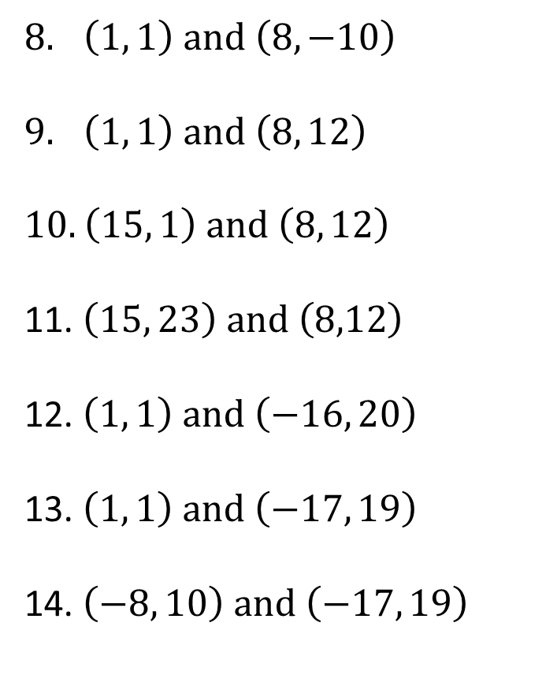
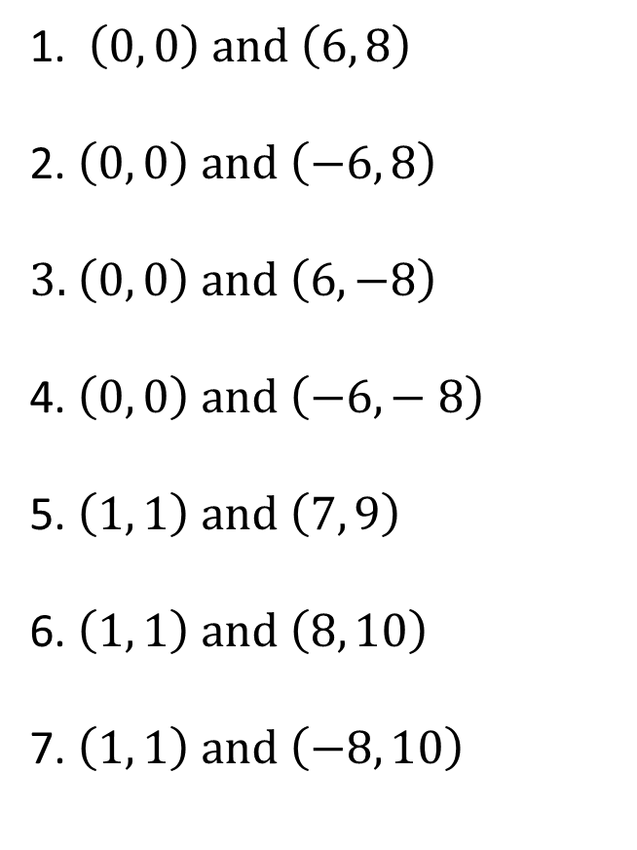
TASK:
Find the length of the line segments between the given points. Give your answers as simplified surds, where appropriate:
1. $\left(0, 0\right) and \left(6, 8\right)$
2. $\left(0, 0\right) and \left(−6, 8\right)$
3. $\left(0, 0\right) and \left(6, −8\right)$
4. $\left(0, 0\right) and \left(−6,− 8\right)$
5. $\left(1, 1\right) and \left(7, 9\right)$
6. $\left(1, 1\right) and \left(8, 10\right)$
7. $\left(1, 1\right) and \left(−8, 10\right)$
$\left(1, 1\right) and \left(8, −10\right)$
$\left(1, 1\right) and \left(8, 12\right)$
10. $\left(15, 1\right) and \left(8, 12\right)$
11. $\left(15, 23\right) and \left(8,12\right)$
12. $\left(1, 1\right) and \left(−16, 20\right)$
13. $\left(1, 1\right) and \left(−17, 19\right)$
14. $\left(−8, 10\right) and \left(−17, 19\right)$
EXTENSION:
Point A is at (1, 2). The distance between Point A and Point B is 10 units.
Find all the possible co-ordinates of Point B.

Slide 3
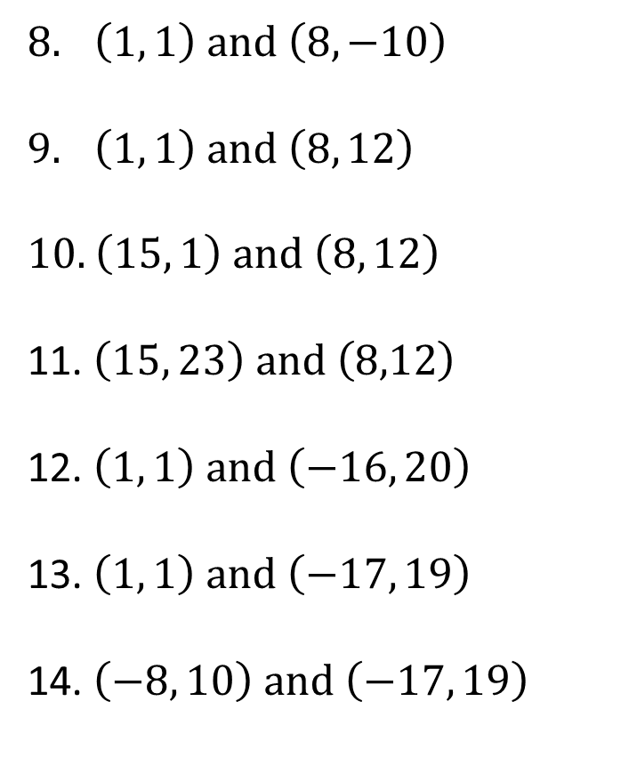
SOLUTIONS:
$$\sqrt{170}$$
$$\sqrt{170}$$
$$\sqrt{170}$$
$$\sqrt{170}$$
$$5\sqrt{26}$$
$$18\sqrt{2}$$
$$9\sqrt{2}$$
1. $\left(0, 0\right) and \left(6, 8\right)$
2. $\left(0, 0\right) and \left(−6, 8\right)$
3. $\left(0, 0\right) and \left(6, −8\right)$
4. $\left(0, 0\right) and \left(−6,− 8\right)$
5. $\left(1, 1\right) and \left(7, 9\right)$
6. $\left(1, 1\right) and \left(8, 10\right)$
7. $\left(1, 1\right) and \left(−8, 10\right)$
10
10
10
10
10
$$\sqrt{130}$$
$$9\sqrt{2}$$
$\left(1, 1\right) and \left(8, −10\right)$
$\left(1, 1\right) and \left(8, 12\right)$
10. $\left(15, 1\right) and \left(8, 12\right)$
11. $\left(15, 23\right) and \left(8,12\right)$
12. $\left(1, 1\right) and \left(−16, 20\right)$
13. $\left(1, 1\right) and \left(−17, 19\right)$
14. $\left(−8, 10\right) and \left(−17, 19\right)$

