Slide 1
Multiplying unit fractions
Silent
Teacher
Intelligent Practice
Narration
Your Turn
$$\frac{1}{2}×\frac{1}{5}=?$$
$$\frac{1}{5}×\frac{1}{2}=?$$
$$\frac{1}{5}×\frac{1}{3}=?$$
Practice

Slide 2
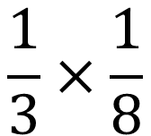
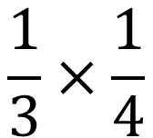
Worked Example
Your Turn
$$\frac{1}{3}×\frac{1}{4}$$
$$\frac{1}{3}×\frac{1}{8}$$
@missolivemaths

Slide 3


$\frac{1}{?}×\frac{1}{?}=\frac{1}{9}$
$\frac{1}{a}×\frac{1}{a}=?$
${\left(\frac{1}{a}\right)}^{2}=?$
${\left(\frac{1}{9}\right)}^{2}=?$
${\left(\frac{1}{?}\right)}^{2}=\frac{1}{4}$
$\frac{1}{3}×\frac{1}{4}×\frac{1}{5}=?$
$\frac{1}{3}×\frac{1}{?}×\frac{1}{5}=\frac{1}{90}$
$\frac{1}{3}×{\left(\frac{1}{5}\right)}^{2}=?$
$\frac{1}{3}×{\left(\frac{1}{b}\right)}^{2}=?$
$\frac{1}{y}×{\left(\frac{1}{b}\right)}^{2}=?$
$\frac{1}{2}×\frac{1}{5}=?$
$\frac{1}{5}×\frac{1}{2}=?$
$\frac{1}{5}×\frac{1}{3}=?$
$\frac{1}{5}×\frac{1}{4}=?$
$\frac{1}{2}×\frac{1}{4}=?$
$\frac{1}{1}×\frac{1}{8}=?$
$\frac{1}{3}×\frac{1}{8}=?$
$\frac{1}{3}×\frac{1}{?}=\frac{1}{12}$
$\frac{1}{6}×\frac{1}{?}=\frac{1}{12}$
$\frac{1}{3}×\frac{1}{?}=\frac{1}{6}$
@missolivemaths

Slide 4
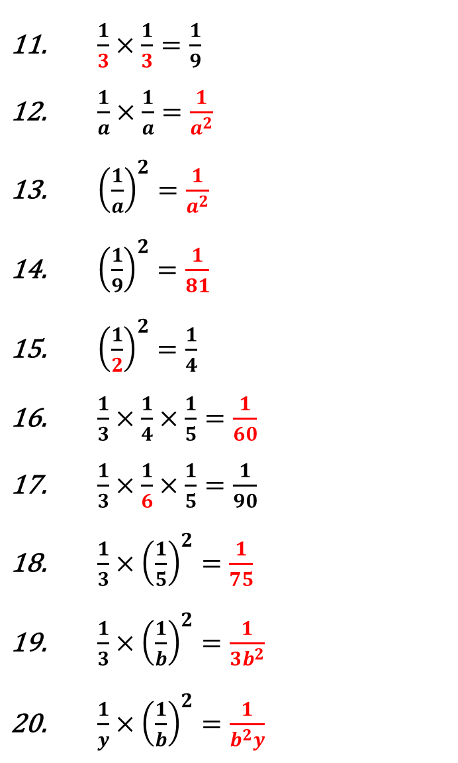
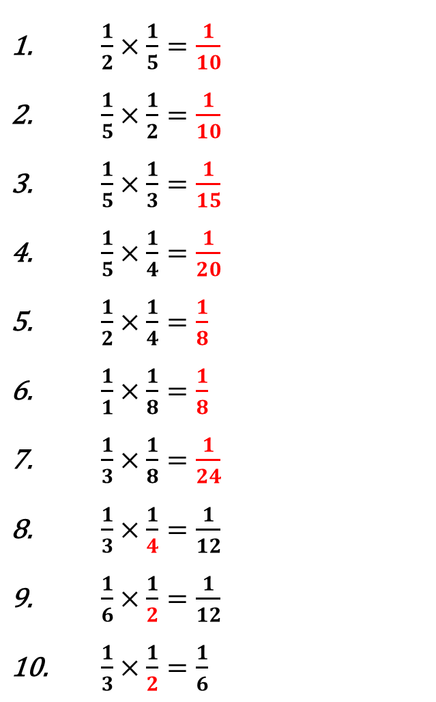
$\frac{1}{3}×\frac{1}{3}=\frac{1}{9}$
$\frac{1}{a}×\frac{1}{a}=\frac{1}{a^{2}}$
${\left(\frac{1}{a}\right)}^{2}=\frac{1}{a^{2}}$
${\left(\frac{1}{9}\right)}^{2}=\frac{1}{81}$
${\left(\frac{1}{2}\right)}^{2}=\frac{1}{4}$
$\frac{1}{3}×\frac{1}{4}×\frac{1}{5}=\frac{1}{60}$
$\frac{1}{3}×\frac{1}{6}×\frac{1}{5}=\frac{1}{90}$
$\frac{1}{3}×{\left(\frac{1}{5}\right)}^{2}=\frac{1}{75}$
$\frac{1}{3}×{\left(\frac{1}{b}\right)}^{2}=\frac{1}{3b^{2}}$
$\frac{1}{y}×{\left(\frac{1}{b}\right)}^{2}=\frac{1}{b^{2}y}$
$\frac{1}{2}×\frac{1}{5}=\frac{1}{10}$
$\frac{1}{5}×\frac{1}{2}=\frac{1}{10}$
$\frac{1}{5}×\frac{1}{3}=\frac{1}{15}$
$\frac{1}{5}×\frac{1}{4}=\frac{1}{20}$
$\frac{1}{2}×\frac{1}{4}=\frac{1}{8}$
$\frac{1}{1}×\frac{1}{8}=\frac{1}{8}$
$\frac{1}{3}×\frac{1}{8}=\frac{1}{24}$
$\frac{1}{3}×\frac{1}{4}=\frac{1}{12}$
$\frac{1}{6}×\frac{1}{2}=\frac{1}{12}$
$\frac{1}{3}×\frac{1}{2}=\frac{1}{6}$
@missolivemaths

