Slide 1
Adding and subtracting tenths and hundredths
Silent
Teacher
Intelligent Practice
Narration
Your Turn
$$\frac{4}{10}+ \frac{3}{10}=$$
$$0.4+ \frac{3}{10}=$$
$$0.4+ \frac{3}{100}=$$
Practice

Slide 2
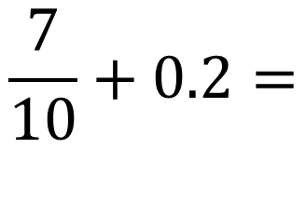
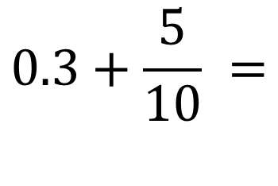
Worked Example
Your Turn
$$\frac{7}{10}+0.2=$$
$$0.3+\frac{5}{10} =$$
$$\frac{7}{100}+0.23+\frac{1}{10}=$$
$$\frac{9}{100}+0.35+\frac{4}{10}=$$
@MsSandsMaths
Notes:
Answers can be given as both decimals and fractions in terms of tenths or hundredths.

Slide 3

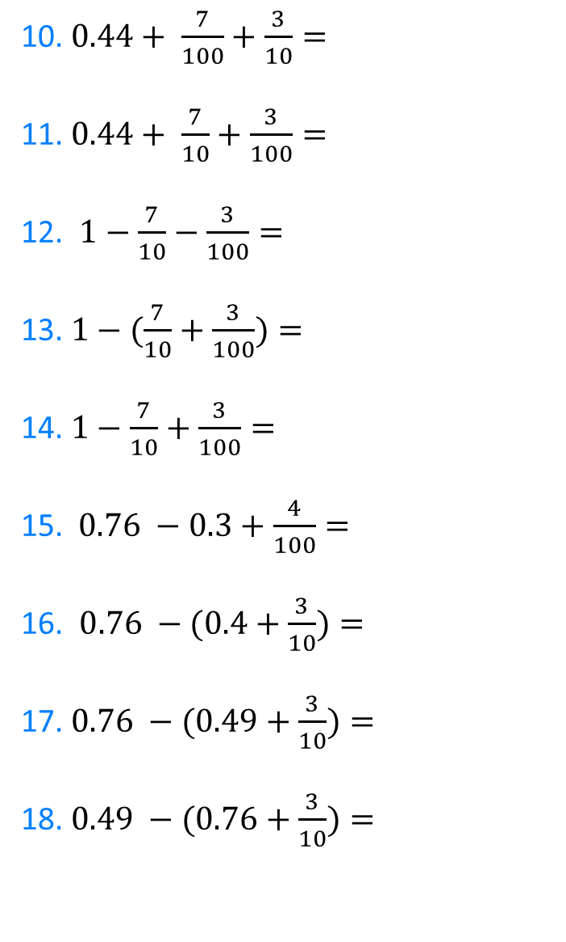
1. $\frac{4}{10}+ \frac{3}{10}=$
2. $0.4+ \frac{3}{10}=$
3.$0.4+ \frac{30}{100}=$
4.$0.4+ \frac{3}{100}=$
5. $0.04+ \frac{3}{100}=$
6.$0.04 − \frac{3}{100}=$
7. $\frac{40}{100} − \frac{3}{100}=$
8. $\frac{40}{100} −0.33=$
9. $\frac{ 4}{10} −\frac{33}{100}=$
10. $0.44+ \frac{7}{100}+\frac{3}{10}=$
11.$0.44+ \frac{7}{10}+\frac{3}{100}=$
12. $1−\frac{7}{10}−\frac{3}{100}=$
13. $1−(\frac{7}{10}+\frac{3}{100})=$
14. $1−\frac{7}{10}+\frac{3}{100}=$
15.$0.76 −0.3+\frac{4}{100}=$
16. $0.76 −(0.4+\frac{3}{10})=$
17. $0.76 −(0.49+\frac{3}{10})=$
18. $0.49 −(0.76+\frac{3}{10})=$
@MsSandsMaths

Slide 4
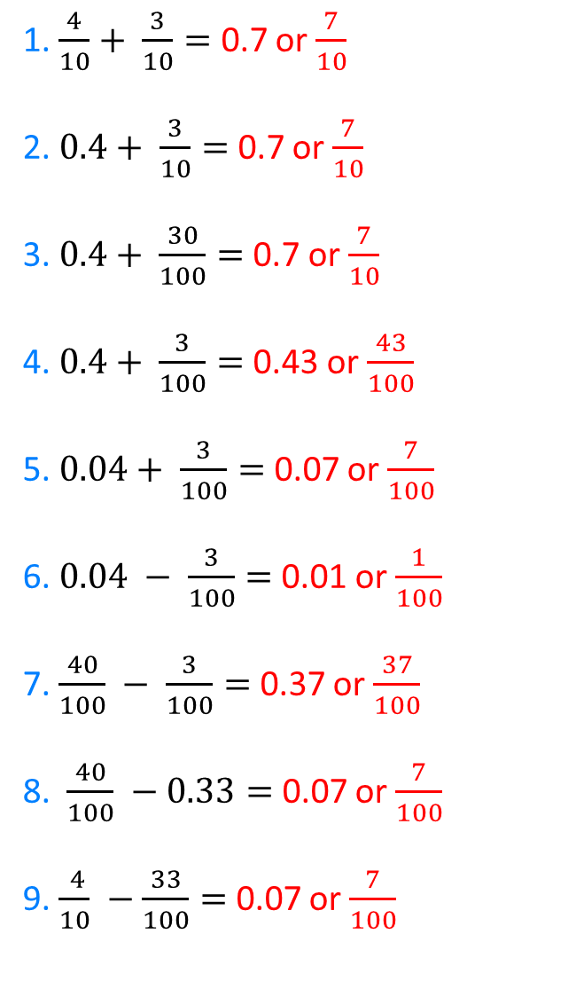
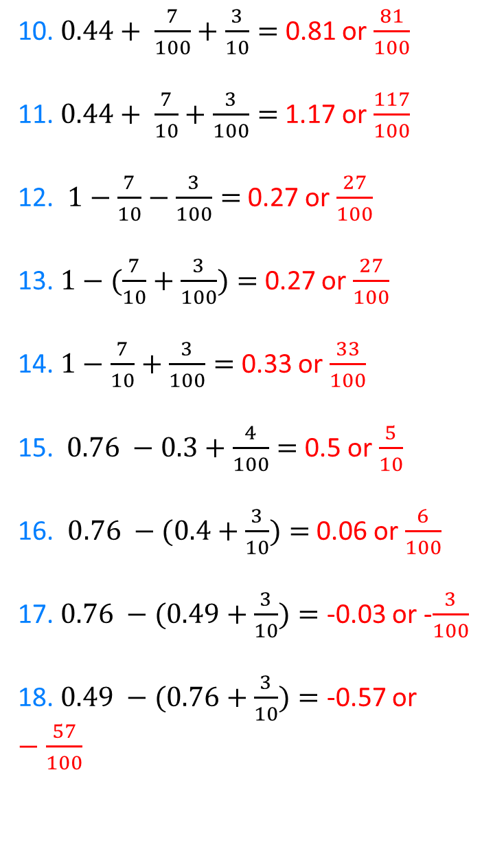
1. $\frac{4}{10}+ \frac{3}{10}=$ 0.7 or $\frac{7}{10}$
2. $0.4+ \frac{3}{10}=$ 0.7 or $\frac{7}{10}$
3.$0.4+ \frac{30}{100}=$ 0.7 or $\frac{7}{10}$
4.$0.4+ \frac{3}{100}=$ 0.43 or $\frac{43}{100}$
5. $0.04+ \frac{3}{100}=$ 0.07 or $\frac{7}{100}$
6.$0.04 − \frac{3}{100}=$ 0.01 or $\frac{1}{100}$
7. $\frac{40}{100} − \frac{3}{100}=$ 0.37 or $\frac{37}{100}$
8. $\frac{40}{100} −0.33=$ 0.07 or $\frac{7}{100}$
9. $\frac{ 4}{10} −\frac{33}{100}=$ 0.07 or $\frac{7}{100}$
10. $0.44+ \frac{7}{100}+\frac{3}{10}=$ 0.81 or $\frac{81}{100}$
11.$0.44+ \frac{7}{10}+\frac{3}{100}=$ 1.17 or $\frac{117}{100}$
12. $1−\frac{7}{10}−\frac{3}{100}=$ 0.27 or $\frac{27}{100}$
13. $1−(\frac{7}{10}+\frac{3}{100})=$ 0.27 or $\frac{27}{100}$
14. $1−\frac{7}{10}+\frac{3}{100}=$ 0.33 or $\frac{33}{100}$
15.$0.76 −0.3+\frac{4}{100}=$ 0.5 or $\frac{5}{10}$
16. $0.76 −(0.4+\frac{3}{10})=$ 0.06 or $\frac{6}{100}$
17. $0.76 −(0.49+\frac{3}{10})=$ -0.03 or -$\frac{3}{100}$
18. $0.49 −(0.76+\frac{3}{10})=$ -0.57 or $−\frac{57}{100}$
@MsSandsMaths

