Slide 1
Straight Line Graphs: Length between two points
Silent
Teacher
Intelligent Practice
Narration
Your Turn
$\left(4,−2\right)$ and $\left(0,0\right)$
$\left(5,−1\right)$ and $\left(1,1\right)$
$\left(10,−2\right)$ and $\left(2,2\right)$
Practice

Slide 2
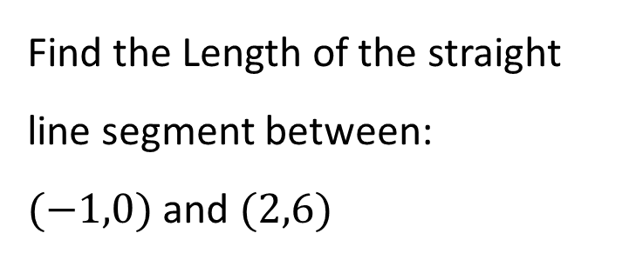
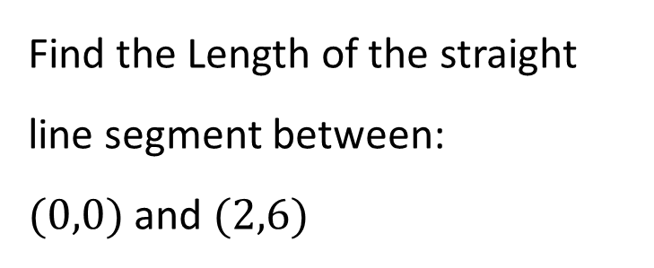
Worked Example
Your Turn
Find the Length of the straight line segment between:
$(0,0)$ and $(2,6)$
Find the Length of the straight line segment between:
$(−1,0)$ and $(2,6)$
@fortyninecubed
@mrladellstuart

Slide 3
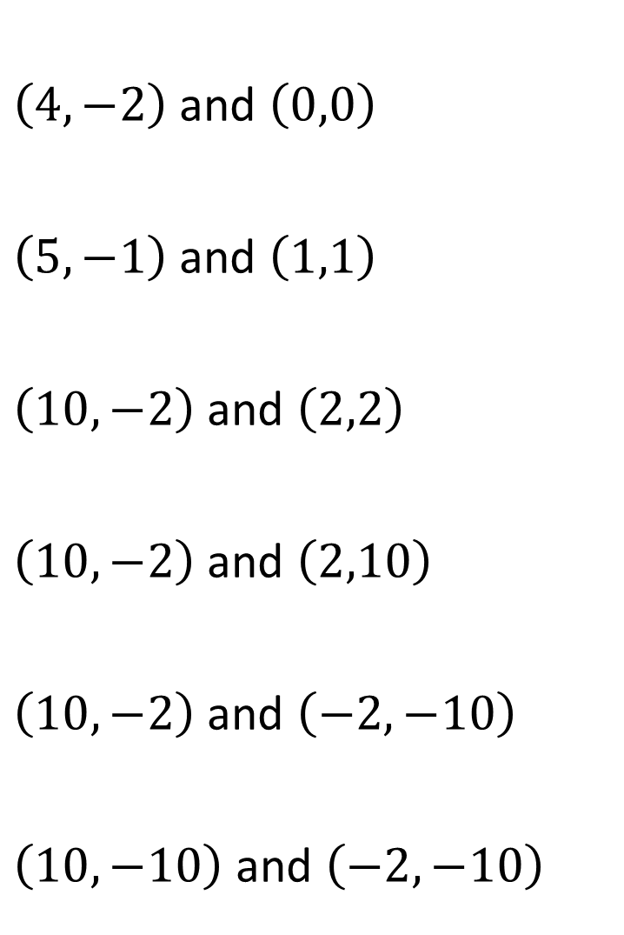
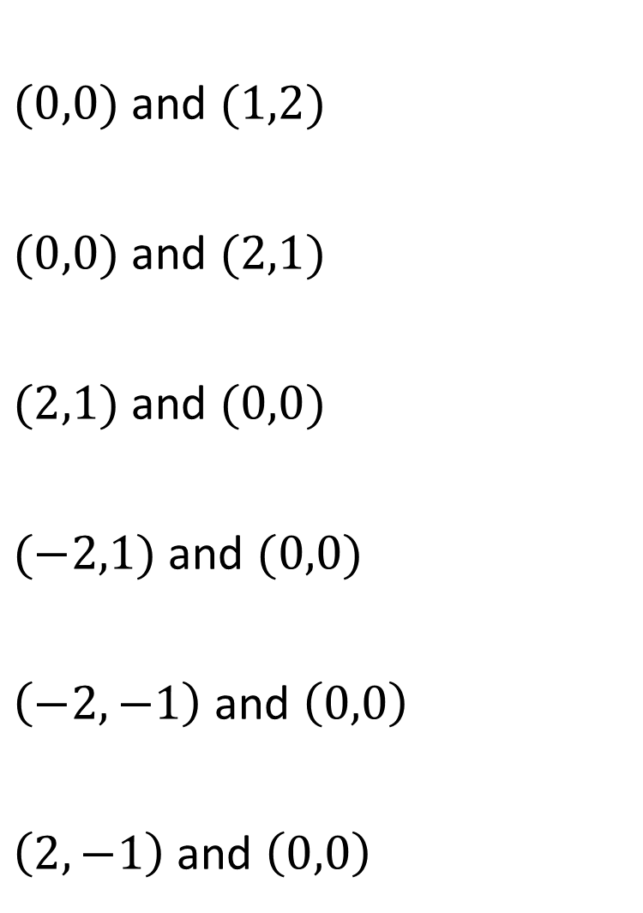
$(0,0)$ and $(1,2)$
$(0,0)$ and $(2,1)$
$(2,1)$ and $(0,0)$
$(−2,1)$ and $(0,0)$
$\left(−2,−1\right)$ and $\left(0,0\right)$
$\left(2,−1\right)$ and $\left(0,0\right)$
$\left(4,−2\right)$ and $\left(0,0\right)$
$\left(5,−1\right)$ and $\left(1,1\right)$
$\left(10,−2\right)$ and $\left(2,2\right)$
$\left(10,−2\right)$ and $\left(2,10\right)$
$\left(10,−2\right)$ and $\left(−2,−10\right)$
$\left(10,−10\right)$ and $\left(−2,−10\right)$
@fortyninecubed
@mrladellstuart

Slide 4



$(0,0)$ and $(1,2)$
$(0,0)$ and $(2,1)$
$(2,1)$ and $(0,0)$
$(−2,1)$ and $(0,0)$
$\left(−2,−1\right)$ and $\left(0,0\right)$
$\left(2,−1\right)$ and $\left(0,0\right)$
$\left(4,−2\right)$ and $\left(0,0\right)$
$\left(5,−1\right)$ and $\left(1,1\right)$
$\left(10,−2\right)$ and $\left(2,2\right)$
$\left(10,−2\right)$ and $\left(2,10\right)$
$\left(10,−2\right)$ and $\left(−2,−10\right)$
$\left(10,−10\right)$ and $\left(−2,−10\right)$
$$2\text{✓}5$$
$$2\text{✓}5$$
$$4\text{✓}5$$
4✓$13$
4✓$13$
12
✓$5$
$$\text{✓}5$$
✓$5$
$$\text{✓}5$$
✓$5$
✓$5$
@fortyninecubed
@mrladellstuart

