Slide 1
Simplifying Ratio 2
Silent
Teacher
Intelligent Practice
Narration
Your Turn
Simplify 7:14
Simplify 14:21
Simplify 14a:21a²
Practice

Slide 2
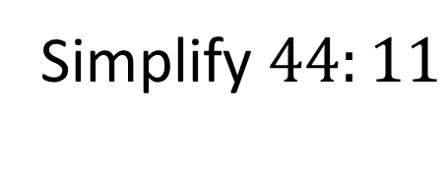
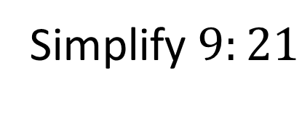
Worked Example
Your Turn
Simplify $9:21$
Simplify $44:11$
@RMS_maths

Slide 3


1. $10:15$
2. $15:10$
3. $150:100$
4. $6:18$
5. $4:12$
6. $24:8$
7. $80:240$
8. $0.8:2.4$
9. $21:35$
10. $3:5$
11. $3a:5a$
12. $3a:5a^{2}$
13. $6b:10b$
14. $6:10:12$
15. $12:10:6$
16. $10ml:12ml$
17. $45cm:50cm$
18. $45cm:0.5m$
19. $700ml:1L$
20. $7500m:3.5km$
@RMS_maths

Slide 4
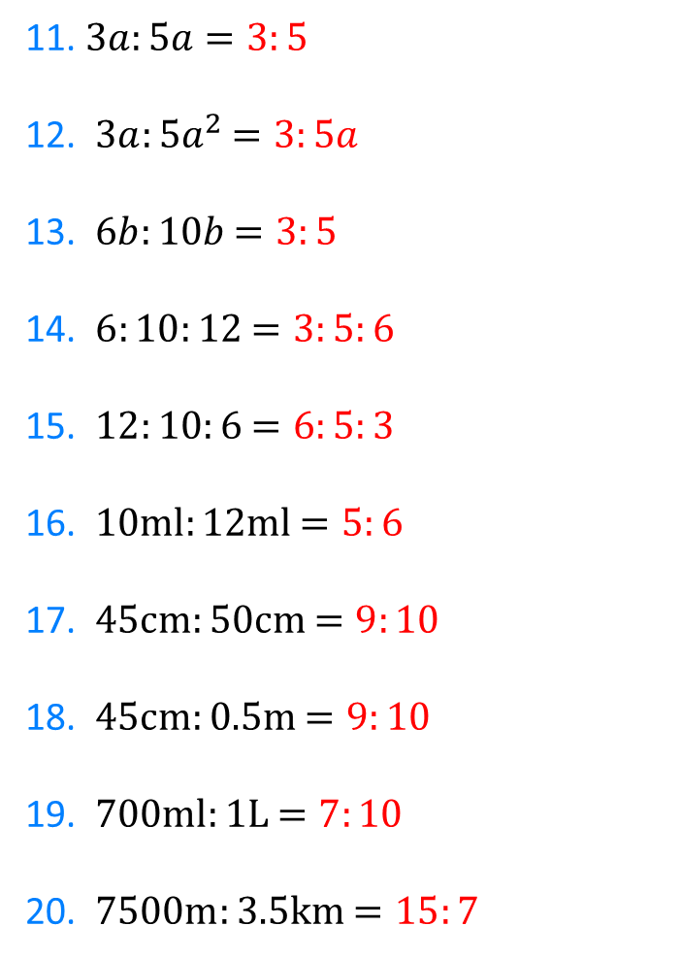

1. $10:15$ $=2:3$
2. $15:10$ $=3:2$
3. $150:100$ $=3:2$
4. $6:18$ $=1:3$
5. $4:12$ $=1:3$
6. $24:8$ $=3:1$
7. $80:240$ $=1:3$
8. $0.8:2.4$ $=1:3$
9. $21:35$ $=3:5$
10. $3:5$ $=3:5$
11. $3a:5a$ $=3:5$
12. $3a:5a^{2}$ $=3:5a$
13. $6b:10b$ $=3:5$
14. $6:10:12$ $=3:5:6$
15. $12:10:6$ $=6:5:3$
16. $10ml:12ml$ $=5:6$
17. $45cm:50cm$ $=9:10$
18. $45cm:0.5m$ $=9:10$
19. $700ml:1L$ $=7:10$
20. $7500m:3.5km$ $=15:7$
@RMS_maths

