Slide 1
Difference between Temperatures
Silent
Teacher
Intelligent Practice
Narration
Your Turn
Difference between $50C \& 100C$
Difference between -$50C \& 100C$
Difference between -$50C \& −100C$
Practice

Slide 2
Worked Example
Your Turn
Find the difference between 3⁰C and 10^{O}C Find the difference between -3⁰C and 10⁰C
Find the difference between 3⁰C and 5^{O}C
Find the difference between -3⁰C and 5^{O}C

Slide 3
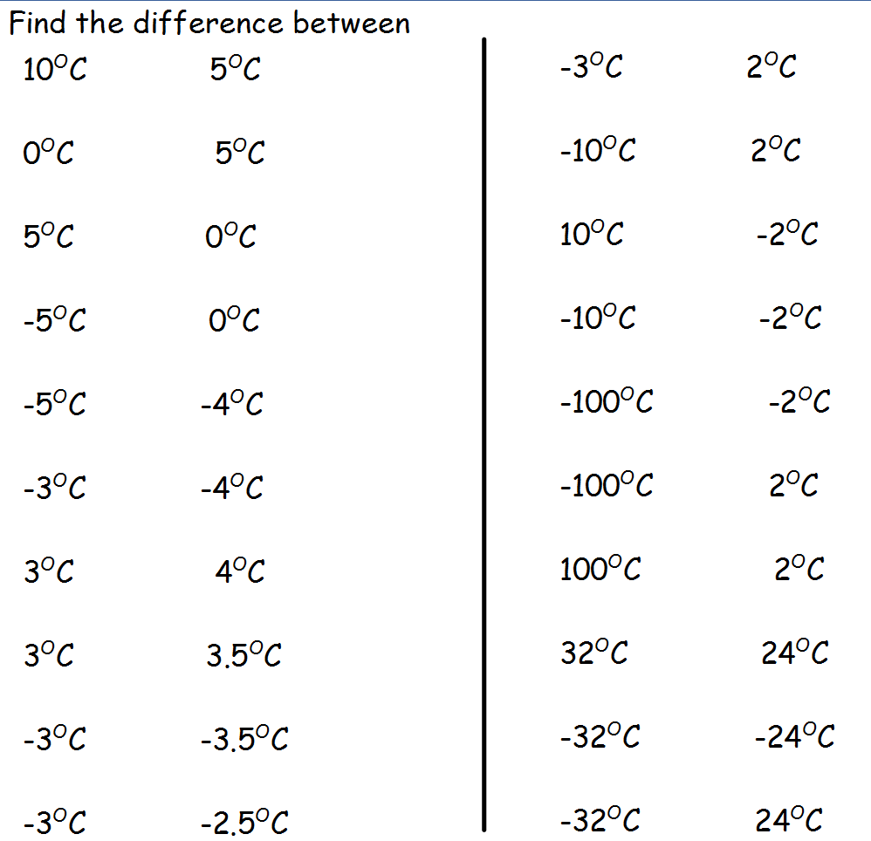

Slide 4
