Slide 1
Worked Example
Your Turn
$$y^{11}×y^{5}=$$
$$x^{5}×x^{−2}=$$
$${6y}^{3}×2y^{5}=$$
$${7x}^{5}×8x^{−3}=$$
$$y^{5}÷y^{4}=$$
$$y^{5}÷y^{2}=$$
$${15y}^{3}÷3y=$$
$${8y}^{3}÷2y=$$
$${{(y}^{3})}^{7}=$$
$${{(y}^{7})}^{8}=$$
$${{(3y}^{4})}^{2}=$$
$${{(5y}^{4})}^{3}=$$

Slide 2
1
$$y^{13}×y^{4}=$$
10
$${2x}^{7}×5x^{4}=$$
2
$${6y}^{13}×{5y}^{4}=$$
11
$${12y}^{5}×{5x}^{4}=$$
3
$$y^{13}÷y^{4}=$$
12
$${12y}^{5}÷6y^{4}=$$
4
$${40y}^{13}÷{8y}^{4}=$$
13
$${12y}^{5}÷{12y}^{−4}=$$
5
$${{(y}^{13})}^{4}=$$
14
$${{(12y}^{5})}^{2}=$$
6
$${{(3y}^{13})}^{4}=$$
15
$${{(12y}^{−3})}^{2}=$$
7
$${7y}^{4}÷y^{2}=$$
16
$$12y^{−3}÷{4y}^{2}=$$
8
$${7y}^{4}×y^{2}=$$
17
$${12y}^{−3}÷{4y}^{−2}=$$
9
$${{(7y}^{4})}^{2}=$$
18
$$12y^{−3}×4y^{−2}=$$

Slide 3
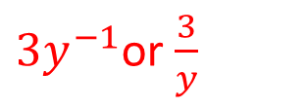
1
$$y^{13}×y^{4}=$$
$$y^{17}$$
10
$${2x}^{7}×5x^{4}=$$
$$10x^{11}$$
2
$${6y}^{13}×{5y}^{4}=$$
$${30y}^{17}$$
11
$${12y}^{5}×{5x}^{4}=$$
$$60{y^{5}x}^{4} or 60x^{4}y^{5}$$
3
$$y^{13}÷y^{4}=$$
$$y^{9}$$
12
$${12y}^{5}÷6y^{4}=$$
$$2y$$
4
$${40y}^{13}÷{8y}^{4}=$$
$${5y}^{9}$$
13
$${12y}^{5}÷{12y}^{−4}=$$
$$y^{9}$$
5
$${{(y}^{13})}^{4}=$$
$$y^{52}$$
14
$${{(12y}^{5})}^{2}=$$
$${144y}^{10}$$
6
$${{(3y}^{13})}^{4}=$$
$$81y^{52}$$
15
$${{(12y}^{−3})}^{2}=$$
$${144y}^{−6}$$
7
$${7y}^{4}÷y^{2}=$$
$$7y^{2}$$
16
$$12y^{−3}÷{4y}^{2}=$$
$${3y}^{−1}$$
8
$${7y}^{4}×y^{2}=$$
$$7y^{6}$$
17
$${12y}^{−3}÷{4y}^{−2}=$$
${3y}^{−1}$or $\frac{3}{y}$
9
$${{(7y}^{4})}^{2}=$$
$$49y^{8}$$
18
$$12y^{−3}×4y^{−2}=$$
$${48y}^{−5}$$

Slide 4
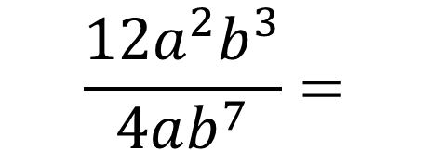
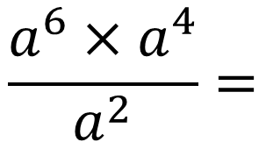
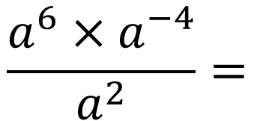
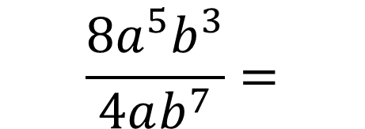
Worked Example
Your Turn
$$\frac{a^{6}×a^{4}}{a^{2}}=$$
$$\frac{a^{6}×a^{−4}}{a^{2}}=$$
$${\left(4a^{6}b^{3}\right)}^{2}=$$
$${\left(2a^{6}b^{3}\right)}^{4}=$$
$$\frac{8a^{5}b^{3}}{4ab^{7}}=$$
$$\frac{12a^{2}b^{3}}{4ab^{7}}=$$

Slide 5
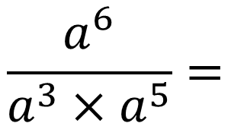
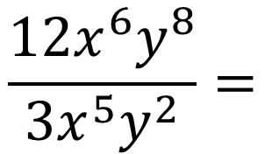
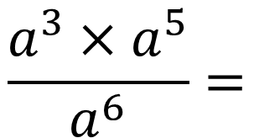
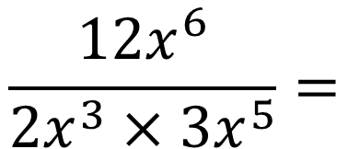
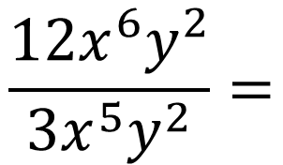
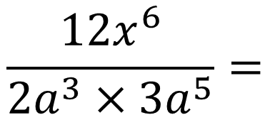
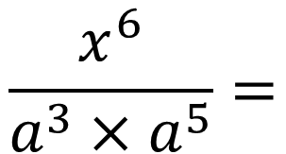
6
$$2x^{3}×3x^{5}=$$
$$\frac{a^{3}×a^{5}}{a^{6}}=$$
1
7
$$2x^{3}y^{2}×3x^{5}y^{2}=$$
$$\frac{a^{6}}{a^{3}×a^{5}}=$$
2
8
$$12x^{6}y^{2}×3x^{5}y^{2}=$$
$$\frac{x^{6}}{a^{3}×a^{5}}=$$
3
9
$$12x^{6}y^{2}÷3x^{5}y^{2}=$$
$$\frac{12x^{6}y^{2}}{3x^{5}y^{2}}=$$
$$\frac{{12x}^{6}}{{2a}^{3}×{3a}^{5}}=$$
10
4
$$\frac{12x^{6}y^{8}}{3x^{5}y^{2}}=$$
$$\frac{{12x}^{6}}{{2x}^{3}×{3x}^{5}}=$$
11
5

Slide 6
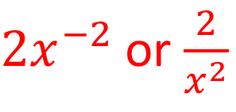
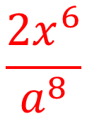
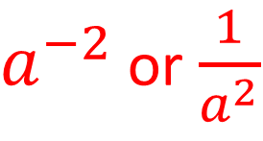
6
$$2x^{3}×3x^{5}=$$
$${6x}^{8}$$
$$\frac{a^{3}×a^{5}}{a^{6}}=$$
1
$$a^{2}$$
7
$$2x^{3}y^{2}×3x^{5}y^{2}=$$
$${6x}^{8}y^{4}$$
$$\frac{a^{6}}{a^{3}×a^{5}}=$$
2
$a^{−2}$ or $\frac{1}{a^{2}}$
8
$$12x^{6}y^{2}×3x^{5}y^{2}=$$
$${36x}^{11}y^{4}$$
$$\frac{x^{6}}{a^{3}×a^{5}}=$$
$$\frac{x^{6}}{a^{8}}$$
3
9
$$12x^{6}y^{2}÷3x^{5}y^{2}=$$
$$4x$$
$$\frac{12x^{6}y^{2}}{3x^{5}y^{2}}=$$
$$\frac{{12x}^{6}}{{2a}^{3}×{3a}^{5}}=$$
$$\frac{{2x}^{6}}{a^{8}}$$
10
$$4x$$
4
$$\frac{12x^{6}y^{8}}{3x^{5}y^{2}}=$$
$$\frac{{12x}^{6}}{{2x}^{3}×{3x}^{5}}=$$
11
$$4xy^{6}$$
5
$2x^{−2}$ or $\frac{2}{x^{2}}$

