Slide 1
Negative Temperatures
Silent
Teacher
Intelligent Practice
Narration
Your Turn
$$50C >or< 100C$$
$$50C >or< −100C$$
$$−50C >or< −100C$$
Practice

Slide 2
Worked Example
Your Turn

Slide 3
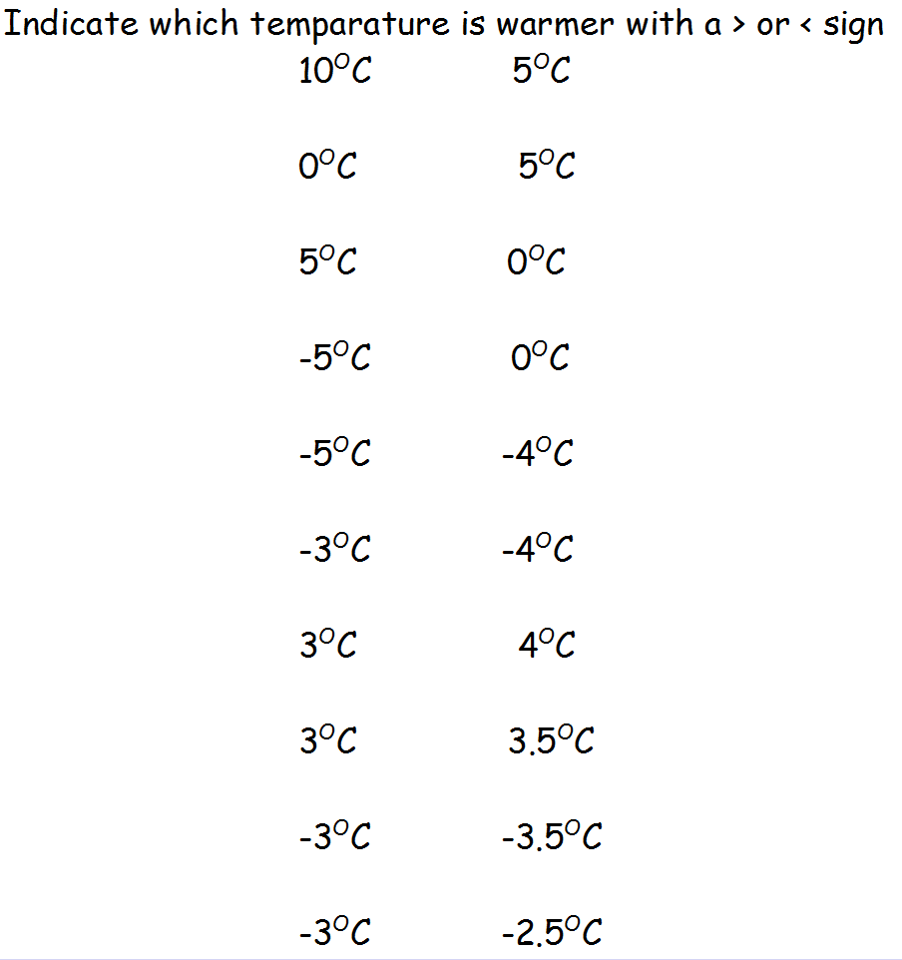

Slide 4
