Slide 1
Substitution (one letter)
Silent
Teacher
Intelligent Practice
Narration
Your Turn
3 + a =
3a =
Practice

Slide 2
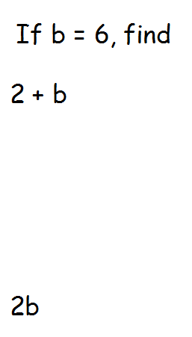
Worked Example
Your Turn

Slide 3
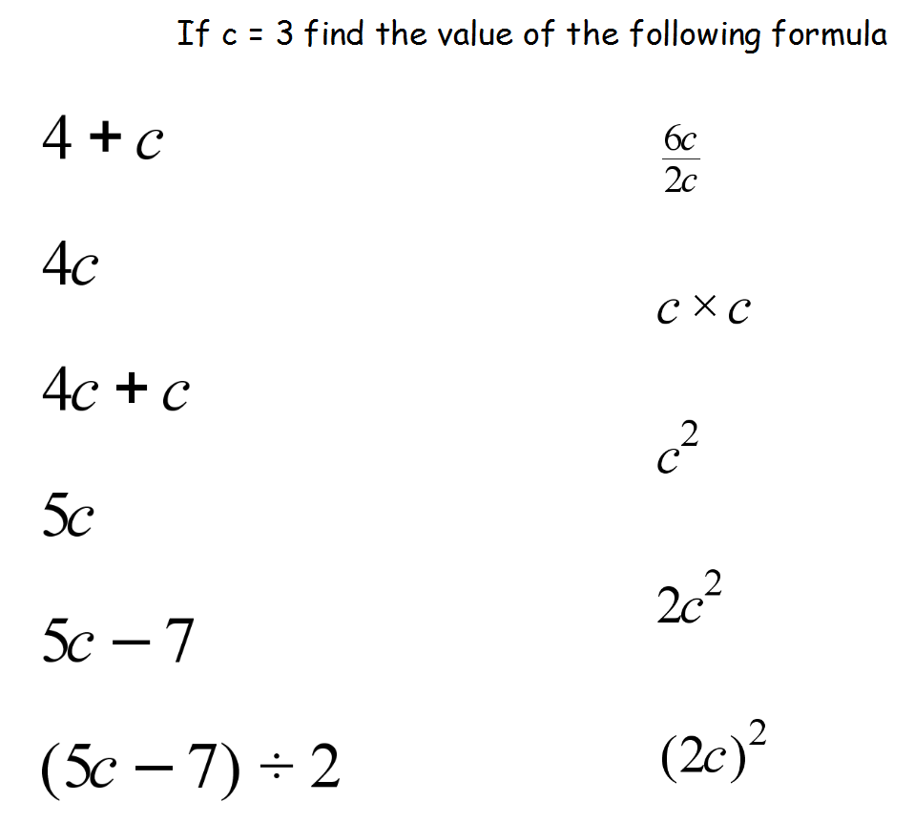

Slide 4
