Slide 1
Numerical probability on a probability line
Silent
Teacher
Intelligent Practice
Narration
Your Turn
How likely is a probability of 3/8
How likely is a probability of 4/8
How likely is a probability of 0/8
Practice

Slide 2
Worked Example
Your Turn

Slide 3
Worked Example
Your Turn

Slide 4
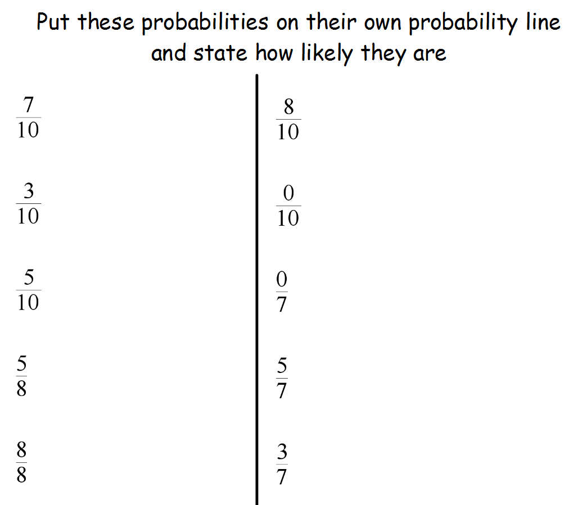

Slide 5
