Slide 1
Factorising by Grouping
Silent
Teacher
Intelligent Practice
Narration
Your Turn
$$x\left(x+1\right)+3\left(x+1\right)=$$
$$x^{2}+2x+3x+6=$$
Practice

Slide 2
Worked Example
Your Turn
Factorise
$$x\left(x+1\right)−3(x+1)$$
Factorise
$$2x\left(x+1\right)−3\left(x+1\right)$$
@mrbansalmaths

Slide 3
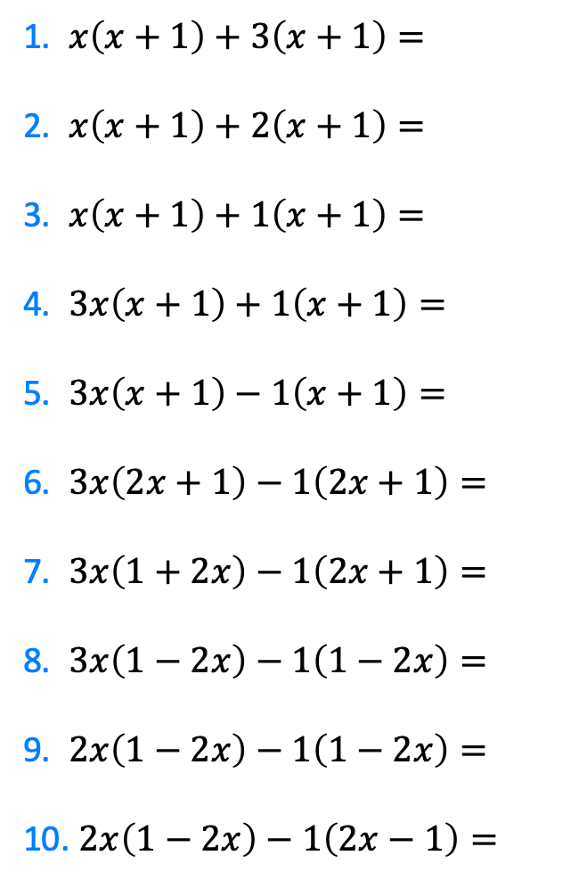
1. $x\left(x+1\right)+3\left(x+1\right)=$
2. $x\left(x+1\right)+2\left(x+1\right)=$
3. $x\left(x+1\right)+1\left(x+1\right)=$
4. $3x\left(x+1\right)+1\left(x+1\right)=$
5. $3x\left(x+1\right)−1\left(x+1\right)=$
6. $3x\left(2x+1\right)−1\left(2x+1\right)=$
7. $3x\left(1+2x\right)−1\left(2x+1\right)=$
8. $3x\left(1−2x\right)−1\left(1−2x\right)=$
9. $2x\left(1−2x\right)−1\left(1−2x\right)=$
10. $2x\left(1−2x\right)−1\left(2x−1\right)=$
@mrbansalmaths

Slide 4
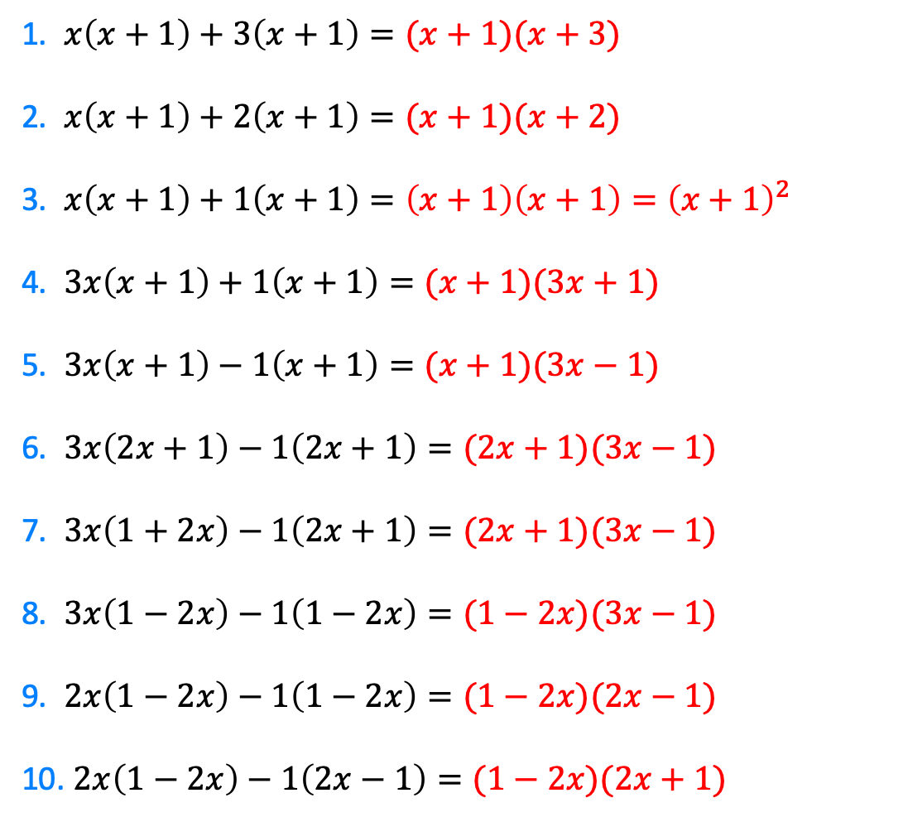
1. $x\left(x+1\right)+3\left(x+1\right)=(x+1)(x+3)$
2. $x\left(x+1\right)+2\left(x+1\right)=(x+1)(x+2)$
3. $x\left(x+1\right)+1\left(x+1\right)=\left(x+1\right)\left(x+1\right)={\left(x+1\right)}^{2}$
4. $3x\left(x+1\right)+1\left(x+1\right)=(x+1)(3x+1)$
5. $3x\left(x+1\right)−1\left(x+1\right)=(x+1)(3x−1)$
6. $3x\left(2x+1\right)−1\left(2x+1\right)=(2x+1)(3x−1)$
7. $3x\left(1+2x\right)−1\left(2x+1\right)=(2x+1)(3x−1)$
8. $3x\left(1−2x\right)−1\left(1−2x\right)=(1−2x)(3x−1)$
9. $2x\left(1−2x\right)−1\left(1−2x\right)=(1−2x)(2x−1)$
10. $2x\left(1−2x\right)−1\left(2x−1\right)=(1−2x)(2x+1)$
@mrbansalmaths

Slide 5
Worked Example
Your Turn
Factorise
$$2x^{2}+2x−3x−3$$
Factorise
$$2x^{2}−2x−3x+3$$
@mrbansalmaths

Slide 6
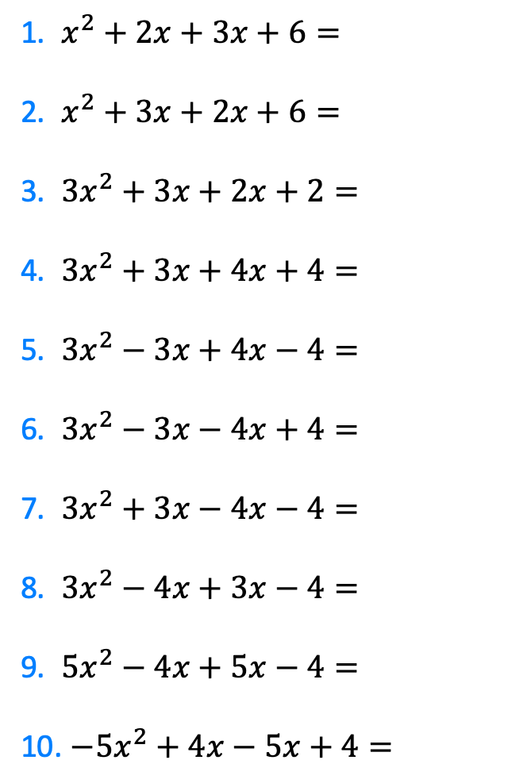
1. $x^{2}+2x+3x+6=$
2. $x^{2}+3x+2x+6=$
3. $3x^{2}+3x+2x+2=$
4. $3x^{2}+3x+4x+4=$
5. $3x^{2}−3x+4x−4=$
6. $3x^{2}−3x−4x+4=$
7. $3x^{2}+3x−4x−4=$
8. $3x^{2}−4x+3x−4=$
9. $5x^{2}−4x+5x−4=$
10. $−5x^{2}+4x−5x+4=$
@mrbansalmaths

Slide 7
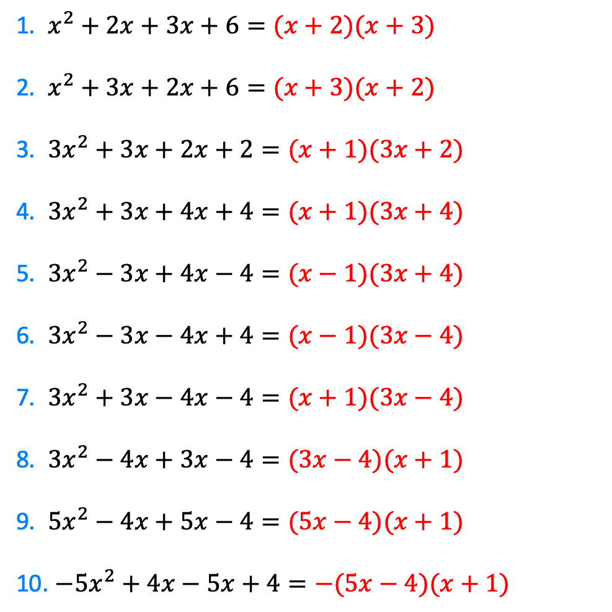
1. $x^{2}+2x+3x+6=(x+2)(x+3)$
2. $x^{2}+3x+2x+6=(x+3)(x+2)$
3. $3x^{2}+3x+2x+2=(x+1)(3x+2)$
4. $3x^{2}+3x+4x+4=(x+1)(3x+4)$
5. $3x^{2}−3x+4x−4=(x−1)(3x+4)$
6. $3x^{2}−3x−4x+4=(x−1)(3x−4)$
7. $3x^{2}+3x−4x−4=(x+1)(3x−4)$
8. $3x^{2}−4x+3x−4=(3x−4)(x+1)$
9. $5x^{2}−4x+5x−4=(5x−4)(x+1)$
10. $−5x^{2}+4x−5x+4=−(5x−4)(x+1)$
@mrbansalmaths

