Slide 1
Multiplying: 3 exercises
Silent
Teacher
Intelligent Practice
Narration
Your Turn
$$23 x 43=\left(20+3\right) x (40+3)$$
$$y=x+\sqrt{rs}$$
Practice

Slide 2
Multiplying two-digit numbers by a single digit
Silent
Teacher
Intelligent Practice
Narration
Your Turn
$$34×2$$
$$23×5$$
$$79×3$$
Practice

Slide 3
Worked Examples
Your Turn
Multiply two-digit numbers by a single digit
Multiply two-digit numbers by a single digit
a) $34×2$
a) $43×2$
b) $23×5$
b) $32×5$
c) $79×3$
c) $97×3$
@MathsJanet

Slide 4

Multiply two-digit numbers by a single digit:
$$32×2$$
$$23×2$$
$$23×4$$
$$46×4$$
$$46×5$$
$$5×46$$
$$4×64$$
$$87×8$$
@MathsJanet
Notes:
Simplify formative assessment for teachers
Immediately demonstrate students’ level of understanding
Teachers share questions and students share explanations
Focused not on what a student got wrong but why

Slide 5
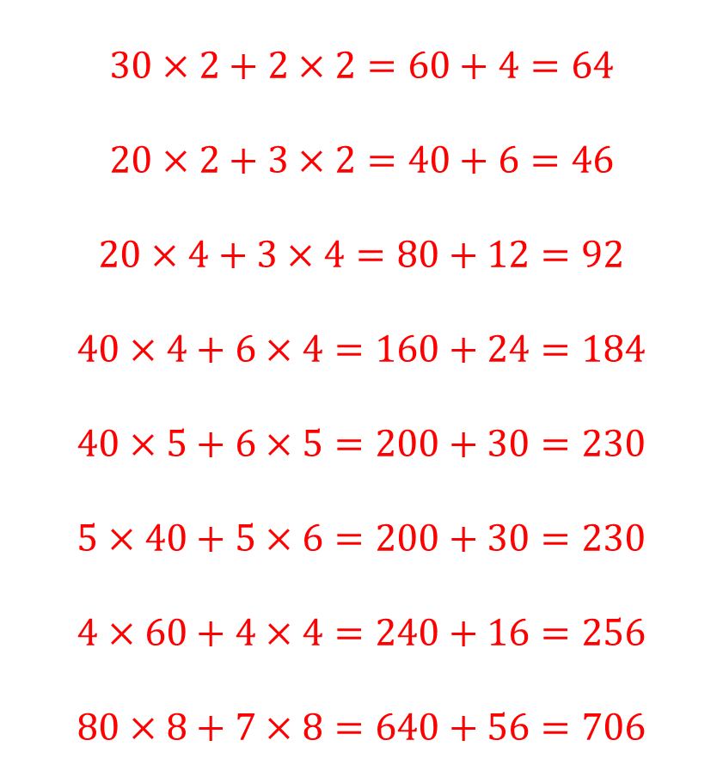
Multiply two-digit numbers by a single digit:
$$32×2$$
$$23×2$$
$$23×4$$
$$46×4$$
$$46×5$$
$$5×46$$
$$4×64$$
$$87×8$$
$$30×2+2×2=60+4=64$$
$$20×2+3×2=40+6=46$$
$$20×4+3×4=80+12=92$$
$$40×4+6×4=160+24=184$$
$$40×5+6×5=200+30=230$$
$$5×40+5×6=200+30=230$$
$$4×60+4×4=240+16=256$$
$$80×8+7×8=640+56=706$$
@MathsJanet
Notes:
Simplify formative assessment for teachers
Immediately demonstrate students’ level of understanding
Teachers share questions and students share explanations
Focused not on what a student got wrong but why

Slide 6
Multiplying two-digit numbers by a single digit
Silent
Teacher
Intelligent Practice
Narration
Your Turn
$$34×7$$
$$23×3$$
$$69×9$$
Practice

Slide 7
Worked Examples
Your Turn
Multiply two-digit numbers by a single digit
Multiply two-digit numbers by a single digit
a) $34×7$
a) $43×7$
b) $23×3$
b) $32×3$
c) $69×9$
c) $96×9$
@MathsJanet

Slide 8

Multiply two-digit numbers by a single digit:
$$32×3$$
$$23×3$$
$$23×7$$
$$46×7$$
$$46×9$$
$$9×46$$
$$9×64$$
$$98×7$$
@MathsJanet
Notes:
Simplify formative assessment for teachers
Immediately demonstrate students’ level of understanding
Teachers share questions and students share explanations
Focused not on what a student got wrong but why

Slide 9
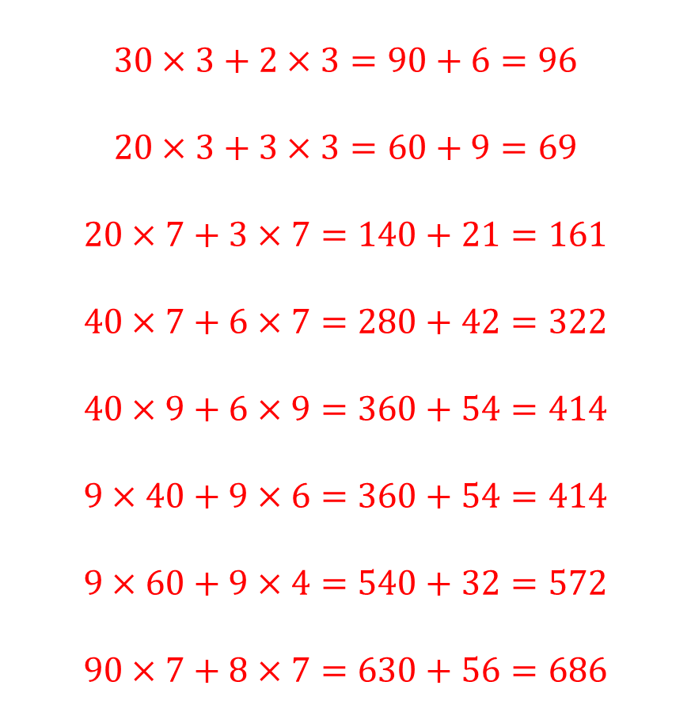
Multiply two-digit numbers by a single digit:
$$32×3$$
$$23×3$$
$$23×7$$
$$46×7$$
$$46×9$$
$$9×46$$
$$9×64$$
$$98×7$$
$$30×3+2×3=90+6=96$$
$$20×3+3×3=60+9=69$$
$$20×7+3×7=140+21=161$$
$$40×7+6×7=280+42=322$$
$$40×9+6×9=360+54=414$$
$$9×40+9×6=360+54=414$$
$$9×60+9×4=540+32=572$$
$$90×7+8×7=630+56=686$$
@MathsJanet
Notes:
Simplify formative assessment for teachers
Immediately demonstrate students’ level of understanding
Teachers share questions and students share explanations
Focused not on what a student got wrong but why

Slide 10
Multiplying two-digit numbers by a double-digits
Silent
Teacher
Intelligent Practice
Narration
Your Turn
$$14×27$$
$$23×35$$
$$18×37$$
Practice

Slide 11
Worked Examples
Your Turn
Multiply two-digit numbers by a single digit
Multiply two-digit numbers by a single digit
a) $14×27$
a) $21×47$
b) $23×35$
b) $35×23$
c) $18×37$
c) $19×47$
@MathsJanet

Slide 12

Multiply two-digit numbers by a single digit:
$$32×23$$
$$23×23$$
$$23×17$$
$$46×17$$
$$40×17$$
$$19×50$$
$$59×10$$
$$98×71$$
@MathsJanet
Notes:
Simplify formative assessment for teachers
Immediately demonstrate students’ level of understanding
Teachers share questions and students share explanations
Focused not on what a student got wrong but why

Slide 13

Multiply two-digit numbers by a single digit:
$$32×23$$
$$23×23$$
$$23×17$$
$$46×17$$
$$40×17$$
$$19×50$$
$$59×10$$
$$98×71$$
$$32×23=736$$
$$23×23=529$$
$$23×17=391$$
$$46×17=782$$
$$40×17=680$$
$$19×50=950$$
$$59×10=590$$
$$98×71=6958$$
@MathsJanet
Notes:
Simplify formative assessment for teachers
Immediately demonstrate students’ level of understanding
Teachers share questions and students share explanations
Focused not on what a student got wrong but why

