Slide 1
Volume: Volume of prisms alternative version
Silent
Teacher
Intelligent Practice
Narration
Your Turn
Practice

Slide 2
Worked Example
Your Turn
8cm
8cm
4cm
4cm
3cm
6cm

Slide 3
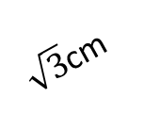
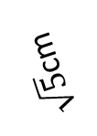
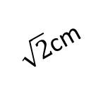
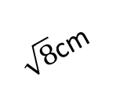
2cm
4cm
5cm
5cm
4cm
4cm
4cm
2cm
3cm
4cm
4cm
4cm
6cm
6cm
6cm
6cm
V = 56cm³, find h
2cm
0.4cm
5/4 cm
$\sqrt{5}$cm
h cm
¾ cm
$\sqrt{4}$cm
2cm
0.3cm
½ cm
$\sqrt{8}$cm
2cm
0.6cm
6/4 cm
$\sqrt{6}$cm
6cm
V = 108cm³, find y
$\sqrt{2}$cm
$\sqrt{4}$cm
3x cm
3cm
$\sqrt{4}$cm
4x cm
4cm
$\sqrt{3}$cm
$\sqrt{3}$cm
2x cm
y cm
$\sqrt{2}$cm
$\sqrt{6}$cm
6x cm
6cm
$\sqrt{6}$cm

Slide 4
2cm
9600cm³
4cm
36cm³
5cm
48cm³
4cm
4cm
5cm
4cm
2cm
64cm³
3cm
4cm
4m
4cm
6cm
6cm
6cm
6cm
V = 56cm³, find h
2cm
0.036cm³
9/32 cm³
$4\sqrt{6}$cm³
0.4cm
5/4 cm
$\sqrt{5}$cm
h cm
¾ cm
$\sqrt{4}$cm
2cm
h = 10
0.3cm
½ cm
$\sqrt{8}$cm
2cm
0.6cm
6/4 cm
$\sqrt{6}$cm
6cm
V = 108cm³, find y
$\sqrt{2}(\sqrt{18}+ \sqrt{2}(2 − \sqrt{3})$)cm³
$\sqrt{2}$cm
2400x³cm³
= $\sqrt{2}(3\sqrt{2}+2\sqrt{2}−\sqrt{6})$cm³
= $\sqrt{2}(5\sqrt{2}−\sqrt{6})$cm³
6cm³
3x cm
4.5
$\sqrt{4}$cm
= $10−\sqrt{12}$cm³
3cm
$\sqrt{4}$cm
4x cm
4cm
$\sqrt{3}$cm
= $10−2\sqrt{3}$cm³
$\sqrt{3}$cm
x m
y cm
$\sqrt{2}$cm
$\sqrt{6}$cm
6x cm
6cm
$\sqrt{6}$cm

