Slide 1
Algebraic Expression Vocabulary
Silent
Teacher
Intelligent Practice
Narration
Your Turn
$$3x−9$$
$$3x+4y−9$$
$$3x−4y−9$$
Practice

Slide 2
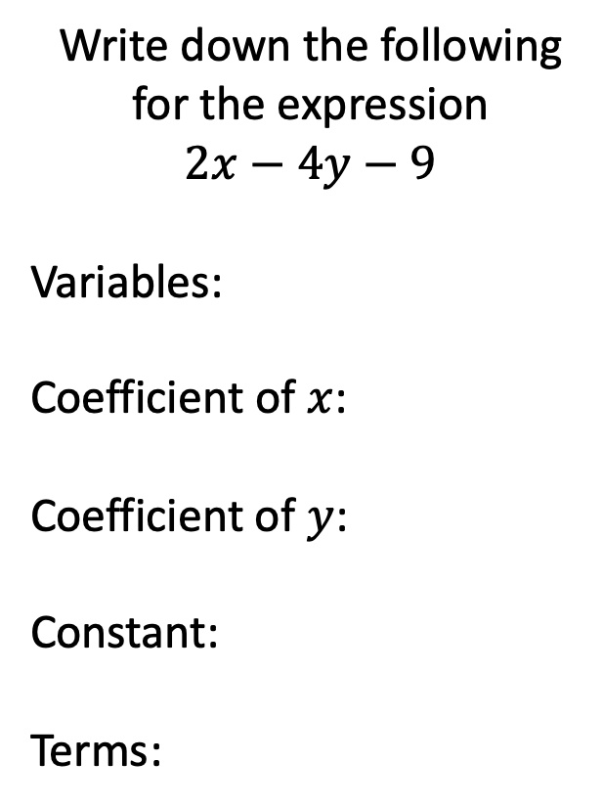
Worked Example
Your Turn
Write down the following for the expression
$$2x−4y−9$$
Variables:
Coefficient of $x$:
Coefficient of $y$:
Constant:
Terms:
Write down the following for the expression
$$−2a+4b+9$$
Variables:
Coefficient of $a$:
Coefficient of $b$:
Constant:
Terms:
@mrbansalmaths

Slide 3
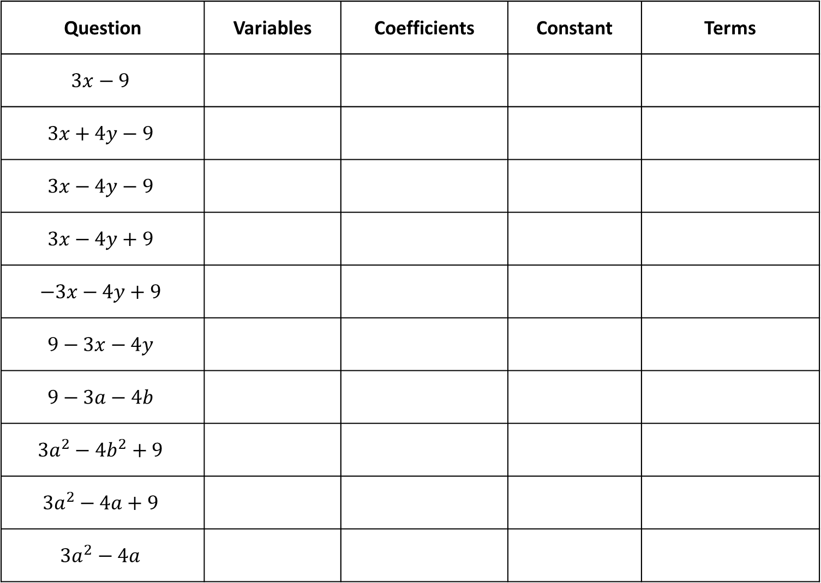
Question | Variables | Coefficients | Constant | Terms
$$3x−9$$
$$3x+4y−9$$
$$3x−4y−9$$
$$3x−4y+9$$
$$−3x−4y+9$$
$$9−3x−4y$$
$$9−3a−4b$$
$$3a^{2}−4b^{2}+9$$
$$3a^{2}−4a+9$$
$$3a^{2}−4a$$
@mrbansalmaths

Slide 4
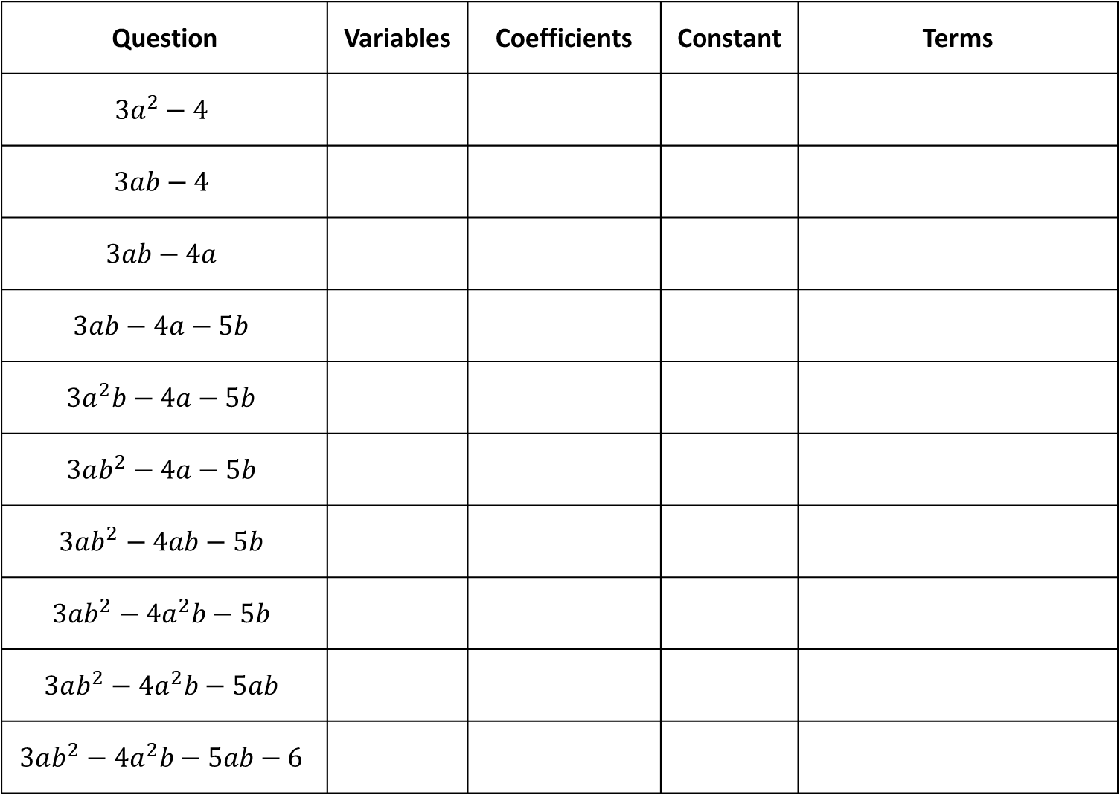
Question | Variables | Coefficients | Constant | Terms
$$3a^{2}−4$$
$$3ab−4$$
$$3ab−4a$$
$$3ab−4a−5b$$
$$3a^{2}b−4a−5b$$
$$3ab^{2}−4a−5b$$
$$3ab^{2}−4ab−5b$$
$$3ab^{2}−4a^{2}b−5b$$
$$3ab^{2}−4a^{2}b−5ab$$
$$3ab^{2}−4a^{2}b−5ab−6$$
@mrbansalmaths

Slide 5
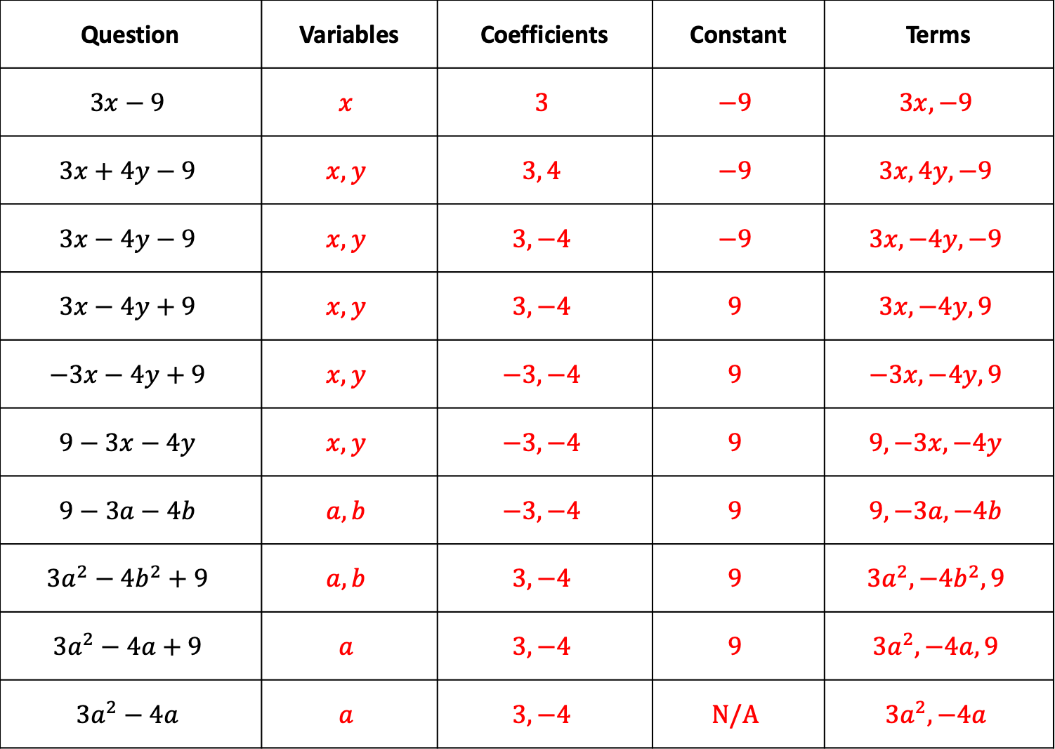
Question | Variables | Coefficients | Constant | Terms
$$3x−9$$ | $$x$$ | $$3$$ | $$−9$$ | $$3x, −9$$
$$3x+4y−9$$ | $$x, y$$ | $$3, 4$$ | $$−9$$ | $$3x, 4y, −9$$
$$3x−4y−9$$ | $$x, y$$ | $$3, −4$$ | $$−9$$ | $$3x, −4y, −9$$
$$3x−4y+9$$ | $$x, y$$ | $$3, −4$$ | $$9$$ | $$3x, −4y, 9$$
$$−3x−4y+9$$ | $$x, y$$ | $$−3, −4$$ | $$9$$ | $$−3x, −4y, 9$$
$$9−3x−4y$$ | $$x, y$$ | $$−3, −4$$ | $$9$$ | $$9, −3x, −4y$$
$$9−3a−4b$$ | $$a, b$$ | $$−3, −4$$ | $$9$$ | $$9, −3a, −4b$$
$$3a^{2}−4b^{2}+9$$ | $$a, b$$ | $$3, −4$$ | $$9$$ | $$3a^{2}, −4b^{2}, 9$$
$$3a^{2}−4a+9$$ | $$a$$ | $$3, −4$$ | $$9$$ | $$3a^{2}, −4a, 9$$
$$3a^{2}−4a$$ | $$a$$ | $$3, −4$$ | $$N/A$$ | $$3a^{2}, −4a$$
@mrbansalmaths

Slide 6
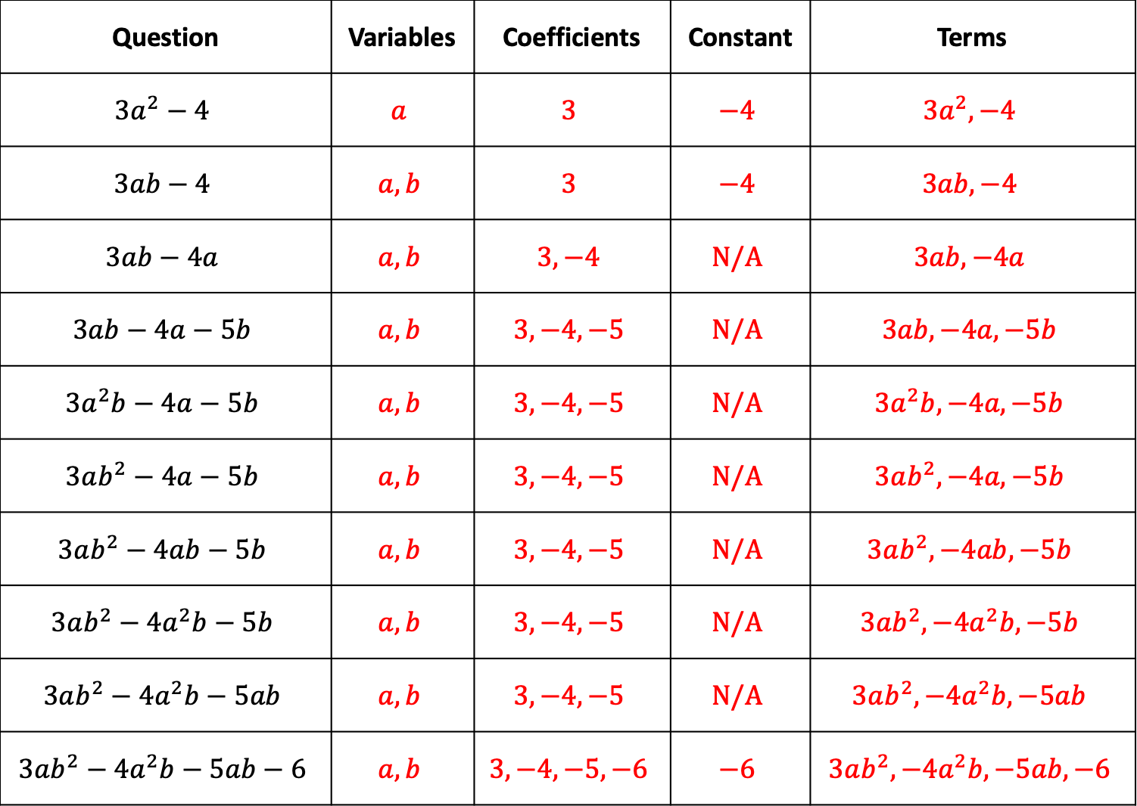
Question | Variables | Coefficients | Constant | Terms
$$3a^{2}−4$$ | $$a$$ | $$3$$ | $$−4$$ | $$3a^{2}, −4$$
$$3ab−4$$ | $$a, b$$ | $$3$$ | $$−4$$ | $$3ab, −4$$
$$3ab−4a$$ | $$a, b$$ | $$3, −4$$ | $$N/A$$ | $$3ab, −4a$$
$$3ab−4a−5b$$ | $$a, b$$ | $$3, −4, −5$$ | $$N/A$$ | $$3ab, −4a, −5b$$
$$3a^{2}b−4a−5b$$ | $$a, b$$ | $$3, −4, −5$$ | $$N/A$$ | $$3a^{2}b, −4a, −5b$$
$$3ab^{2}−4a−5b$$ | $$a, b$$ | $$3, −4, −5$$ | $$N/A$$ | $$3ab^{2}, −4a, −5b$$
$$3ab^{2}−4ab−5b$$ | $$a, b$$ | $$3, −4, −5$$ | $$N/A$$ | $$3ab^{2}, −4ab, −5b$$
$$3ab^{2}−4a^{2}b−5b$$ | $$a, b$$ | $$3, −4, −5$$ | $$N/A$$ | $$3ab^{2}, −4a^{2}b, −5b$$
$$3ab^{2}−4a^{2}b−5ab$$ | $$a, b$$ | $$3, −4, −5$$ | $$N/A$$ | $$3ab^{2}, −4a^{2}b, −5ab$$
$$3ab^{2}−4a^{2}b−5ab−6$$ | $$a, b$$ | $$3, −4, −5, −6$$ | $$−6$$ | $$3ab^{2}, −4a^{2}b, −5ab, −6$$
@mrbansalmaths

