Slide 1
Collecting Like Terms (with powers)
Silent
Teacher
Intelligent Practice
Narration
Your Turn
$$6a^{2}−5b^{2}−4a^{2}−3b^{2}=$$
$$6a^{2}−5a^{2}b−4a^{2}−3a^{2}b=$$
$$6a^{2}−5{ab}^{2}−4a^{2}−3{ab}^{2}=$$
Practice

Slide 2
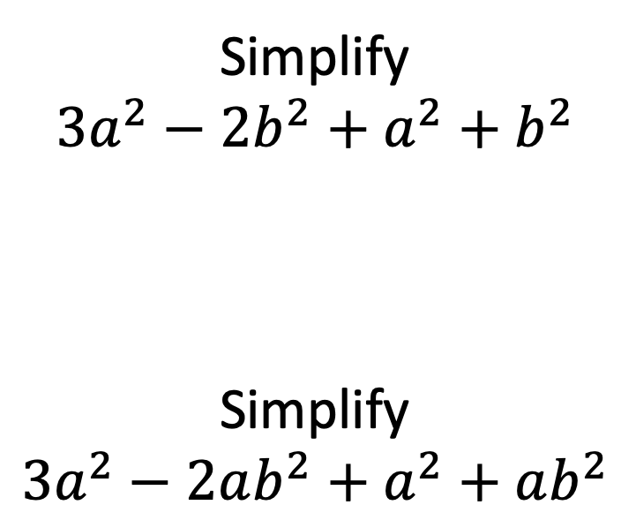
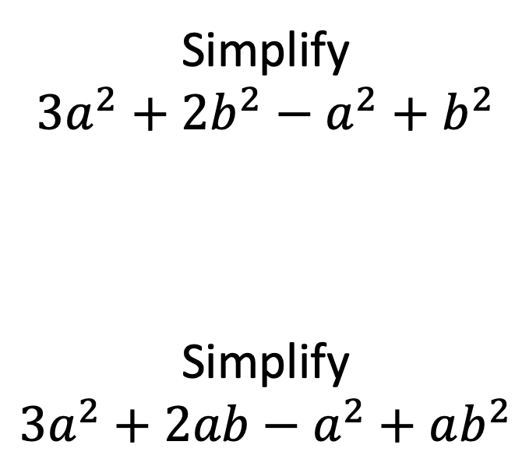
Worked Example
Your Turn
Simplify
$$3a^{2}+2b^{2}−a^{2}+b^{2}$$
Simplify
$$3a^{2}+2ab−a^{2}+ab^{2}$$
Simplify
$$3a^{2}−2b^{2}+a^{2}+b^{2}$$
Simplify
$$3a^{2}−2ab^{2}+a^{2}+ab^{2}$$
@mrbansalmaths

Slide 3
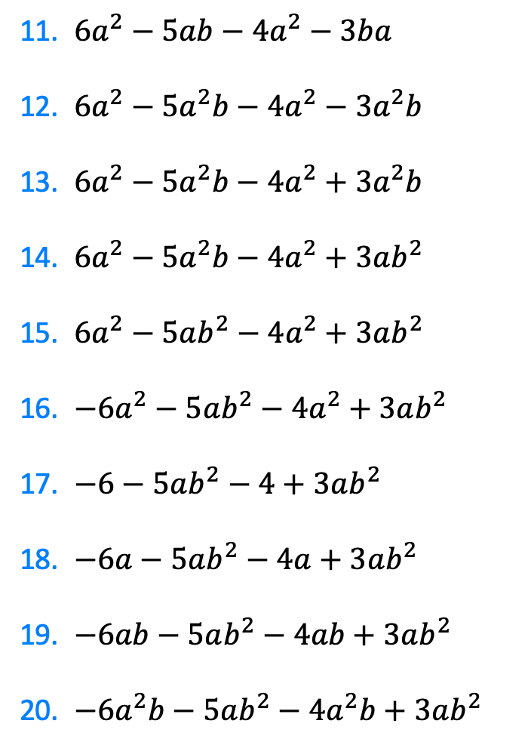
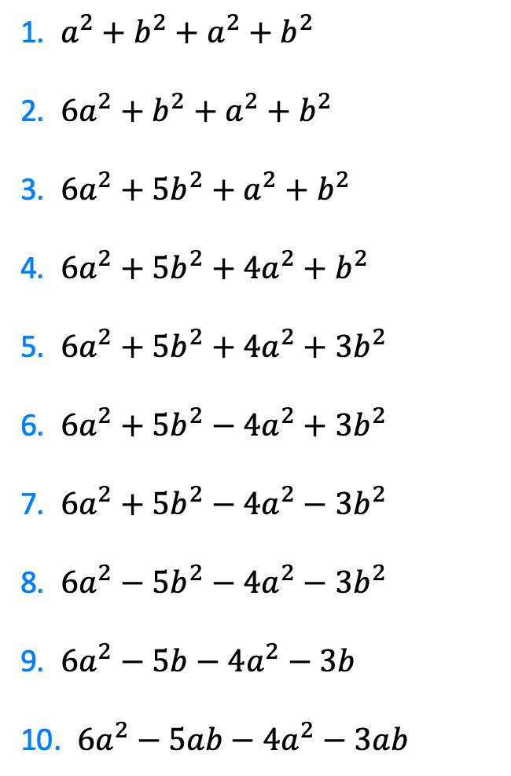
1. $a^{2}+b^{2}+a^{2}+b^{2}$
2. $6a^{2}+b^{2}+a^{2}+b^{2}$
3. $6a^{2}+5b^{2}+a^{2}+b^{2}$
4. $6a^{2}+5b^{2}+4a^{2}+b^{2}$
5. $6a^{2}+5b^{2}+4a^{2}+3b^{2}$
6. $6a^{2}+5b^{2}−4a^{2}+3b^{2}$
7. $6a^{2}+5b^{2}−4a^{2}−3b^{2}$
8. $6a^{2}−5b^{2}−4a^{2}−3b^{2}$
9. $6a^{2}−5b−4a^{2}−3b$
10. $6a^{2}−5ab−4a^{2}−3ab$
11. $6a^{2}−5ab−4a^{2}−3ba$
12. $6a^{2}−5a^{2}b−4a^{2}−3a^{2}b$
13. $6a^{2}−5a^{2}b−4a^{2}+3a^{2}b$
14. $6a^{2}−5a^{2}b−4a^{2}+3ab^{2}$
15. $6a^{2}−5ab^{2}−4a^{2}+3ab^{2}$
16. $−6a^{2}−5ab^{2}−4a^{2}+3ab^{2}$
17. $−6−5ab^{2}−4+3ab^{2}$
18. $−6a−5ab^{2}−4a+3ab^{2}$
19. $−6ab−5ab^{2}−4ab+3ab^{2}$
20. $−6a^{2}b−5ab^{2}−4a^{2}b+3ab^{2}$
@mrbansalmaths

Slide 4
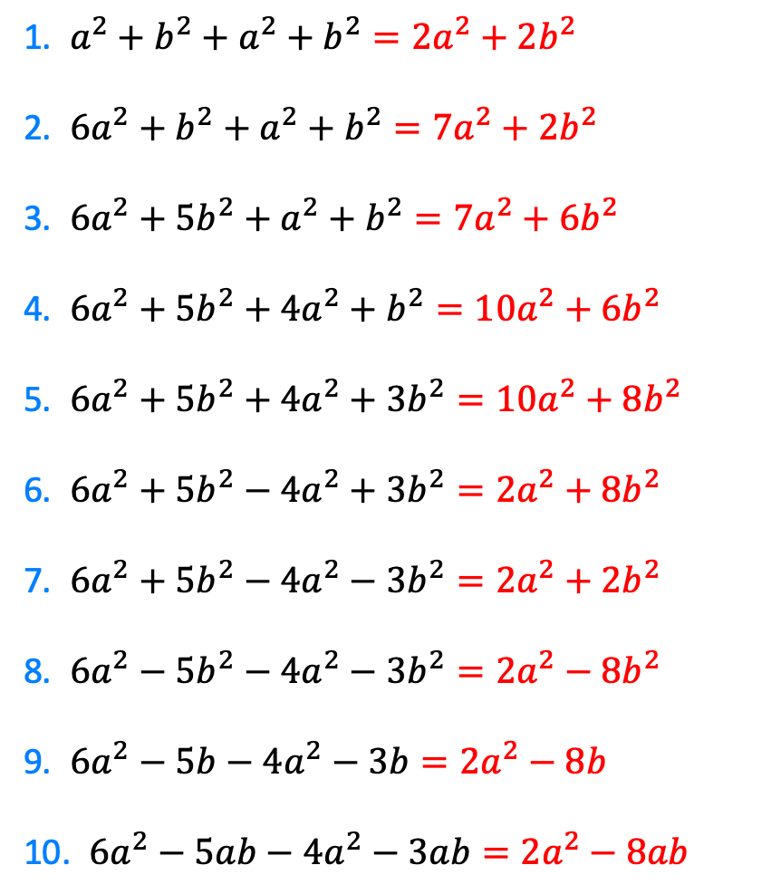
1. $a^{2}+b^{2}+a^{2}+b^{2}=2a^{2}+2b^{2}$
2. $6a^{2}+b^{2}+a^{2}+b^{2}=7a^{2}+2b^{2}$
3. $6a^{2}+5b^{2}+a^{2}+b^{2}=7a^{2}+6b^{2}$
4. $6a^{2}+5b^{2}+4a^{2}+b^{2}=10a^{2}+6b^{2}$
5. $6a^{2}+5b^{2}+4a^{2}+3b^{2}=10a^{2}+8b^{2}$
6. $6a^{2}+5b^{2}−4a^{2}+3b^{2}=2a^{2}+8b^{2}$
7. $6a^{2}+5b^{2}−4a^{2}−3b^{2}=2a^{2}+2b^{2}$
8. $6a^{2}−5b^{2}−4a^{2}−3b^{2}=2a^{2}−8b^{2}$
9. $6a^{2}−5b−4a^{2}−3b=2a^{2}−8b$
10. $6a^{2}−5ab−4a^{2}−3ab=2a^{2}−8ab$
@mrbansalmaths

Slide 5
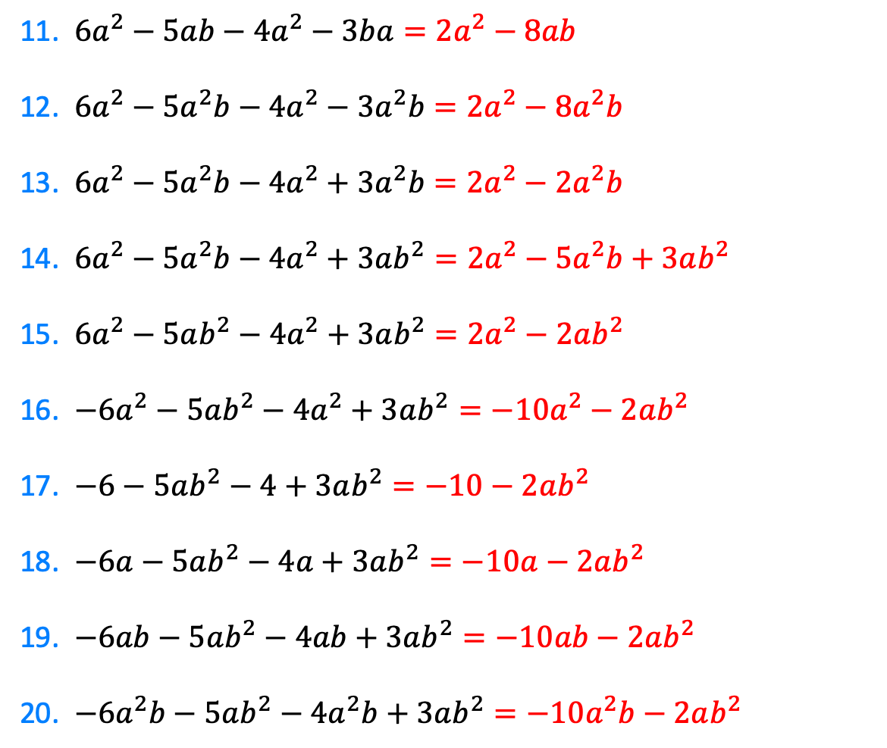
11. $6a^{2}−5ab−4a^{2}−3ba=2a^{2}−8ab$
12. $6a^{2}−5a^{2}b−4a^{2}−3a^{2}b=2a^{2}−8a^{2}b$
13. $6a^{2}−5a^{2}b−4a^{2}+3a^{2}b=2a^{2}−2a^{2}b$
14. $6a^{2}−5a^{2}b−4a^{2}+3ab^{2}=2a^{2}−5a^{2}b+3ab^{2}$
15. $6a^{2}−5ab^{2}−4a^{2}+3ab^{2}=2a^{2}−2ab^{2}$
16. $−6a^{2}−5ab^{2}−4a^{2}+3ab^{2}=−10a^{2}−2ab^{2}$
17. $−6−5ab^{2}−4+3ab^{2}=−10−2ab^{2}$
18. $−6a−5ab^{2}−4a+3ab^{2}=−10a−2ab^{2}$
19. $−6ab−5ab^{2}−4ab+3ab^{2}=−10ab−2ab^{2}$
20. $−6a^{2}b−5ab^{2}−4a^{2}b+3ab^{2}=−10a^{2}b−2ab^{2}$
@mrbansalmaths

