Slide 1
Collecting Like Terms (without powers)
Silent
Teacher
Intelligent Practice
Narration
Your Turn
$$a−b+a+b=$$
$$6a−5b+4a+3b=$$
$$−6a−5b+4a+3b=$$
Practice

Slide 2


Worked Example
Your Turn
Simplify
$$a−b+a+b$$
Simplify
$$3a−2b+a+b$$
Simplify
$$a+b−a+b$$
Simplify
$$3a+2b−a+b$$
@mrbansalmaths

Slide 3
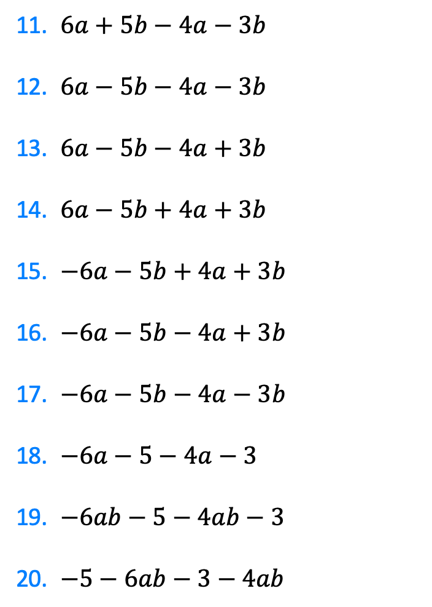
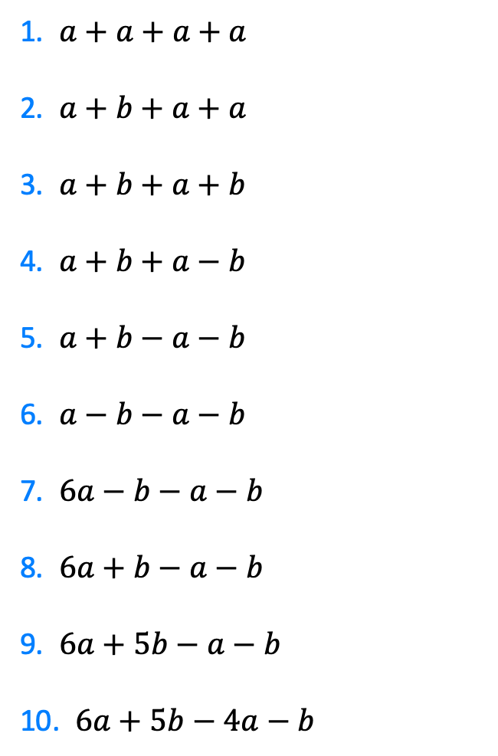
1. $a+a+a+a$
2. $a+b+a+a$
3. $a+b+a+b$
4. $a+b+a−b$
5. $a+b−a−b$
6. $a−b−a−b$
7. $6a−b−a−b$
8. $6a+b−a−b$
9. $6a+5b−a−b$
10. $6a+5b−4a−b$
11. $6a+5b−4a−3b$
12. $6a−5b−4a−3b$
13. $6a−5b−4a+3b$
14. $6a−5b+4a+3b$
15. $−6a−5b+4a+3b$
16. $−6a−5b−4a+3b$
17. $−6a−5b−4a−3b$
18. $−6a−5−4a−3$
19. $−6ab−5−4ab−3$
20. $−5−6ab−3−4ab$
@mrbansalmaths

Slide 4
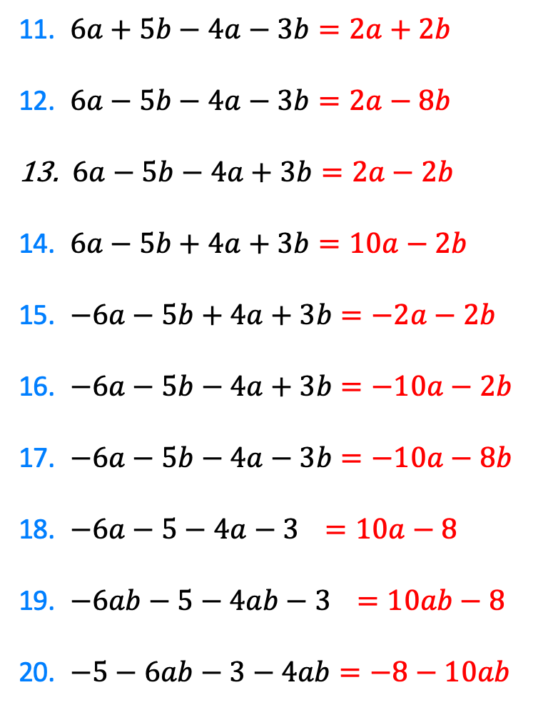
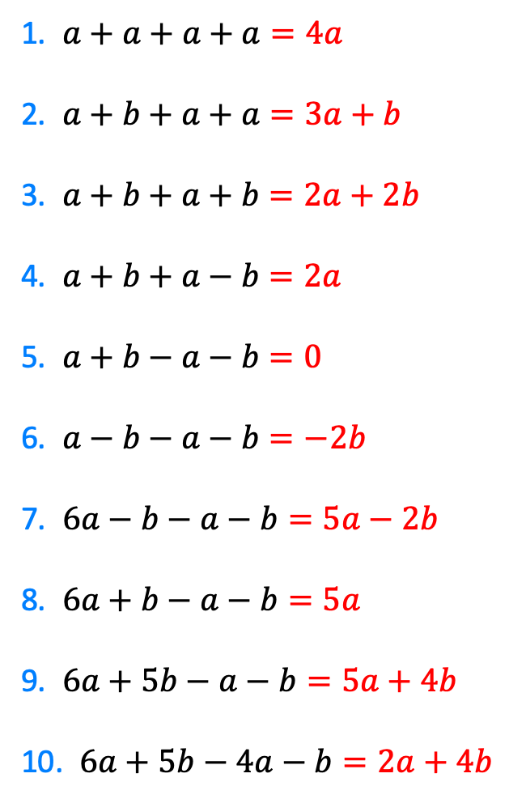
1. $a+a+a+a=4a$
2. $a+b+a+a=3a+b$
3. $a+b+a+b=2a+2b$
4. $a+b+a−b=2a$
5. $a+b−a−b=0$
6. $a−b−a−b=−2b$
7. $6a−b−a−b=5a−2b$
8. $6a+b−a−b=5a$
9. $6a+5b−a−b=5a+4b$
10. $6a+5b−4a−b=2a+4b$
11. $6a+5b−4a−3b=2a+2b$
12. $6a−5b−4a−3b=2a−8b$
$6a−5b−4a+3b=2a−2b$
14. $6a−5b+4a+3b=10a−2b$
15. $−6a−5b+4a+3b=−2a−2b$
16. $−6a−5b−4a+3b=−10a−2b$
17. $−6a−5b−4a−3b=−10a−8b$
18. $−6a−5−4a−3a=10a−8$
19. $−6ab−5−4ab−3a=10ab−8$
20. $−5−6ab−3−4ab=−8−10ab$
@mrbansalmaths

