Slide 1
Dividing fractions by fractions using a common denominator
Silent
Teacher
Intelligent Practice
Narration
Your Turn
$$\frac{3}{5}÷\frac{2}{15}$$
Practice

Slide 2
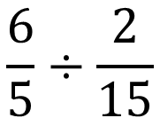
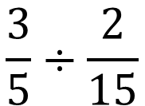
Worked Example
Your Turn
$$\frac{3}{5}÷\frac{2}{15}$$
$$\frac{6}{5}÷\frac{2}{15}$$
@alcmaths

Slide 3
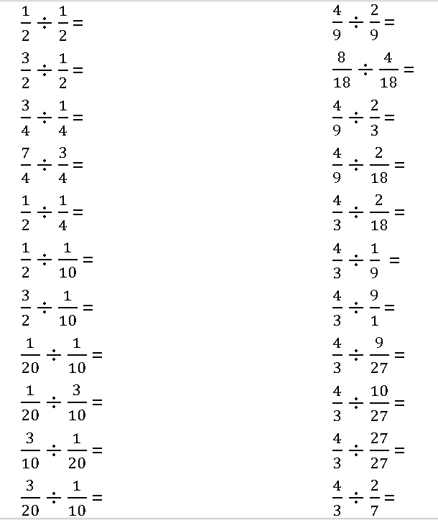
@alcmaths

Slide 4
1
3
3
$$\frac{7}{3} or 2\frac{1}{3}$$
2
5
15
$$\frac{1}{2}$$
$$\frac{1}{6}$$
6
$$\frac{3}{2}$$
2
2
$$\frac{2}{3}$$
4
12
12
$$\frac{4}{27}$$
$$4$$
$$\frac{18}{5} or 3\frac{2}{5}$$
$$\frac{4}{3}$$
$$\frac{14}{3} or 4\frac{2}{3}$$
@alcmaths

