Slide 1
Rearranging Quadratic Equations
Silent
Teacher
Intelligent Practice
Narration
Your Turn
$$4x^{2}+5x+6=2$$
$$4x^{2}+5x+6=−2$$
$$4x^{2}+5x+6=x−2$$
Practice

Slide 2
Worked Example
Your Turn
Rearrange
$$7x^{2}+8x+9=11x−12$$
into the form $ax^{2}+bx+c=0$
Rearrange
$$7x^{2}+8x+9=−11x+12$$
into the form $ax^{2}+bx+c=0$
@mrbansalmaths

Slide 3
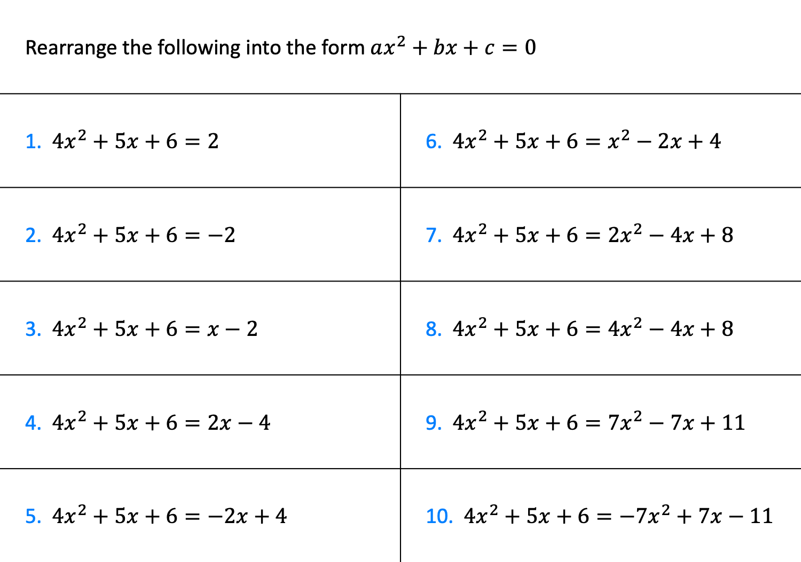
Rearrange the following into the form $ax^{2}+bx+c=0$
1. $4x^{2}+5x+6=2$ | 6. $4x^{2}+5x+6=x^{2}−2x+4$
2. $4x^{2}+5x+6=−2$ | 7. $4x^{2}+5x+6=2x^{2}−4x+8$
3. $4x^{2}+5x+6=x−2$ | 8. $4x^{2}+5x+6=4x^{2}−4x+8$
4. $4x^{2}+5x+6=2x−4$ | 9. $4x^{2}+5x+6=7x^{2}−7x+11$
5. $4x^{2}+5x+6=−2x+4$ | 10. $4x^{2}+5x+6=−7x^{2}+7x−11$
@mrbansalmaths

Slide 4
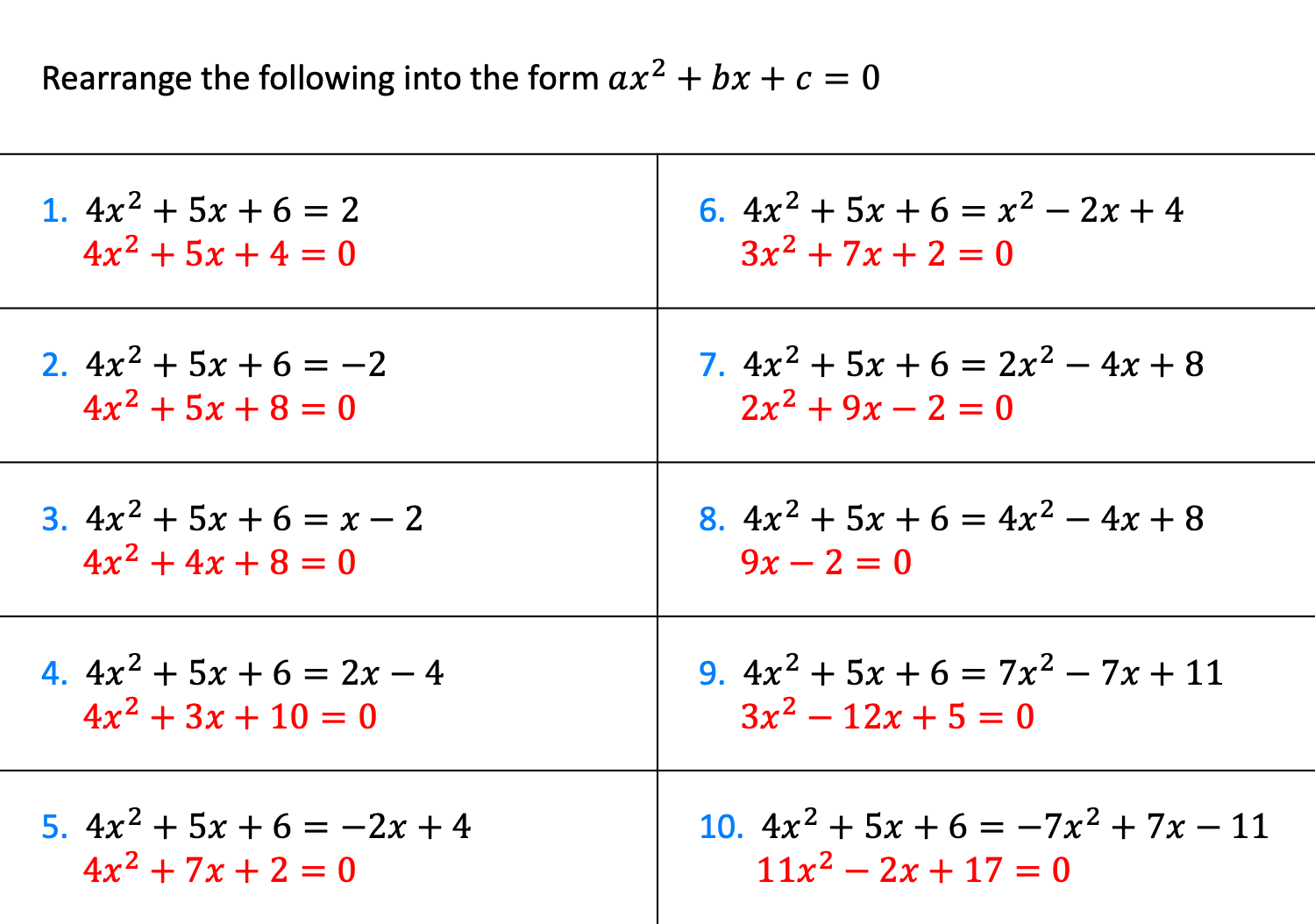
Rearrange the following into the form $ax^{2}+bx+c=0$
1. $4x^{2}+5x+6=2$ $4x^{2}+5x+4=0$ | 6. $4x^{2}+5x+6=x^{2}−2x+4$ $3x^{2}+7x+2=0$
2. $4x^{2}+5x+6=−2$ $4x^{2}+5x+8=0$ | 7. $4x^{2}+5x+6=2x^{2}−4x+8$ $2x^{2}+9x−2=0$
3. $4x^{2}+5x+6=x−2$ $4x^{2}+4x+8=0$ | 8. $4x^{2}+5x+6=4x^{2}−4x+8$ $9x−2=0$
4. $4x^{2}+5x+6=2x−4$ $4x^{2}+3x+10=0$ | 9. $4x^{2}+5x+6=7x^{2}−7x+11$ $3x^{2}−12x+5=0$
5. $4x^{2}+5x+6=−2x+4$ $4x^{2}+7x+2=0$ | 10. $4x^{2}+5x+6=−7x^{2}+7x−11$ $11x^{2}−2x+17=0$
@mrbansalmaths

