Slide 1
Substitution (one letter) Version 2
Silent
Teacher
Intelligent Practice
Narration
Your Turn
3 + a =
3a =
Practice

Slide 2
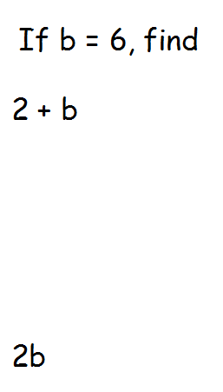
Worked Example
Your Turn

Slide 3


If $d=5$, find the value of the following expressions:
1. $3+d$
2. $3d$
3. $3d+d$
4. $7d−3d$
5. $4d$
6. $5d−1$
7. $\frac{4d}{d}$
8. $\frac{4d}{4}$
9. $\frac{d}{4d}$
10. $d^{2}$
11. $2d^{2}$
12. $(2{d)}^{2}$

Slide 4

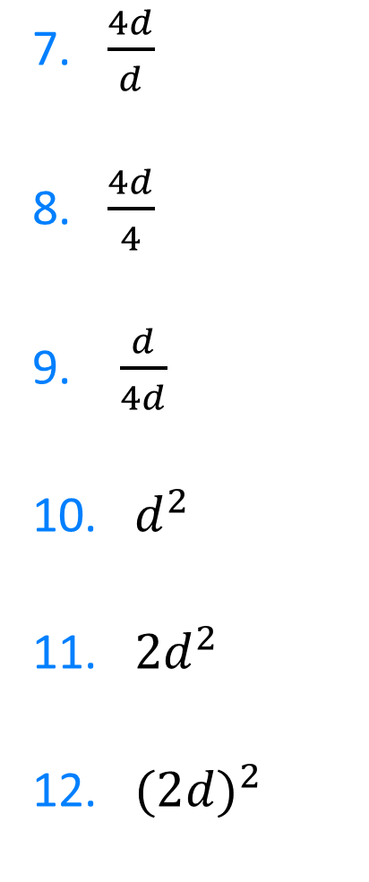
If $d=5$, find the value of the following expressions:
$$8$$
7. $\frac{4d}{d}$
8. $\frac{4d}{4}$
9. $\frac{d}{4d}$
10. $d^{2}$
11. $2d^{2}$
12. $(2{d)}^{2}$
1. $3+d$
2. $3d$
3. $3d+d$
4. $7d−3d$
5. $4d$
6. $5d−1$
$$4$$
$$15$$
$$5$$
$$20$$
$$\frac{1}{5}$$
$$20$$
$$25$$
$$20$$
$$50$$
$$24$$
$$100$$

