Slide 1
Substitution (Quadratic Formula)
Silent
Teacher
Intelligent Practice
Narration
Your Turn
$$b^{2}=$$
$$b^{2}−4ac=$$
$$\sqrt{b^{2}−4ac}=$$
Practice

Slide 2
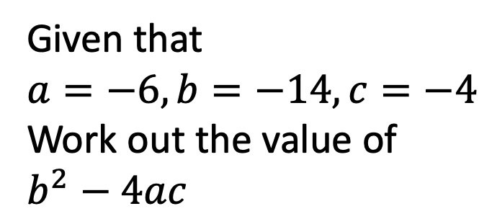
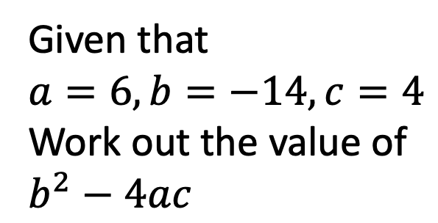
Worked Example
Your Turn
Given that
$$a=6, b=−14, c=4$$
Work out the value of
$$b^{2}−4ac$$
Given that
$$a=−6, b=−14, c=−4$$
Work out the value of
$$b^{2}−4ac$$
@mrbansalmaths

Slide 3
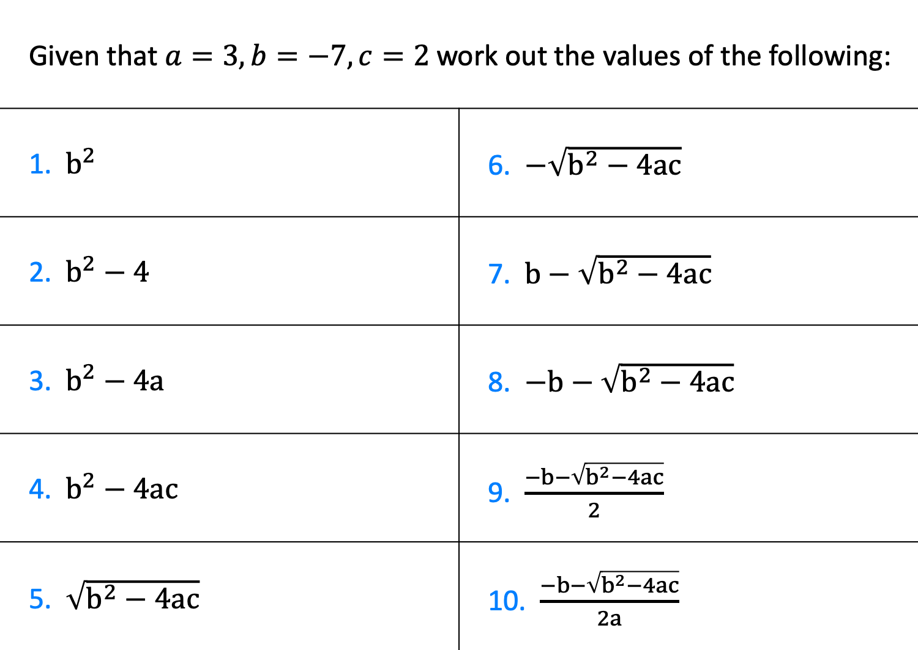
Given that $a=3, b=−7, c=2$work out the values of the following:
1. $b^{2}$ | 6. $−\sqrt{b^{2}−4ac}$
2. $b^{2}−4$ | 7. $b−\sqrt{b^{2}−4ac}$
3. $b^{2}−4a$ | 8. $−b−\sqrt{b^{2}−4ac}$
4. $b^{2}−4ac$ | 9. $\frac{−b−\sqrt{b^{2}−4ac}}{2}$
5. $\sqrt{b^{2}−4ac}$ | 10. $\frac{−b−\sqrt{b^{2}−4ac}}{2a}$
@mrbansalmaths

Slide 4
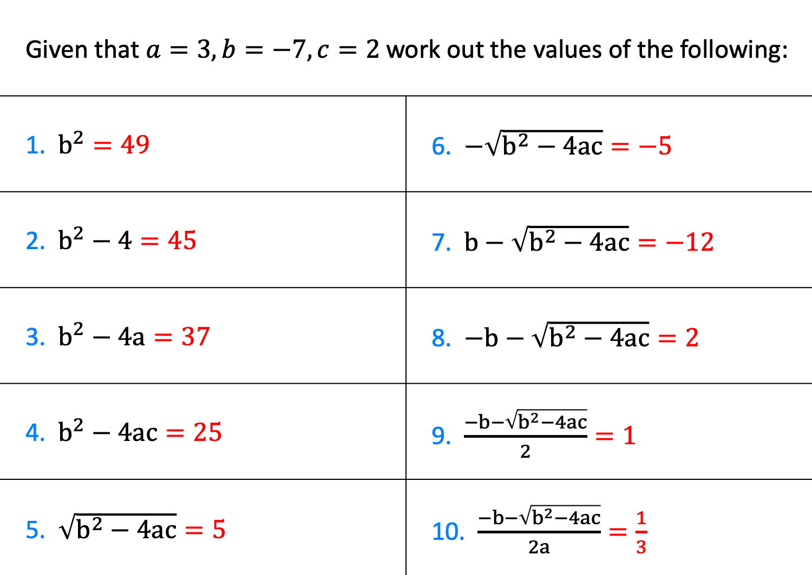
Given that $a=3, b=−7, c=2$work out the values of the following:
1. $b^{2}=49$ | 6. $−\sqrt{b^{2}−4ac}=−5$
2. $b^{2}−4=45$ | 7. $b−\sqrt{b^{2}−4ac}=−12$
3. $b^{2}−4a=37$ | 8. $−b−\sqrt{b^{2}−4ac}=2$
4. $b^{2}−4ac=25$ | 9. $\frac{−b−\sqrt{b^{2}−4ac}}{2}=1$
5. $\sqrt{b^{2}−4ac}=5$ | 10. $\frac{−b−\sqrt{b^{2}−4ac}}{2a}=\frac{1}{3}$
@mrbansalmaths

