Slide 1
Complex Numbers / Polynomials from roots
Silent
Teacher
Intelligent Practice
Narration
Your Turn
$$α=3+2i, β=3−2i$$
$$\left(z^{2}−6z+13=0\right)$$
Practice

Slide 2
Worked Example
Your Turn
Quadratic
1. $α=1+2i, β=1−2i$
$$α=−4+3i, β=−4−3i$$
Cubic
2. $α=\text{1}, β=1+2i, γ=1−2i$
$$α=−\text{2}, β=4+3i, γ=4−3i$$
John Ring

Slide 3
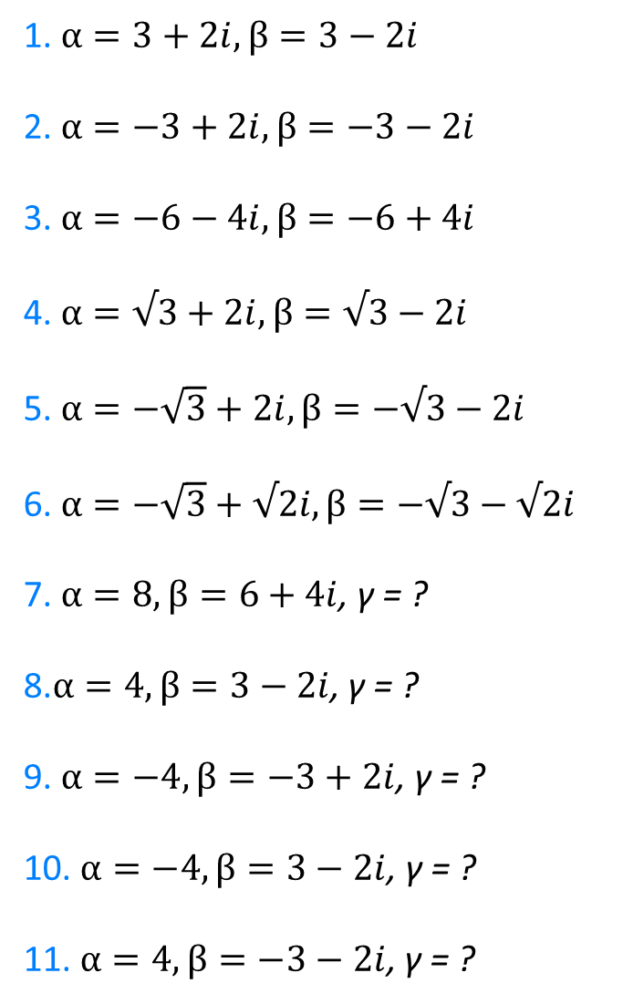
1. $α=3+2i, β=3−2i$
2.$α=−3+2i, β=−3−2i$
3.$α=−6−4i, β=−6+4i$
4.$α=√3+2i, β=√3−2i$
5. $α=−\sqrt{3}+2i, β=−√3−2i$
6.$α=−\sqrt{3}+√2i, β=−√3−√2i$
7. $α=8, β=6+4i$, γ = ?
8.$α=4, β=3−2i$, γ = ?
9. $α=−4, β=−3+2i$, γ = ?
10. $α=−4, β=3−2i$, γ = ?
11.$α=4, β=−3−2i$, γ = ?
John Ring

Slide 4
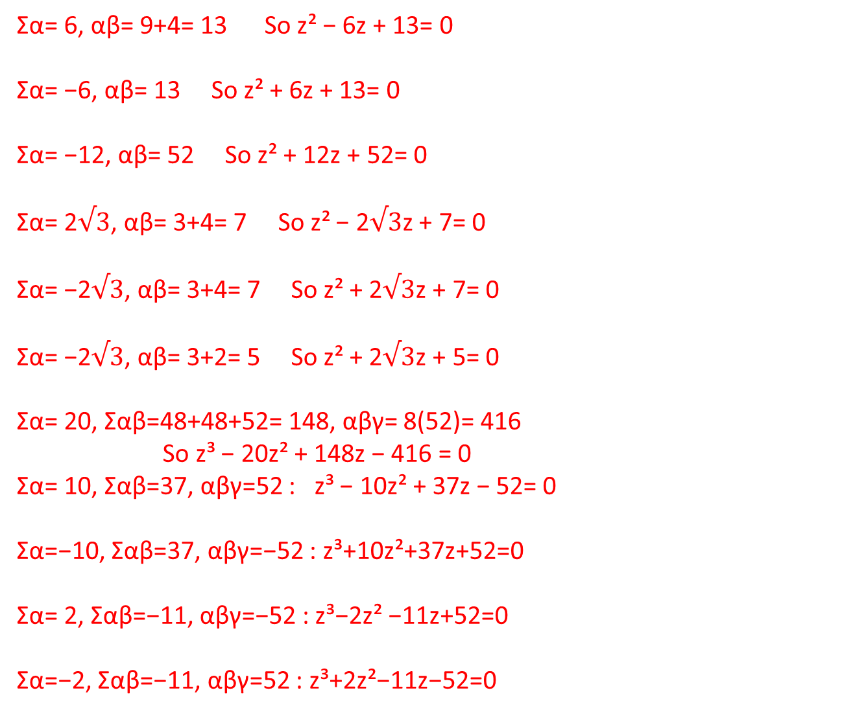
1. $α=3+2i, β=3−2i$
2.$α=−3+2i, β=−3−2i$
3.$α=−6−4i, β=−6+4i$
4.$α=√3+2i, β=√3−2i$
5. $α=−\sqrt{3}+2i, β=−√3−2i$
6.$α=−\sqrt{3}+√2i, β=−√3−√2i$
7. $α=8, β=6+4i$, γ = ?
8.$α=4, β=3−2i$, γ = ?
9. $α=−4, β=−3+2i$, γ = ?
10. $α=−4, β=3−2i$, γ = ?
11.$α=4, β=−3−2i$, γ = ?
Σα= 6, αβ= 9+4= 13 So z² − 6z + 13= 0
Σα= −6, αβ= 13 So z² + 6z + 13= 0
Σα= −12, αβ= 52 So z² + 12z + 52= 0
Σα= 2$√3$, αβ= 3+4= 7 So z² − 2$√3$z + 7= 0
Σα= −2$√3$, αβ= 3+4= 7 So z² + 2$√3$z + 7= 0
Σα= −2$√3$, αβ= 3+2= 5 So z² + 2$√3$z + 5= 0
Σα= 20, Σαβ=48+48+52= 148, αβγ= 8(52)= 416 So z³ − 20z² + 148z − 416 = 0
Σα= 10, Σαβ=37, αβγ=52 : z³ − 10z² + 37z − 52= 0
Σα=−10, Σαβ=37, αβγ=−52 : z³+10z²+37z+52=0
Σα= 2, Σαβ=−11, αβγ=−52 : z³−2z² −11z+52=0
Σα=−2, Σαβ=−11, αβγ=52 : z³+2z²−11z−52=0
John Ring

