Slide 1
Composite functions (algebraic)
Silent
Teacher
Intelligent Practice
Narration
Your Turn
$$If f\left(x\right)=2x+1$$
And g(x) = x²-6
What is gf(x) and fg(x)I
Practice

Slide 2
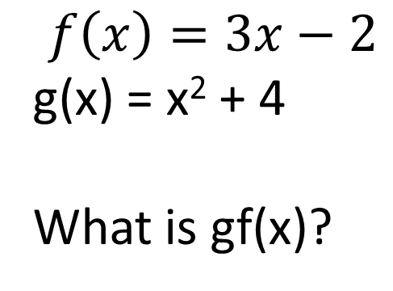
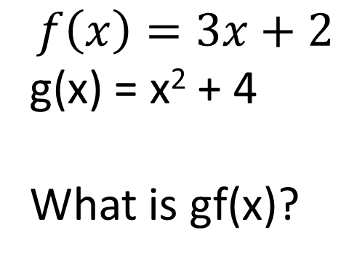
Worked Example
Your Turn
$$f\left(x\right)=3x−2$$
g(x) = x² + 4
What is gf(x)?
$$f\left(x\right)=3x+2$$
g(x) = x² + 4
What is gf(x)?

Slide 3
f(x) | g(x) | fg(x) | gf(x)
x+5 | 3x-2
x-5 | 3x-2
X²-5 | 3x-2
X²-5 | 2-3x
X²-25 | X+5
X²-3 | X+5
3X²+9 | X+5
3X²+9 | X²+5

Slide 4
f(x) | g(x) | gf(x) | fg(x)
x+5 | 3x-2 | 3x+13 | 3x+3
x-5 | 3x-2 | 3x-17 | 3x-7
X²-5 | 3x-2 | 3x²-17 | 9x²-12x-1
X²-5 | 2-3x | 17-3x2 | 9x²-12x-1
X²-25 | X+5 | X²-20 | X²+10x
X²-3 | X+5 | X²+2 | X²+10x+22
3X²+9 | X+5 | 3X²+14 | 3X²+30x+84
3X²+9 | X²+5 | 3X⁴ +54X²+86 | 3X⁴ +30X²+84

