Slide 1
nth term of a Geometric Sequence
Silent
Teacher
Intelligent Practice
Narration
Your Turn
$$3, 30, 300, 3000, …$$
$$1, 2, 4, 8, 16…$$
$$\text{1, }\frac{1}{2}\text{ , }\frac{1}{4}\text{ , }\frac{1}{8}\text{ , }\frac{1}{16}…$$
Practice

Slide 2
Worked Example
Your Turn
Find the nth term:
$$3, 30, 300, 3000, …$$
Find the nth term:
$$3, 6, 12, 24,…$$
J Hepburn

Slide 3
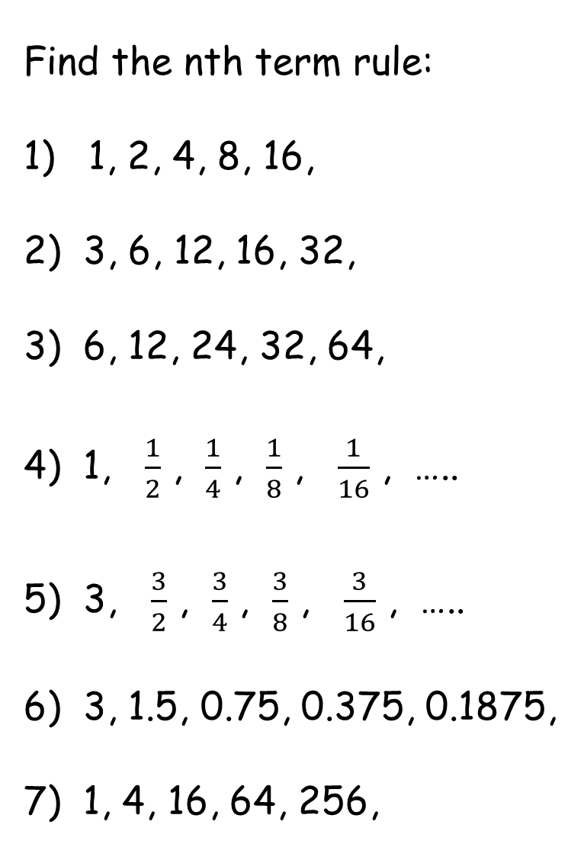
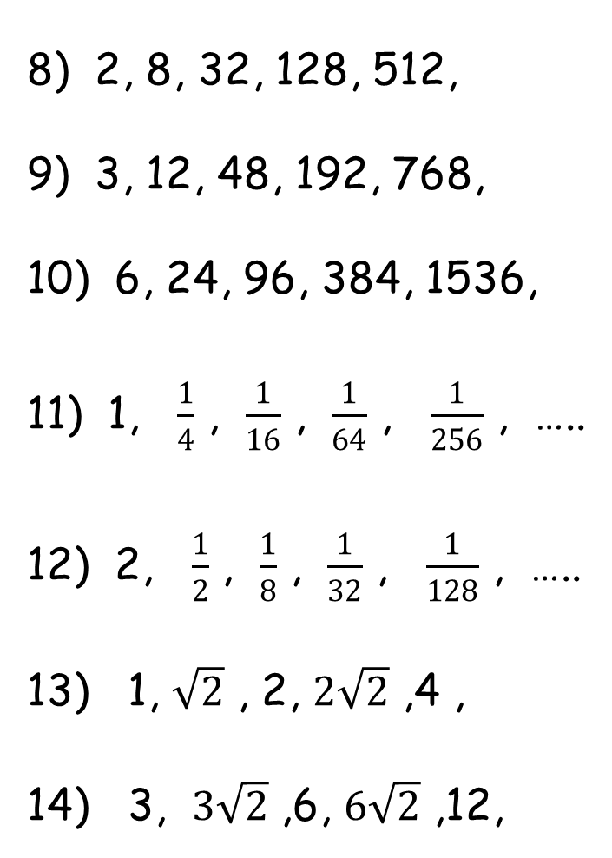
Find the nth term rule:
1) 1, 2, 4, 8, 16,
2) 3, 6, 12, 16, 32,
3) 6, 12, 24, 32, 64,
4) 1, $\frac{1}{2}$ , $\frac{1}{4}$ , $\frac{1}{8}$ , $\frac{1}{16}$ , …..
5) 3, $\frac{3}{2}$ , $\frac{3}{4}$ , $\frac{3}{8}$ , $\frac{3}{16}$ , …..
6) 3, 1.5, 0.75, 0.375, 0.1875,
7) 1, 4, 16, 64, 256,
8) 2, 8, 32, 128, 512,
9) 3, 12, 48, 192, 768,
10) 6, 24, 96, 384, 1536,
11) 1, $\frac{1}{4}$ , $\frac{1}{16}$ , $\frac{1}{64}$ , $\frac{1}{256}$ , …..
12) 2, $\frac{1}{2}$ , $\frac{1}{8}$ , $\frac{1}{32}$ , $\frac{1}{128}$ , …..
13) 1, $\sqrt{2}$ , 2, $2\sqrt{2}$ ,4 ,
14) 3, $3\sqrt{2}$ ,6, $6\sqrt{2}$ ,12,
J Hepburn

Slide 4
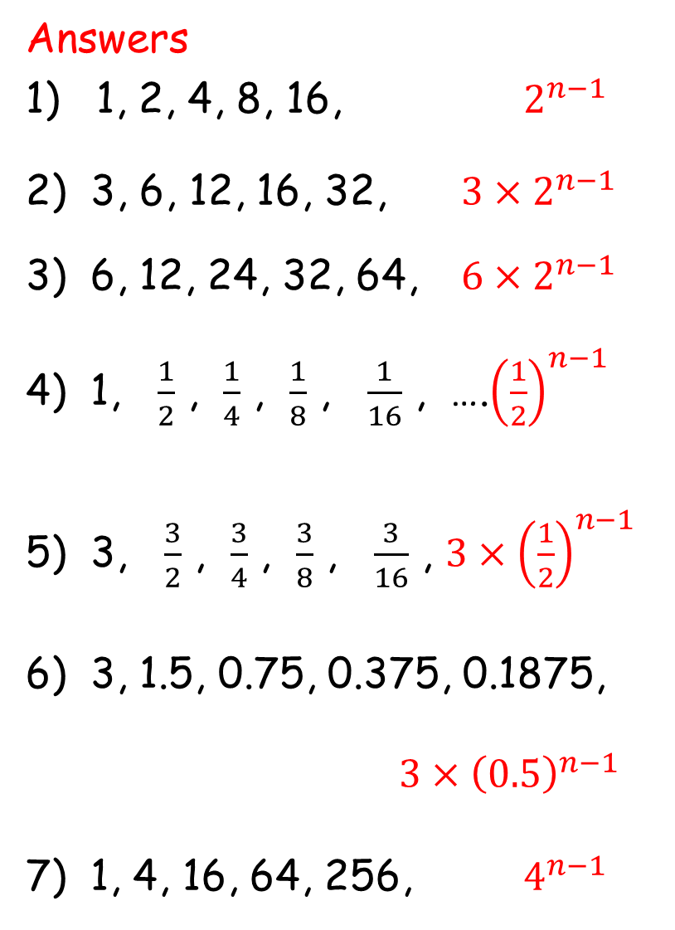
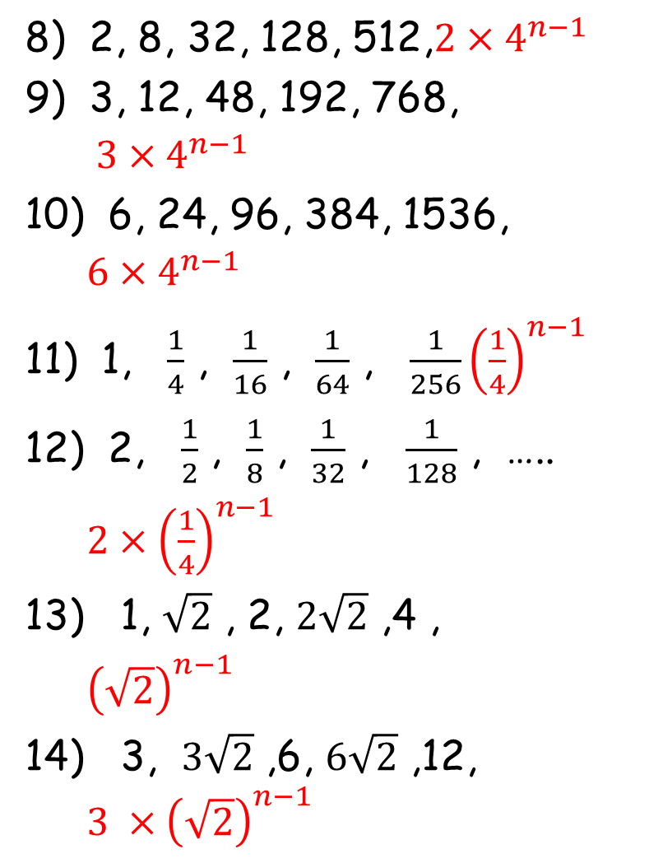
Answers
1) 1, 2, 4, 8, 16, $2^{n−1}$
2) 3, 6, 12, 16, 32, ${3×2}^{n−1}$
3) 6, 12, 24, 32, 64, ${6×2}^{n−1}$
4) 1, $\frac{1}{2}$ , $\frac{1}{4}$ , $\frac{1}{8}$ , $\frac{1}{16}$ , ….${\left(\frac{1}{2}\right)}^{n−1}$
5) 3, $\frac{3}{2}$ , $\frac{3}{4}$ , $\frac{3}{8}$ , $\frac{3}{16}$ , ${3×\left(\frac{1}{2}\right)}^{n−1}$
6) 3, 1.5, 0.75, 0.375, 0.1875, ${3×\left(0.5\right)}^{n−1}$
7) 1, 4, 16, 64, 256, $4^{n−1}$
8) 2, 8, 32, 128, 512,${2×4}^{n−1}$
9) 3, 12, 48, 192, 768, ${3×4}^{n−1}$
10) 6, 24, 96, 384, 1536, ${6×4}^{n−1}$
11) 1, $\frac{1}{4}$ , $\frac{1}{16}$ , $\frac{1}{64}$ , $\frac{1}{256}{\left(\frac{1}{4}\right)}^{n−1}$
12) 2, $\frac{1}{2}$ , $\frac{1}{8}$ , $\frac{1}{32}$ , $\frac{1}{128}$ , ….. ${2×\left(\frac{1}{4}\right)}^{n−1}$
13) 1, $\sqrt{2}$ , 2, $2\sqrt{2}$ ,4 , ${\left(\sqrt{2}\right)}^{n−1}$
14) 3, $3\sqrt{2}$ ,6, $6\sqrt{2}$ ,12, ${3 ×\left(\sqrt{2}\right)}^{n−1}$
J Hepburn

