Slide 1
Greater than, smaller than or equal to 0.5
Silent
Teacher
Intelligent Practice
Narration
Your Turn
$$7287−7296$$
$$7287−7196$$
Practice

Slide 2
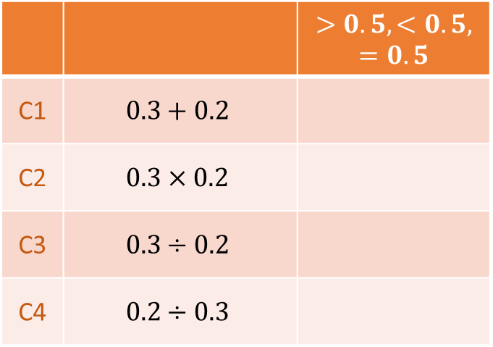
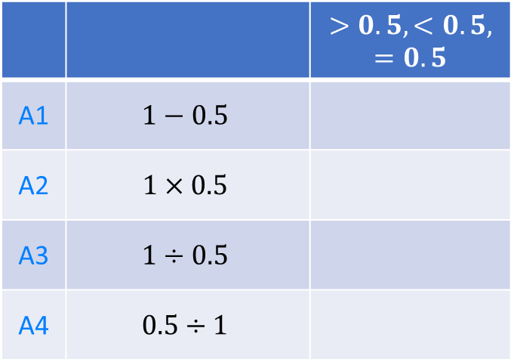
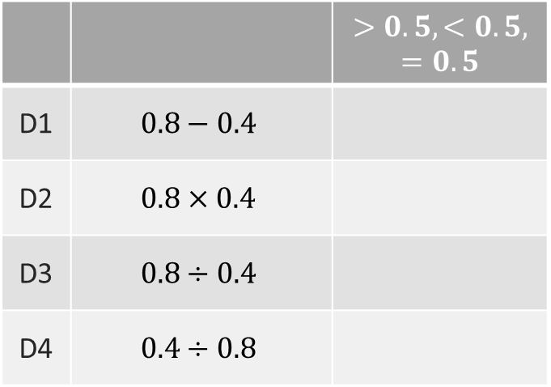
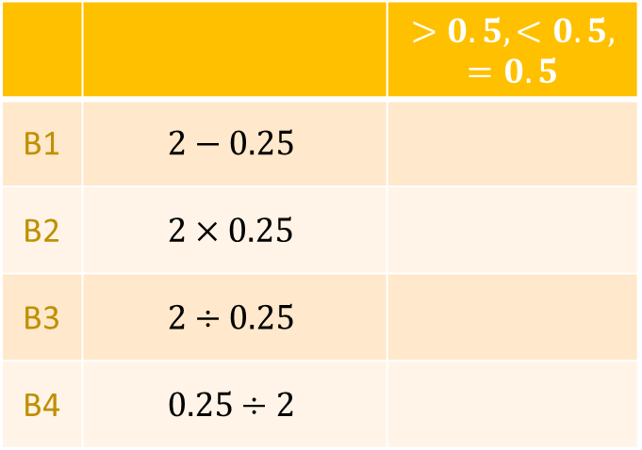
 |  | $$>0.5, <0.5, =0.5$$
A1 | $$1−0.5$$
A2 | $$1×0.5$$
A3 | $$1÷0.5$$
A4 | $$0.5÷1$$
 |  | $$>0.5, <0.5, =0.5$$
C1 | $$0.3+0.2$$
C2 | $$0.3×0.2$$
C3 | $$0.3÷0.2$$
C4 | $$0.2÷0.3$$
 |  | $$>0.5, <0.5, =0.5$$
B1 | $$2−0.25$$
B2 | $$2×0.25$$
B3 | $$2÷0.25$$
B4 | $$0.25÷2$$
 |  | $$>0.5, <0.5, =0.5$$
D1 | $$0.8−0.4$$
D2 | $$0.8×0.4$$
D3 | $$0.8÷0.4$$
D4 | $$0.4÷0.8$$
@mrbartonmaths

Slide 3
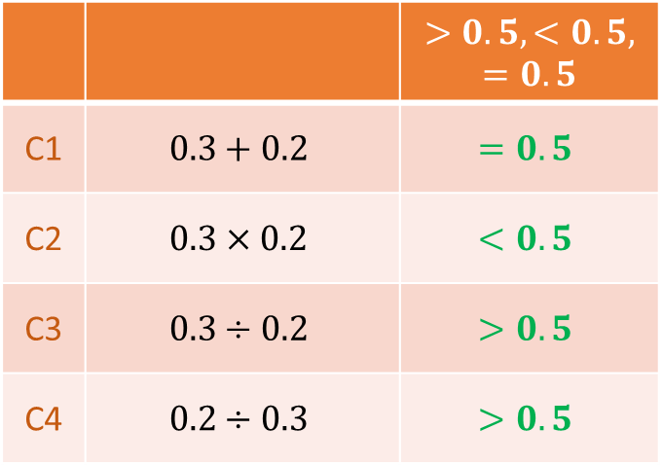
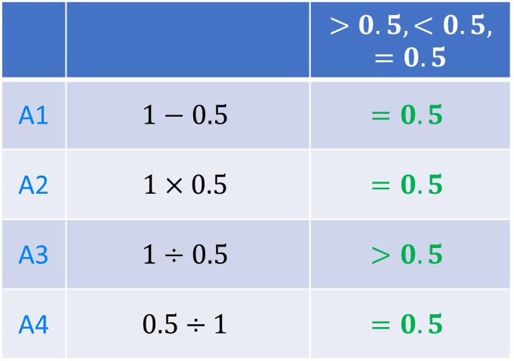
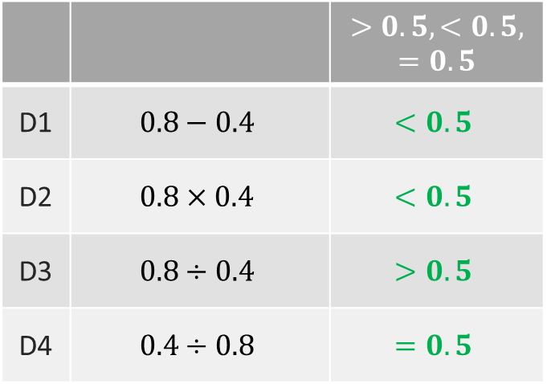
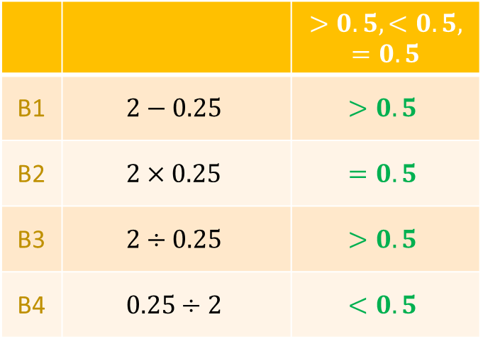
 |  | $$>0.5, <0.5, =0.5$$
A1 | $$1−0.5$$ | $$=0.5$$
A2 | $$1×0.5$$ | $$=0.5$$
A3 | $$1÷0.5$$ | $$>0.5$$
A4 | $$0.5÷1$$ | $$=0.5$$
 |  | $$>0.5, <0.5, =0.5$$
C1 | $$0.3+0.2$$ | $$=0.5$$
C2 | $$0.3×0.2$$ | $$<0.5$$
C3 | $$0.3÷0.2$$ | $$>0.5$$
C4 | $$0.2÷0.3$$ | $$>0.5$$
 |  | $$>0.5, <0.5, =0.5$$
B1 | $$2−0.25$$ | $$>0.5$$
B2 | $$2×0.25$$ | $$=0.5$$
B3 | $$2÷0.25$$ | $$>0.5$$
B4 | $$0.25÷2$$ | $$<0.5$$
 |  | $$>0.5, <0.5, =0.5$$
D1 | $$0.8−0.4$$ | $$<0.5$$
D2 | $$0.8×0.4$$ | $$<0.5$$
D3 | $$0.8÷0.4$$ | $$>0.5$$
D4 | $$0.4÷0.8$$ | $$=0.5$$
@mrbartonmaths

Slide 4
 |  | $$>0.5, <0.5, =0.5$$
A1 | $$1−0.5$$ | $$=0.5$$
A2 | $$1×0.5$$ | $$=0.5$$
A3 | $$1÷0.5$$ | $$>0.5$$
A4 | $$0.5÷1$$ | $$=0.5$$
 |  | $$>0.5, <0.5, =0.5$$
C1 | $$0.3+0.2$$ | $$=0.5$$
C2 | $$0.3×0.2$$ | $$<0.5$$
C3 | $$0.3÷0.2$$ | $$>0.5$$
C4 | $$0.2÷0.3$$ | $$>0.5$$
 |  | $$>0.5, <0.5, =0.5$$
B1 | $$2−0.25$$ | $$>0.5$$
B2 | $$2×0.25$$ | $$=0.5$$
B3 | $$2÷0.25$$ | $$>0.5$$
B4 | $$0.25÷2$$ | $$<0.5$$
 |  | $$>0.5, <0.5, =0.5$$
D1 | $$0.8−0.4$$ | $$<0.5$$
D2 | $$0.8×0.4$$ | $$<0.5$$
D3 | $$0.8÷0.4$$ | $$>0.5$$
D4 | $$0.4÷0.8$$ | $$=0.5$$
@mrbartonmaths

