Slide 1
Addition in Binary (Base 2)
Silent
Teacher
Intelligent Practice
Narration
Your Turn
$$101+1001$$
$$100+1011$$
$$110+1011$$
Practice

Slide 2
Worked Examples
Your Turn
$$11+110$$
$$10+1010$$
$$101+111$$
$$111+111$$
@MrDraperMaths
Notes:
This is in two different sections – Top two show place value clearly and the bottom two involve needing a new column in the solution due to exchanging.

Slide 3
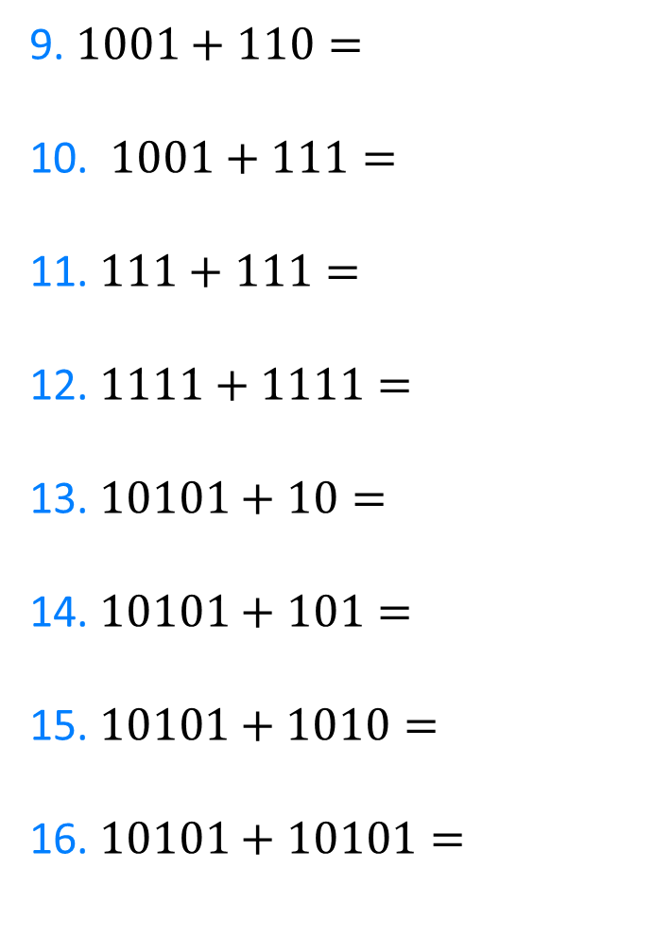
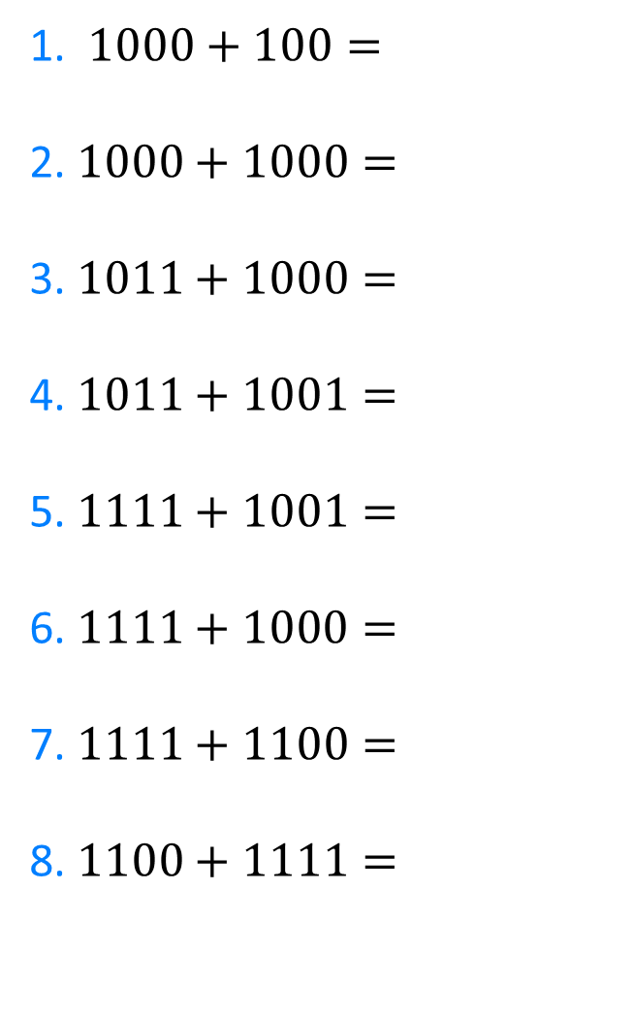
1. $1000+100=$
2. $1000+1000=$
3. $1011+1000=$
4. $1011+1001=$
5. $1111+1001=$
6.$1111+1000=$
7. $1111+1100=$
8. $1100+1111=$
9. $1001+110=$
10. $1001+111=$
11. $111+111=$
12. $1111+1111=$
13. $10101+10=$
14. $10101+101=$
15.$10101+1010=$
16. $10101+10101=$
@MrDraperMaths

Slide 4
1. $1000+100=$
2. $1000+1000=$
3. $1011+1000=$
4. $1011+1001=$
5. $1111+1001=$
6.$1111+1000=$
7. $1111+1100=$
8. $1100+1111=$
$$1100$$
$$10000$$
$$10011$$
$$10100$$
$$11000$$
$$10111$$
$$11011$$
$$11011$$
9. $1001+110=$
10. $1001+111=$
11. $111+111=$
12. $1111+1111=$
13. $10101+10=$
14. $10101+101=$
15.$10101+1010=$
16. $10101+10101=$
$$1111$$
$$10000$$
$$1110$$
$$11110$$
$$10111$$
$$11110$$
$$11111$$
$$101010$$
@MrDraperMaths

